Slide 1


Welcome!
CSP South West Regional Network Conference:
Workforce Ambition

Slide 2


Housekeeping
We will be taking pictures and filming aspects of today – if you do not want to be in the picture please let a member of CSP staff know
Feel free to tweet your observations and pictures of the day using @CSPsouthwest
Throughout the day please let us know your thoughts for 2025 South West motions for the CSP’s Annual Representatives Conference (ARC) taking place on 3 & 4 June and also ideas for future South West events via the menti.com poll and post-it notes
The virtual presentation this morning will be recorded and we will share these recordings with you via email after the event as well as the ppt slide decks from today

Slide 3


Agenda
10am John Cowman, CEO, CSP
10:30 (online presentation)
Sarah Ashley-Maguire, NHSE AHP Education Senior Specialist, on South West Physiotherapy workforce data
11am Break
11:30 International Recruitment session focusing on future ambitions of international recruitment (including panel discussion facilitated by Alec Rickard)
12.30 Lunch and networking
1:15 Working with the Volunteer Sector - Darin Halifax, NHS Devon Lead for the Voluntary, Community and Social Enterprise
1:45 Insight into apprenticeships South West – Anna Gould, University of West of England with apprentice student Rhys Walker
2:15 Break
2.30 The support workforce, Jackie Lidgard, CSP Professional Advisor, South West
3 Developing a research skilled workforce in the South West – Dr Ralph Hammond Senior Research Fellow
3.45 Final summary
4pm Close

Slide 4



CSP SWERN Conference
19th November 2024
John Cowman
Chief Executive - CSP
Notes:
Welcome and introduce yourself – I think the members would like to hear about your background / physio/ career journey ☺

Slide 5

Workforce Ambition
Notes:
The focus of the conference today is workforce. We hear from members almost daily about the challenges you face within the physiotherapy workforce, and also about the fantastic things you are doing as teams and services to overcome these challenges. As an organisation, we know our members are our strongest asset and we want to be here for you to help you make the most of your workforce, we want to help you share great ways of working, and support you, from the moment you start your physiotherapy, or support worker, journey all the way through your career. To set the scene for the day, I’m going to talk about the national perspective for workforce, a little bit about how that impacts this region, and then about some of the work the CSP is doing and has planned around workforce and staffing.

Slide 6
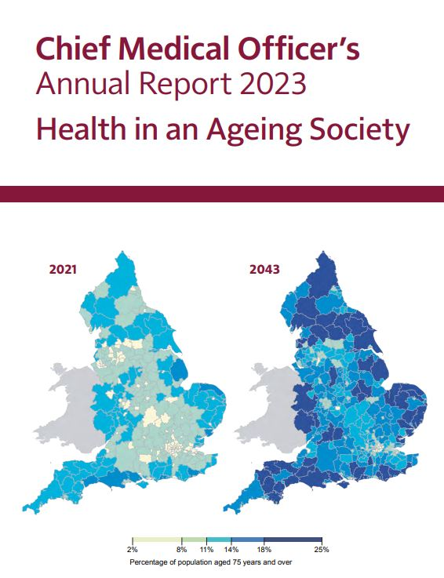

Policy Position
Notes:
The NHS long term workforce plan was published in 2023. The NHS had not had a workforce plan for over 20 years, so one was long overdue. It sets out the case for making more strategic, long-term changes to the NHS workforce and outlines plans to address an expected shortfall of between 260,000 and 360,000 staff by 2036/37. It focuses on three keys themes for health workers: Train, retain, reform.
Starting with training, we are lucky that applications for physio courses are high, and it remains an attractive profession for students of all ages to apply for. We want to be able to showcase the diversity and opportunity that a physiotherapy degree can provide, to give people a varied, lifelong career. We also want to ensure we have a diverse profession that represents the populations that it serves.
In the past decade there has been a 42% increase in the number of physio graduates, and although this is going in the right direction, its not enough... England and the UK are far behind international norms on physio numbers – for example, in England there is one registered physio for every 1,136 people, compared to one for every 450 people in Germany (who have one of the highest) and one for every 742 in Australia (who are average).
And there remains significant unmet need for rehab in the population, which we know that physiotherapy could address.
Following lobbying from the CSP, the plan set out a commitment to a 3.3 per cent annual increase in registered physiotherapy posts in NHS services. This is more than the average annual increases across all NHS staff, because the plan recognises physiotherapists as having a particularly diverse range of skills. However, given the success in growing the physiotherapy workforce the CSP feels this target is under ambitious, and that higher increases are possible if they are implemented alongside actions to retain NHS staff.
From a retention perspective the CSP wants people to remain in the profession and to have choice throughout their career of the settings they work in, and not be disadvantaged by choosing one sector over another, and to have the skills and abilities to work and move between sectors.
The CSP recognises that recruitment and retention of physio staff is a major problem and it is essential that physio staff feel valued and have career opportunities to stay in the NHS, or to develop skills in their chosen sector.
However, we know from what members have said that the problem of retention and recruitment goes hand in hand with low physio staffing levels. The Plan itself recognises the direct link between staffing levels and staff leaving the NHS.
The only way to address this problem is in the round – giving permission to systems to expand physio staffing numbers, encouraging graduates to go into and retaining staff in the NHS through improving conditions and investing in them, for example, by allowing workplace training and CPD. The NHS needs to offer increased flexible working to staff in ways that suit them and work for patients. It also needs to continue to improve the culture and leadership across NHS organisations and reduce the discrimination experienced by Black and minority ethnic staff which contributes to poor staff experience and poor retention.
The ‘reform’ section of the plan focuses on ‘working and training differently’ to improve productivity. This will be achieved through building teams with flexible skills, changing education and training to deliver more staff in roles and services where they are needed most, and ensuring staff have the right skills to take advantage of new technology. Physios with our wide range of skills are perfectly poised to make the most of these opportunities for career and skills development. The plan commits to:
a big increase in the number of advanced practitioners by 2031
formal consultant-level roles to continue to be developed through creative pilot development programmes. MSK is noted as a key area of focus in this area
a commitment to every GP surgery having an MSK FCP by 2032
the expansion of apprenticeships so that five per cent of physio workforce is trained this way by 2032
strong backing for support worker development training programme
a clear target to increase the workforce in community services as well as primary care
introduction of expert practitioners to support rehabilitation as proposed by the CSP
increasing the number of independent prescribers and AHPs acting as senior decision-makers in appropriate settings
All of these proposals offer opportunities to physios. However, there are some caveats with the report. It is very heavily focused on vacancy rates as a shortfall in staffing. The CSP argues that this is limited as a measure, and that there should be a shift in focus away from current establishment and vacancies, and that a more accurate and revealing measure would be a comparison of the shortfall in staffing numbers against a calculation of staffing requirements to meet the needs of the population in line with quality standards and guidance on what treatment patients should receive.
This is in line with information in the Chief Medical Officers report, which was also published in 2023, which talks about the importance of health and care services being concentrated where there is population need.

Slide 7
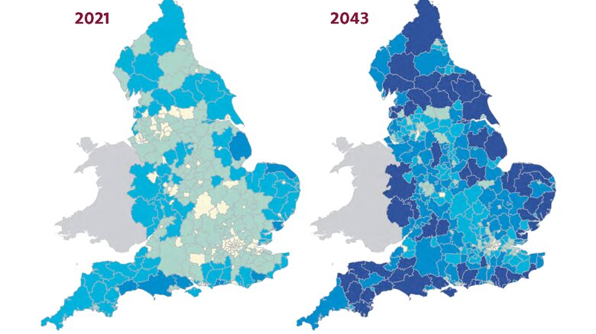

Implications for the SW
Notes:
The geography of older age in England is already highly skewed away from large urban areas towards more rural, coastal and other peripheral areas, and will become more so. Expansion of medical and NHS services needs to be in these areas, and we need to be able to attract people to work in these services, and be able to retain them.
The population of the southwest is going to age rapidly and predictably – and the provision of health and social care services, and the workforce within those, needs to meet the growing population need. The blue colours on the map, correspond to the percentage of the population who is aged 75 years or over, the darker the blue, the higher percentage. At the moment, most of the southwest has between 11 and 18% of people over 75. By 2043, most areas of the southwest will have almost a quarter of their population in the over 75 age category. People outside of the southwest tend to think of it as an affluent area, but actually there are some of the highest levels of health inequity within the southwest, and these need to be addressed alongside the ageing population.

Slide 8

What is the CSP doing?
Notes:
So what is the CSP doing about all this?
We’ve been lobbying the previous government and will continue to lobby the new Labour government to make sure that physiotherapy and AHPs are included and talked about in health policy and conversations. For too long the focus has been on doctors and nurses, and now the tide is slowly turning, with physiotherapy and rehabilitation now being mentioned specifically in health policy.
We’ve done lots of work to support our members and prospective members with regards to internationally trained physiotherapists. We know that a large proportion of the recent increase in physiotherapists on the HCPC register are internationally educated. We also know that these physios are statistically more likely to get reported to the HCPC, and that support and education is needed for both employees and employers. We’ve updated our resources on our website to provide more guidance, and annotated our mentoring platform to show people who are internationally educated, or have a special interest in supporting internationally educated physios.
We’ve given training on influencing workforce plans and that webinar is still available to view on the website. We’ve also brought together data from the Universities and Colleges Admissions Service (UCAS), Higher Education Statistics Agency (HESA), HCPC and NHS England into a workforce data portal, that you can access through the website.
We’ve been developing a digital career framework tool, which will hopefully be released before the end of the year, and we’re developing webinars on support worker career development, and the importance of support workers having a career ladder.

Slide 9

Notes:
As a result of the strike action CSP members took, and as one of the non-pay elements of the settlement, the CSP has had a place at the safe staffing working group as one of the non-pay elements of the settlement. This is attended by the health unions, employers, DHSC and the NHSE effective staffing programme staff. The CSP has highlighted the lack of inclusion of AHPs in existing staffing level guidance, and has also been raising this, along with other AHP professional bodies, to the Chief AHP team. As a direct result of this influencing a new evidence review is being commissioned on AHP workforce requirements. This will include guidance on staffing for all community-based rehab/ therapy services, as well as AHPs in critical care, mental health, children's services, maternity, UEC and more. Until now the NHSE safe and effective staffing programme has been almost entirely focussed on nursing, so this is a big step forward. AHP staffing guidance will be something NHS Trusts are required to take account of in their twice-yearly reviews of staffing levels. The CSP will be part of this work, sitting on reference groups and providing insight and evidence for the document.
The CSP is working with Glasgow Caledonian University on a commissioned project to look at improving quality in student education, and how we teach students to ensure they are well-equipped to meet the demands of the profession. There’s still time to feed into this project as the insight gathering doesn’t close until the end of November and the link is in the resources.
We will also link in with all the great work that is currently going on nationally and regionally, and I know we have some members here working specifically on recruitment and retention. Lincoln University are carrying out their study on AHPs in rural and coastal areas to identify solutions to recruitment and retention in these areas. We look forward to seeing and helping you share the results of this work, as it’s released.

Slide 10

Notes:
Hopefully, that’s given you all a brief insight into some of the policy and background to the current workforce picture, thank you for listening, enjoy your day and the chance to network, it’s your chance to quiz me now, so any questions?

Slide 11
Resources:
https://www.england.nhs.uk/long-read/nhs-long-term-workforce-plan-2/
https://www.nuffieldtrust.org.uk/resource/the-nhs-workforce-in-numbers
https://www.nuffieldtrust.org.uk/sites/default/files/2023-09/Nuffield%20Trust%20-%20Waste%20not%20want%20not_WEB_FINAL.pdf
https://assets.publishing.service.gov.uk/media/6674096b64e554df3bd0dbc6/chief-medical-officers-annual-report-2023-web-accessible.pdf
How to influence your local workforce plan | The Chartered Society of Physiotherapy
https://www.csp.org.uk/careers-jobs/working-united-kingdom
Transforming Quality in Pre-Registration Physiotherapy Education | The Chartered Society of Physiotherapy

Slide 12

Southwest Physiotherapy Workforce data
Presented by:
Sarah Ashley-Maguire (she/her)
AHP Education Senior Specialist – Integrated Care
NHS England Southwest, Workforce Training and Education directorate, AHP programme
Notes:
Good morning everyone, my name is Sarah Ashley-Maguire and I work in NHSE’s Southwest workforce, training and education directorates, AHP programme team, and I previously worked in legacy Health Education England’s workforce transformation team. Thank you for the invitation to present some data on Sw Physiotherapy workforce data.

Slide 13

Break
Resume at 11:30
Notes:
Welcome and introduce yourself – I think the members would like to hear about your background / physio/ career journey ☺

Slide 14
International Recruitment session
future ambitions of international recruitment
Notes:
Welcome and introduce yourself – I think the members would like to hear about your background / physio/ career journey ☺

Slide 15
Lunch
Resume at 1:15
Notes:
Welcome and introduce yourself – I think the members would like to hear about your background / physio/ career journey ☺

Slide 16
Working with the VCSE
Darin Halifax –NHS Devon Head of VCSE Partnerships

Slide 17
What is the VCSE?
Voluntary
Community
and
Social Enterprise.
From regulated care to hula hooping classes and everything in between.
It’s not all about volunteers!!!
And it’s not free !!!

Slide 18
The VCSE in the South West
Approximately 24,000 organisations making up the county’s voluntary, community and social enterprise sector (VCSE).
Less than £10k p.a – 18,800
Up to £1m p.a - 5,000
Over £1m - 1,200
The VCSE employs around 83,000 people – paid employees
An estimated 1.2 m volunteers.
Contribution to the SW Economy £1.6 billion
IT’S A BIG DEAL

Slide 19
What can the VCSE be?
Be the front line/front door for health and wellbeing
Be incredibly local
Be agile and responsive
Be a place of sanctuary and trust
Be incredible value for money
Be a critical friend
Be a place we can trust
Be an equal partner
Be Lord Darzi’s dream

Slide 20
Practical Examples of VCSE Delivery
Waiting Well
Social Care Front Door
Virtual Wards
Weight Management
Mental Health
Social Prescription (Primary, secondary and acute care)
Community Connectors
And many others.

Slide 21
What makes it work? Some Principles
Less a conscious decision to involve the VCSE/communities – it’s a given
Shared leadership
More co-design at the earliest opportunity
Collaboration - not hierarchy and lanyards and competitive bureacracy
Measuring what matters to people (Hitting the targets, but missing the point)

Slide 22
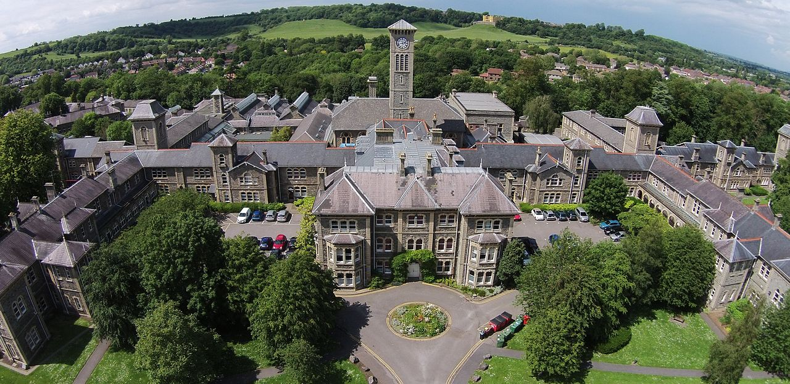
Presentation by
BSc (Hons) Physiotherapy
Physiotherapy Degree Apprenticeship Programme
Dr Anna Gould and Rhys Walker

Slide 23
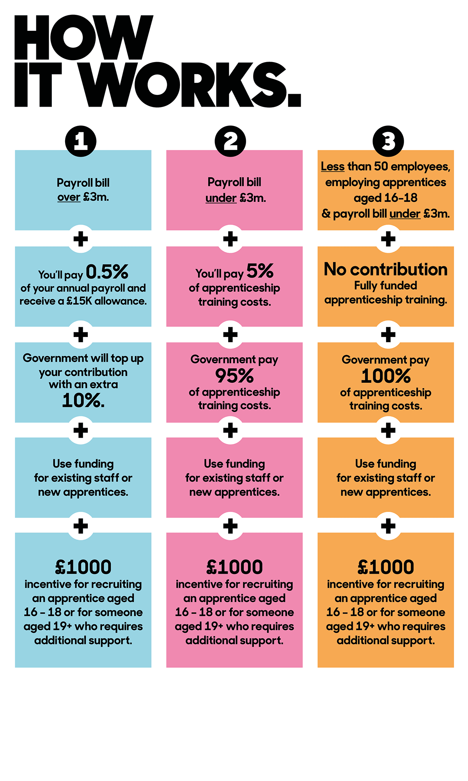
Notes:
2017 – apprenticeship ley was introduced. This set out that employers would pay 0.5% of their pay bill over £3m a year into a designated account.

Slide 24
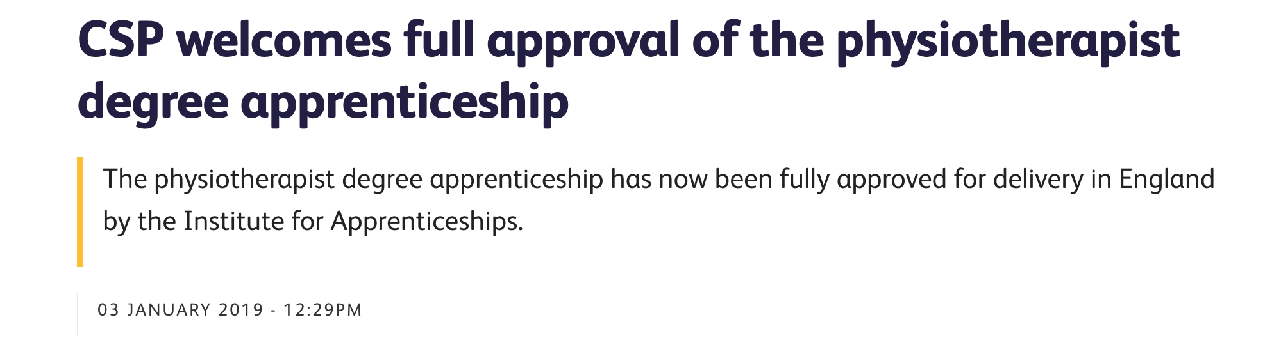
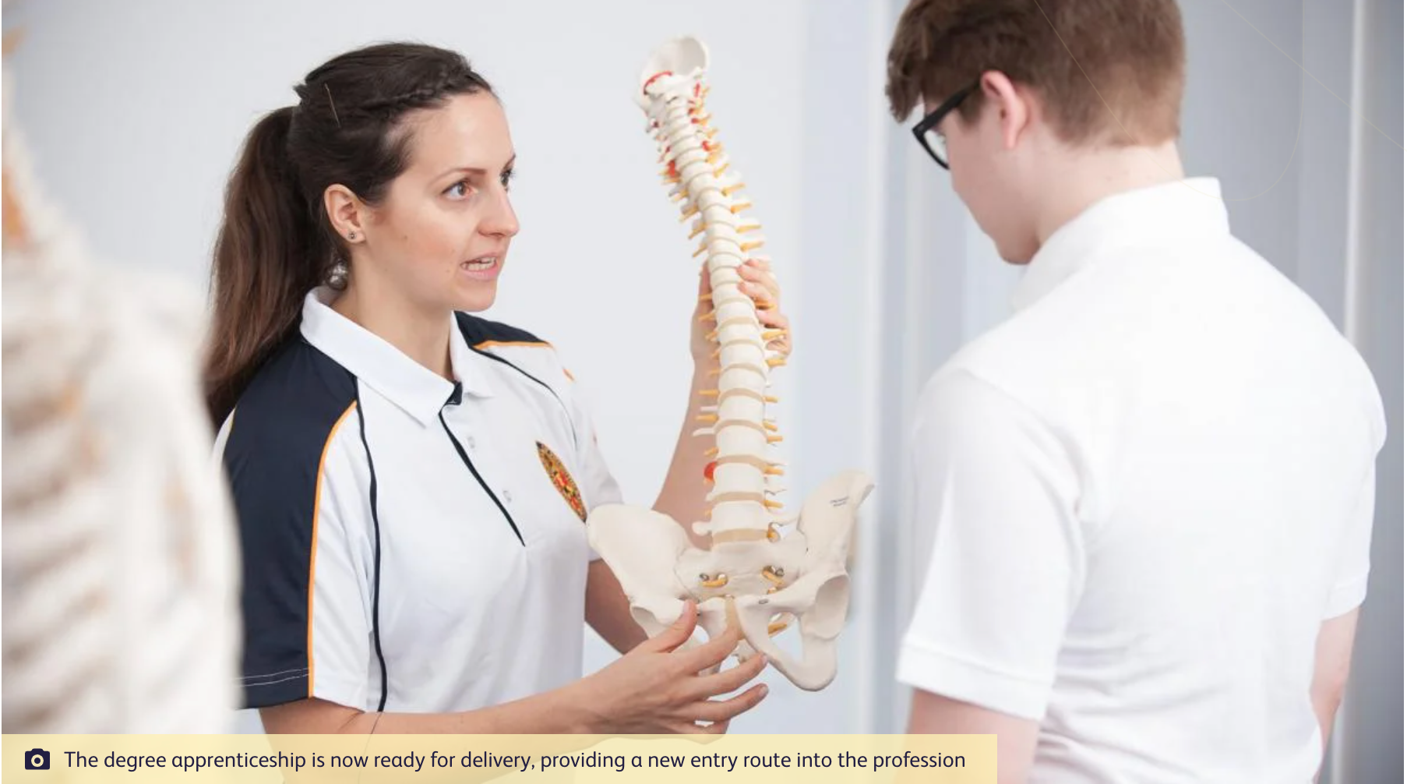

Slide 25
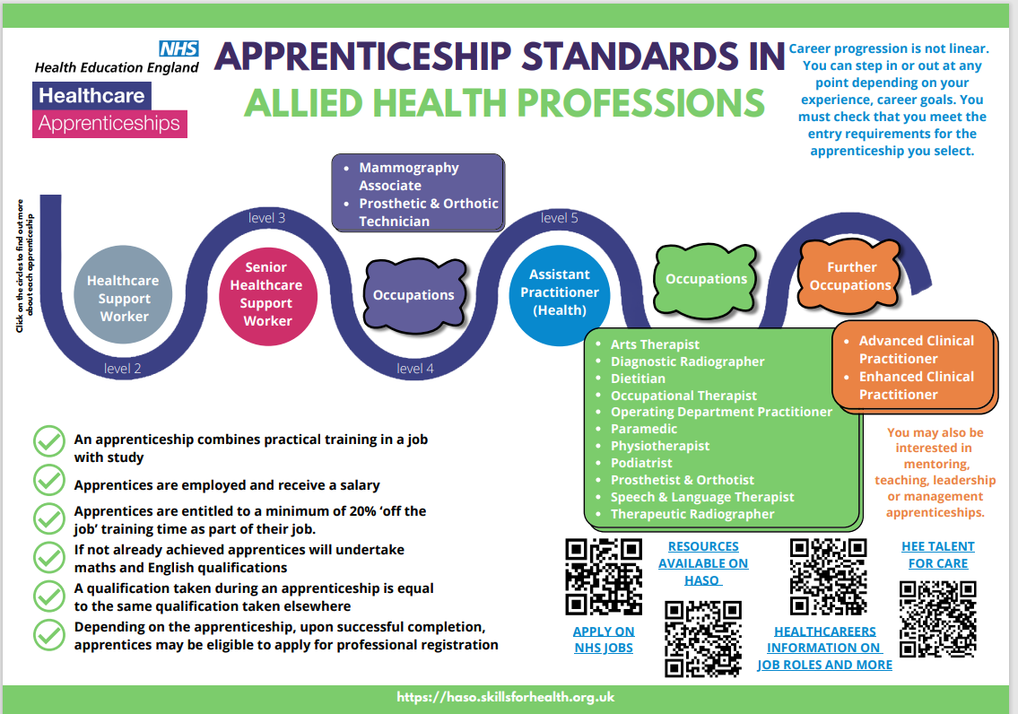

Slide 26

Duty (10)
For example:
Duty 1 Practise safely and effectively within the scope of practice and within the legal and ethical boundaries of the profession.
Knowledge (46)
For example:
K1: The importance of continuing professional development throughout own career.
K2: The importance of safeguarding, signs of abuse and relevant safeguarding processes.
K3: What is required by the Health and Care Professions Council, including but not limited to the Standards of conduct, performance and ethics.
Skills (73)
For example:
S1: Identify the limits of own practice and when to seek advice or refer to another professional or service.
S2: Recognise the need to manage own workload and resources safely and effectively, including managing the emotional burden that comes with working in a pressured environment.
S3: Keep own skills and knowledge up to date.
Behaviours (7)
For example:
B1: Kind, caring, compassionate and empathetic.
B2: Accountable, adaptable, reliable, flexible and resilient.
B3: Promote and protect the interest of service users and carers, treating people with dignity, respecting an individual’s diversity, beliefs, culture, needs, and preferences.
Physiotherapist Apprenticeship Standard

Slide 27
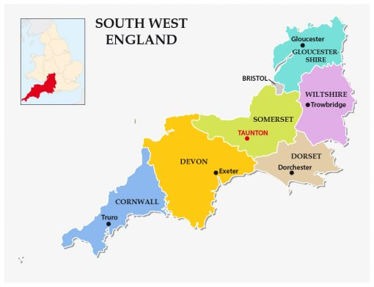
BSc (Hons) Physiotherapy (Apprenticeship) at UWE
4-year programme for employees working throughout the South West
Notes:
This is a 4 year programme for people working in the south west
Programme has been developed based on learning gained from running a number of different apprenticeship programmes across the faculty within and outside of healthcare programmes.
Our programme design is most akin to the OT apprenticeship, which has now completed it’s first year and got excellent feedback from apprentices and employers. I’ll mention some of the innovative learning and teaching methods we’ve gained from from them.
The programme has been developed in partnership with employers through various mechanisms:
Shared teams site which we utilize for the 2-way exchange of information and feedback.
And we have recently run an information sharing event, which again allowed for a productive conversation about development plans so far.

Slide 28
Current entry requirements
Employed in a health or social care position for a minimum of 30 hours per week and be sponsored by their employer
Level 2
Maths and English (GCSE Grade C/4 or Functional Skills Level 2 pass)
Double Science (GCSE Grade C/4)
Level 3
128 UCAS Tariff points and C in Biology A Level/equivalent at level 3 OR
104 UCAS Tariff points and C in Biology with relevant work experience
Notes:
Level 3 Senior Healthcare Support Worker Apprenticeship (where the applicant has chosen the Senior HCSW Allied Health Profession - therapy support option) can count towards tariff points, but does not meet Biology requirement.
Level 5 Assistant Practitioner – counts towards tariff points and meets the biology requirement, with potential for accredited learning.

Slide 29
Programme Overview
On the job learning
80%
Off the job learning
Minimum of 6 hours per week
Working 4 days a week alongside physiotherapists
Facilitators and mentors in practice
Tripartite Meetings
Record and track progress on APTEM
1 day a week for academic study
Face to face delivery/online/independent study
Placements
1000 hours
5 blocks of placements in the first 3 years
Working in a range of settings

Slide 30
Colour Key
Level 4
Level 5
Level 6
NB paler shades indicate practice placement modules
Year 1
Clinical Anatomy for Physiotherapy
30 credits (2x SOPEs)
Applied Physiotherapy Practice 1
(5 weeks)
30 credits (Practice Assessment & Portfolio)
Fundamentals of Human Anatomy and Physiology 15 credits (Exam)
Fundamentals of Musculoskeletal Physiotherapy
15 credits (SOPE)
Year 2
Fundamentals of Neuroscience for Physiotherapy 15 credits (Exam & SOPE)
Fundamentals of Respiratory Physiotherapy
15 credits (Exam & SOPE)
Informing Practice through Research and Enquiry
15 credits (Written Assignment)
Developing Clinical reasoning for Musculoskeletal Physiotherapy and Practice 2a (6 weeks)
30 credits (Practice Assessment & SOPE)
Applied Physiotherapy Practice 2b (6 weeks)
15 credits (Practice Assessment & Grading of Practice)
Year 3
Physiotherapy Practice Across the Lifespan
30 credits (Presentation & Essay/Blog)
Developing Clinical Reasoning for Neurological Physiotherapy 15 credits (OSCE)
Applied Physiotherapy Practice 3
3a (6 weeks) and 3b (6 weeks)
15 credits (Practice Assessment & Grading of Practice)
Developing Clinical Reasoning for Cardiorespiratory Physiotherapy
15 credits (Exam)
Healthy Futures
15 credits (Reflective Assignment & Wiki Contribution)
Year 4
Research and Evidence in Practice
30 credits (Dissertation)
Integration of learning in practice 15 credits (Viva/interview)
Management of the critically ill patient: complex clinical reasoning 15 credits (Presentation )
Complex Clinical Reasoning in Neurological, and Musculoskeletal Practice
30 credits
(Written Assignment & Presentation)

Slide 31
Off the job learning
Minimum of 6 hours per week
Bristol Group
(Glenside Campus, Bristol)
Flying Faculty Group
(Cullompton)
Delivery Methods:
Face to face – practical sessions and seminars
Live online seminars
Recorded lectures
Assessment Methods:
Structured Oral Practical Examination (SOPE)
Objective Structured Clinical Examinations (OSCE)
Presentations
Written assignment
Portfolio
Grading in practice (Common Placement Assessment Form)
Interview
Dissertation

Slide 32
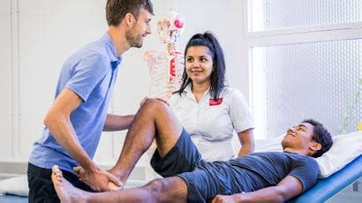
Year 1
Year 2
Year 3
Practice 1
(5 weeks)
Practice 2a
(6 weeks)
Practice 2b (6 weeks)
Practice 3a
(6 weeks)
Practice 3b
(6 weeks)
Sourced and allocated by employers
Range of placement experiences (acute, rehabilitation and MSK)
Practice Educator to supervise, teach and assess
Visiting lecturer to complete a midway review
Notes:
During the 4 years, the apprentice will also participate in 5 placement blocks in settings different to their usual work place.
There is 1 placement at the end of year one, two in year 2 and two placement blocks in year 3
The plan is for placements to be sourced and allocated by the employers who will be encouraged to form recipricol arrangements with other employers across the same geographical foot-print
Our Practice Placement Office can offer additional support with sourcing placements if needed.
Important that they have a range of experiences, and that placements look and feel different to their day job, on placement they are seen as student physiotherapists and not as assistants or support workers.
As with our full time program, students will have dedicated practice educators responsible for supervising teaching and assessing
And a visiting lecturer will support both the apprentice and the placement educator via a mid way review.
Employers to source and allocate placements
Range of placement experiences (acute, rehabilitation and MSK)
Practice Educator to supervise, teach and assess
Visiting lecturer to complete a midway review

Slide 33
My journey onto the programme
Taunton School
Swansea University – History BA
Physiotherapy Assistant (COTE, Medical, Respiratory, Neurology/Stroke, Trauma and Orthopaedics, Surgery)
Teaching break - Graduate Residential Assistant, Taunton School and Tae-Kwon Do
Physiotherapy Calling
Apprenticeship
Notes:
Rhys

Slide 34
Benefits for my employers
Permanent employee for 4 years expanding knowledge and critical thinking
A great benefit of becoming a Physiotherapy assistant
High interest from other members of the assistant team (not just Physiotherapy)
Notes:
Rhys

Slide 35
How can you support your apprentices
Importance of a supportive employer and how two-way flexibility has allowed the process to be successful
Allowing them to be students, a change in dynamic allowing for a freer conversation
Notes:
Rhys

Slide 36
How will we support employers?
Board and Curriculum Development Meetings
Facilitator and Mentor training
APTEM and APTEM Support
‘Teams’ forum for ongoing questions advice and support
UWE Apprenticeship Office
Support practice educators
Tripartite co-ordinators and tripartite reviews
Notes:
This slide illustrates the support we will provide to our employers. We will provide training for the workplace assessors and mentors and they will have access to support from the learning technology team.

Slide 37
Contact Us
Anna Gould and Amy Belisario
Physiotherapy Degree Apprenticeship Programme Leaders
Email: physioapprenticeship@uwe.ac.uk
Robyn Osborne
Physiotherapy Degree Apprenticeship Admissions Tutor
Email: robyn.osborne.@uwe.ac.uk
The Degree Apprenticeship Hub:
Email: degreeapprenticeships@uwe.ac.uk
Tel: 0117 328 4888

Slide 38
Break
Resume at 2:30
Notes:
Welcome and introduce yourself – I think the members would like to hear about your background / physio/ career journey ☺

Slide 39
The Support Workforce
Jackie Lidgard, Professional Advisor, CSP South West
Notes:
Welcome and introduce yourself – I think the members would like to hear about your background / physio/ career journey ☺

Slide 40



Ralph Hammond MCSP
Senior Research Fellow
CSP SW network
19/11/24
Notes:
DRSW is a piece of work to promote engagement with the SW regional research workforce strategy. A team at University of Plymouth was commissioned to delvier this.

Slide 41




Website: https://tinyurl.com/t3xup3m4
Email: researchskilledworkforce@plymouth.ac.uk
Twitter: @SWresearchGO
Notes:
DRSW has a webpage which includes the research strategy, and many other resources to access; an email address to sign up for regular updates, and atwitter account

Slide 42

Developing a research skilled workforce in the South West
The workforce includes registered health, social care, and scientific professions
allied health professionals (AHPs)
dental care
optical
pharmacy
public health professionals
chiropractors
healthcare scientists
medical associate professionals
midwives
nurses
nurse associates
psychological professionals and psychology practitioners
clinical researcher practitioners
social workers
Notes:
We are part of the target audience

Slide 43
Developing a research skilled workforce in the South West
Why we need this work
Medics and dentists have established programmes for research development within their career pathways.
This does not exist for wider clinical, care and scientific professionals.
Integrated Care Boards (ICB) pair research with innovation:
“ensure that… innovation and research support continuous improvements in health and well-being including digitally enabled clinical transformation and the clinical and care elements of a sustainable People Plan for the ICB workforce”.

Slide 44
Developing a research skilled workforce in the South West
Our intentions
To take a collective multi-professional and collaborative approach to embed research as the keystone that underpins excellent care and supports innovation.
To create sustainable research skills, capacity and capabilities within the health and care workforce across the southwest region over the next three to five years.
To produce a strategic multi-year plan that will align individual, employer, provider and integrated care system research capacity and capabilities needs.

Slide 45
Developing a research skilled workforce in the South West
Our intentions
4. To align our strategic goals with those of higher education institutes and research networks, with a shared purpose to support regional research development and delivery needs.
5. To align our regional ambitions with professional bodies and national research support groups and networks to take targeted actions once and well.

Slide 46
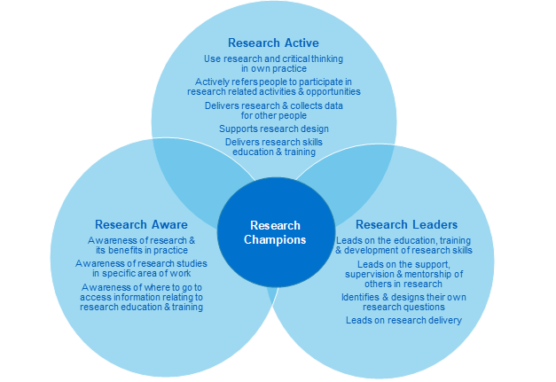
Notes:
All registrants should be research aware, we hope to support more to become research active: thinking of research as a wider, more inclusive concept, inducing service evaluation – audit, quality improvement, implementation of evidence

Slide 47

South West Plan on a Page
Create a thriving research culture
across our communities, networks, and Integrated Care Boards.
To find ways to develop &
translate research knowledge and skills into practice
Invest in and nurture our workforce (health, social care, and scientific professional) to be research aware, research active and research leaders
Improve access and equity to research career development, research delivery and research leadership
Grow our influence
providing direction and support to inform the training needs and career pathways required
DEVELOPING
A RESEARCH SKILLED WORKFORCE across the South West
Support south west research priorities enabling research skills development to support research priorities
Lead by example
and embed evidence-based practice, research, and innovation into career development pathways
The plan provides a framework to guide the right actions in the right places with research as a keystone that underpins excellent care and supports innovation
Notes:
6 domains; you can click on each domain to go to more information

Slide 48
Developing a research skilled workforce
Reach out to more specific professional groups
Build on relationship with key stakeholders
Address enablers and barriers to staff participation
Maintaining momentum in building a research culture
Transition to NIHR regional research office
2024
Notes:
DRSW work started in April 2023; we have just received news that funding has been granted for a third and final year.
DRSW team keen to connect with the psychological professions.

Slide 49

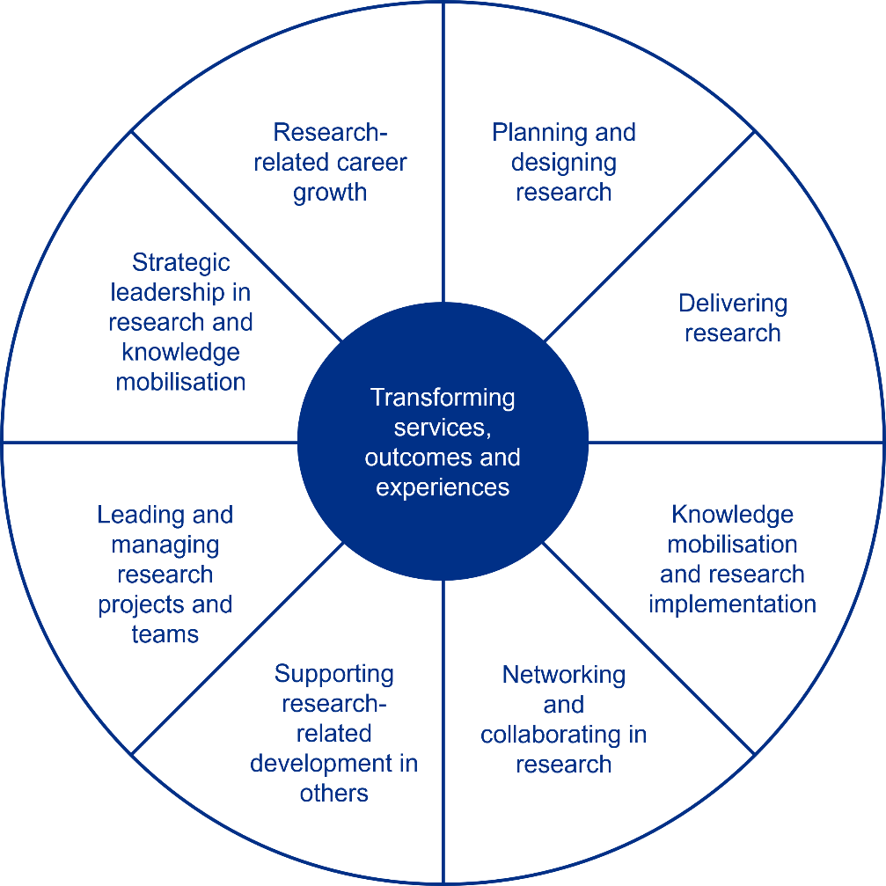
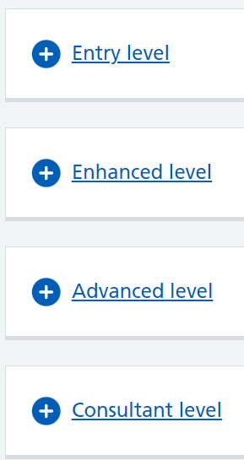

Different Domains of Research Activity
Research is more than RCTs and statistics.
Each domain has different requirements for capability.
Multi-professional Practice-based Research Capabilities Framework
(NHSE, 2024)
Slide by King Tam, UWE Physio student, June 2024
Notes:
To help you frame research activity at individual and service level, NHSE has produced this document.

Slide 50
Multi-professional, Practice-based
Research Capabilities
Framework
Entry level
Demonstrate knowledge and understanding of the importance of practitioners’ contributions to developing the knowledge base through active engagement at appropriate levels in audit, service evaluation, quality improvement and research.
Demonstrate insight into own knowledge creation and research capabilities and developmental needs and take action to address those needs.
Constructively question own and others’ practice, identifying opportunities to generate new knowledge and enhance services.
Develop awareness of local research-related resources and opportunities and how they can be accessed.
Notes:
DRSW work started in April 2023; we have just received news that funding has been granted for a third and final year.
DRSW team keen to connect with the psychological professions.

Slide 51


Allied health professionals begin to lose confidence related to EBP activities within the first 5 years of clinical practice, particularly for those activities involving critical analysis of published studies.
Klaic, et al., 2018
How soon do allied health professionals lose confidence to perform EBP activities? A cross-sectional study
…nurses need to understand that nursing practice depends on some fundamental factors such as nurse education, computer literacy, work environment, experience, personal qualities, and colleagues around them
NERP 2023;13(1):14-2
Registered Nurses’ Attitudes and Confidence in Evidence-based Practice and Facilitators and Barriers for Implementation: A Literature Review
Notes:
These quotations show the reality for many of the workforce: there are organisaitonal, service-level activities to support research activity to flourish and be celebrated

Slide 52



Sign up for Open Athens
Notes:
A key one is to learn how to access the evidence!

Slide 53

DRSW 25 in-person conference: 2nd April 2025
Call for abstracts: Closes 23.59 Sunday 17th November

Slide 54

NIHR Research Internships
Protected time with £12,500 for up to 1 year
now open: deadline 18th December 2024

Slide 55
NIHR INSIGHT programme: offering Masters in Clinical Research for early career practitioners: 0-5 years post-registration)

Slide 56
Website: https://tinyurl.com/t3xup3m4
Email: researchskilledworkforce@plymouth.ac.uk
Twitter: @SWresearchGO
Notes:
Thank you

Slide 57
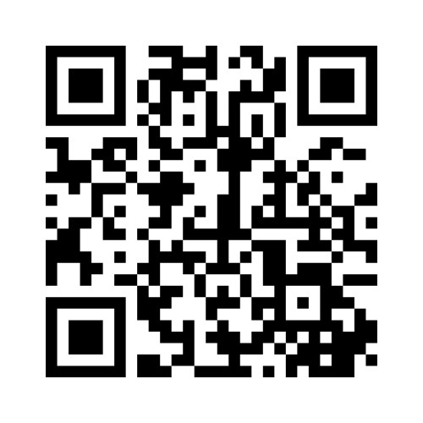
Tell us your views
Join Menti.com and
enter code 6439 7310
or scan the QR code

Slide 58
Stay in touch with us
Twitter: twitter.com/CSPsouthwest
Facebook: https://www.facebook.com/groups/828183730720424
iCSP: csp.org.uk/emailpreferences
(to make sure you receive latest news & events from CSP South West)

