Slide 1
Welcome!
The Therapist Voice;
How to be Heard!
Leigh Forsyth, BSc Hons Physio, MSc Rehabilitation
Head of Improvement: Therapies and Social Care, ECIST
Notes:
Standard title slide

Slide 2


My journey….
National QI advisor
QI coach
Senior PT permanent role
Graduated
Organisational restructure – role was deleted
Developing People Improving Care 2016
experience
Brunel University
Band 7 role – 12 month rotational across acute and community – where stayed
Had a year's training and coaching from the NHS III
IHI, Virginia Mason, Health Foundation, Aqua, NETS, European QI forum
2000
Started; rotations – Royal Brompton then Imperial College
1.5 Years
2 years
02
01
03
2 years
Locum-ing
Started in operational management
Stepping stones
ECIST
Job roles
Several assignments across different trusts
CCG Data analyst for Q&S
CCG deputy director for nursing (AHP)
Monitor - Quality Improvement coach
National improvement team supporting people to drive improvements across the UEC pathway
Brain injury, elderly medicine, intermediate care, private sector 3rd sector
Went from a band 7 clinician to an operational role managing the community rehab services across Hammersmith & Fulham – 65 WTE
Therapy-Improvement manager
&
Head of Improvement for therapies and Social care

Slide 3
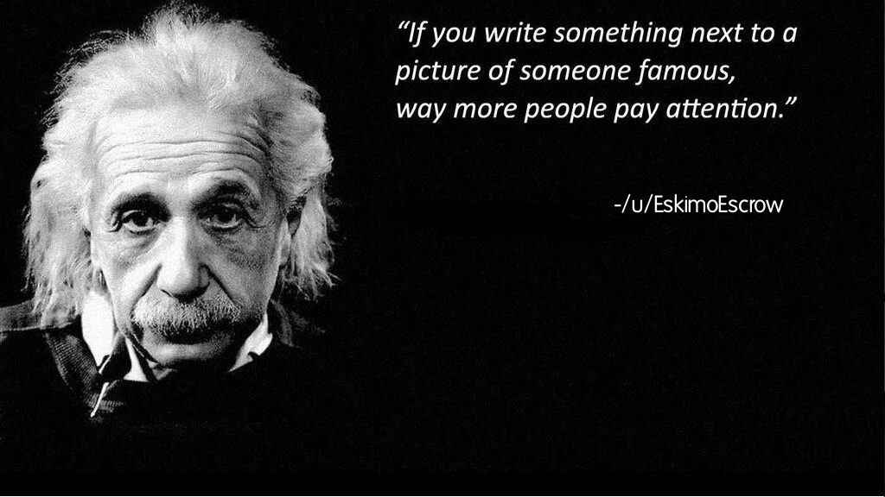
How do you get the therapy voice heard?

Slide 4
How to make yourself heard
2. Introduce yourself
3. Start with active listening
5. Be prepared
6. Offer value
7. Silence your inner critic
1. Understand the situation
4. Use the ‘yes and’ approach
8. Don’t fear conflict
10. Appearances matter

Slide 5



3. Understand the situation
- Simple, complicated and complex problems
Notes:
Simple problems are ones like baking a cake from a mix. Success comes from following the recipe.
Complicated problems are ones like sending a rocket to the moon. Sometimes we can break them down into a series of simple problems. But this is not always the case. Success often takes multiple people, multiple teams, and specialized expertise. Unanticipated difficulties are frequent. Timing and coordination become serious concerns.
Complex problems are ones like raising a child. Once you learn how to send a rocket to the moon, you can repeat the process with other rockets and perfect it. One rocket is like another rocket. But not so with raising a child, the professors point out. Each child is unique and we must understand her as an individual. Although raising one child may provide experience, it does not guarantee success with the next child. Expertise is valuable but not sufficient. The next child may require an entirely different approach from the previous one. Which points to another feature of complex problems -- their outcomes remain highly uncertain. Yet we all know that it is possible to raise a child well even as the process is complex.

Slide 6
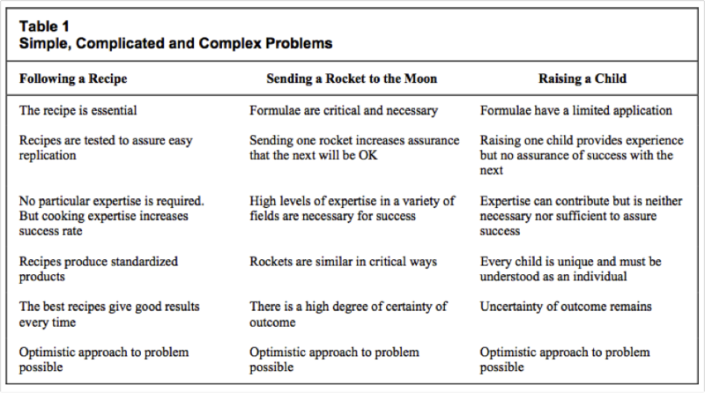
The Canadian health care system was an improtant ingredient of Canadian federalism for twenty years (publications.gc.ca)
Notes:
Expertise in a variety of fields – implies collaboration and partnership working
Expertise is neither necessary or sufficient to assure success; need to understand the partners views

Slide 7
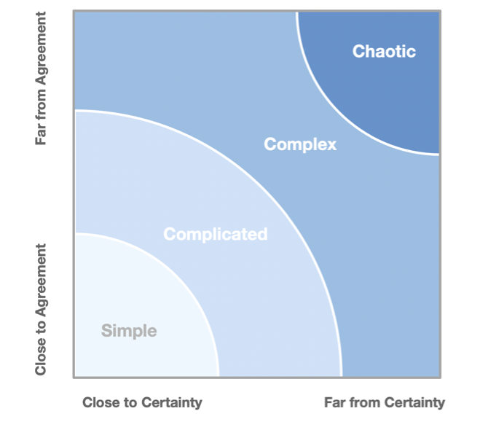


Stacey complexity matrix
‘Our world is increasingly complex, interdependent, and culturally diverse. The most pressing challenges we face cut across geographic, cultural, and technical boundaries. Working together is central to making progress.’

Slide 8
2. Introduce yourself
Introducing yourself at the start helps remind or inform people of who you are and what role you play.
When introducing yourself, speak confidently.
Be concise and to the point.
People are much more likely to listen to you when they know who you are.

Slide 9

3. Start with active listening
Absorb your colleagues’ viewpoints, then reflect them back.
Whether or not you concur you can use this as a platform.
When it’s your turn to speak, do so with certainty and without hesitation.
Making people feel heard is crucial for persuasion

Slide 10

4. Use the ‘yes and..’ approach
There is a trick from Alan Alda and from communication science experts that relies on improv comedy exercises to better your communication in groups.
In the exercise, you are part of a scene that develops a story with multiple people, using "yes, and" as transitions.
You acknowledge the input of another person, then add to it. It is effective for listening to others and for being heard.
The power of "Yes And" - YouTube

Slide 11

5. Be prepared
You aren't just going to speak to be heard, you're going to contribute value to move the agenda forward. So be prepared.
Avoid walking blindly into a meeting. Research the topic that will be discussed and form your own opinions and ideas about that topic.
Find an advocate!
You're likely to be more assertive when you know what you're saying

Slide 12

6. Offer value
Use your voice to offer value. If you just talk to talk, then your voice will stop being heard.
Be sure to speak with confidence. The way you think about yourself is the way you show up in the world, so if you want to be heard, believe you are worth listening to

Slide 13
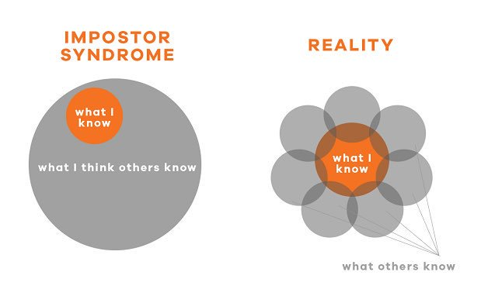
7. Silence your inner critic
I've found that the loudest critic is the one inside each of our minds.
We always feel that what we are going to say is wrong or sounds stupid.
The truth is, most of these voices are internal; you have to learn to put your feelings of self-doubt on the side.
Once you manage to overcome that challenge, it will be much easier for you to be heard.

Slide 14

8. Don’t fear Conflict…

Slide 15
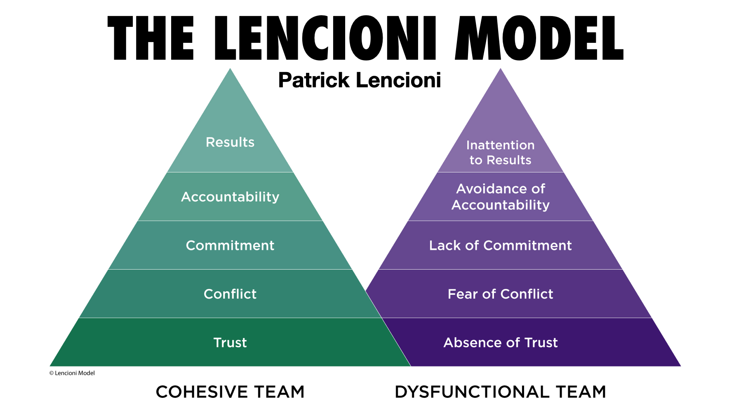
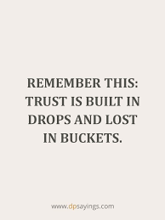
Team of teams

Slide 16
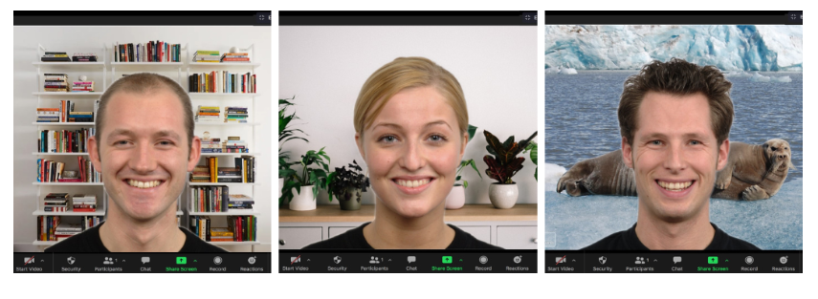
9. Appearances matter
Fair or not fair people judge us by the way we look – that includes the way we dress
Research shows that your appearance strongly influences other peoples perception of your financial success, authority, trustworthiness, intelligence and suitability to hire or be promoted.
Research has also found that when you combine your appearance with your communication skills it results in peoples behaviour towards you being influenced.
When viewed positively your appearance and communication skills determine whether others will comply with your request, whether they trust you with information, give you access to decision makers etc…
That also includes ‘teams’ backgrounds;
Recent research has found that a background of books and/or plants significantly contributed towards creating a trusting and competent first impression.
Comedic or living room backgrounds consistently scored the lowest.
Women consistently appear more trustworthy and competent than men regardless of the background.

Slide 17

My reflections
You will always have spells in your career when you don’t feel listened to
Any organisation and team has ‘cultures’ and ‘sub-cultures’
Are you truly ‘listening’ to other people in these cultures
There are competing priorities in most situations
Hierarchies work well with simple or complicated issues – they struggle with complexity
I have probably benefitted by white privilege
Shouting your point rarely changes the outcome!
Who empowers you?
Reflective practice……

Slide 18


