Slide 1

.
Engagement and Coproduction
- working with people to improving outcomes
Carol Quint
Childrens Physio Professional Advisor and Locality Manager
Jo Johnson
Childrens Occupational Therapy Advisor and Locality Manager

Slide 2
Outline of session
What is engagement and co-production?
Why bother?
What are the barriers?
How ?
Notes:
On table – discuss in 1 minute what is engagement ., Participation, coproduction.

Slide 3
What is your definition of engagement and co-production?
Rate on scale (0-10) how well your service participates in engagement.
Rate on scale (0-10) how well your service participates in co-production.

Slide 4
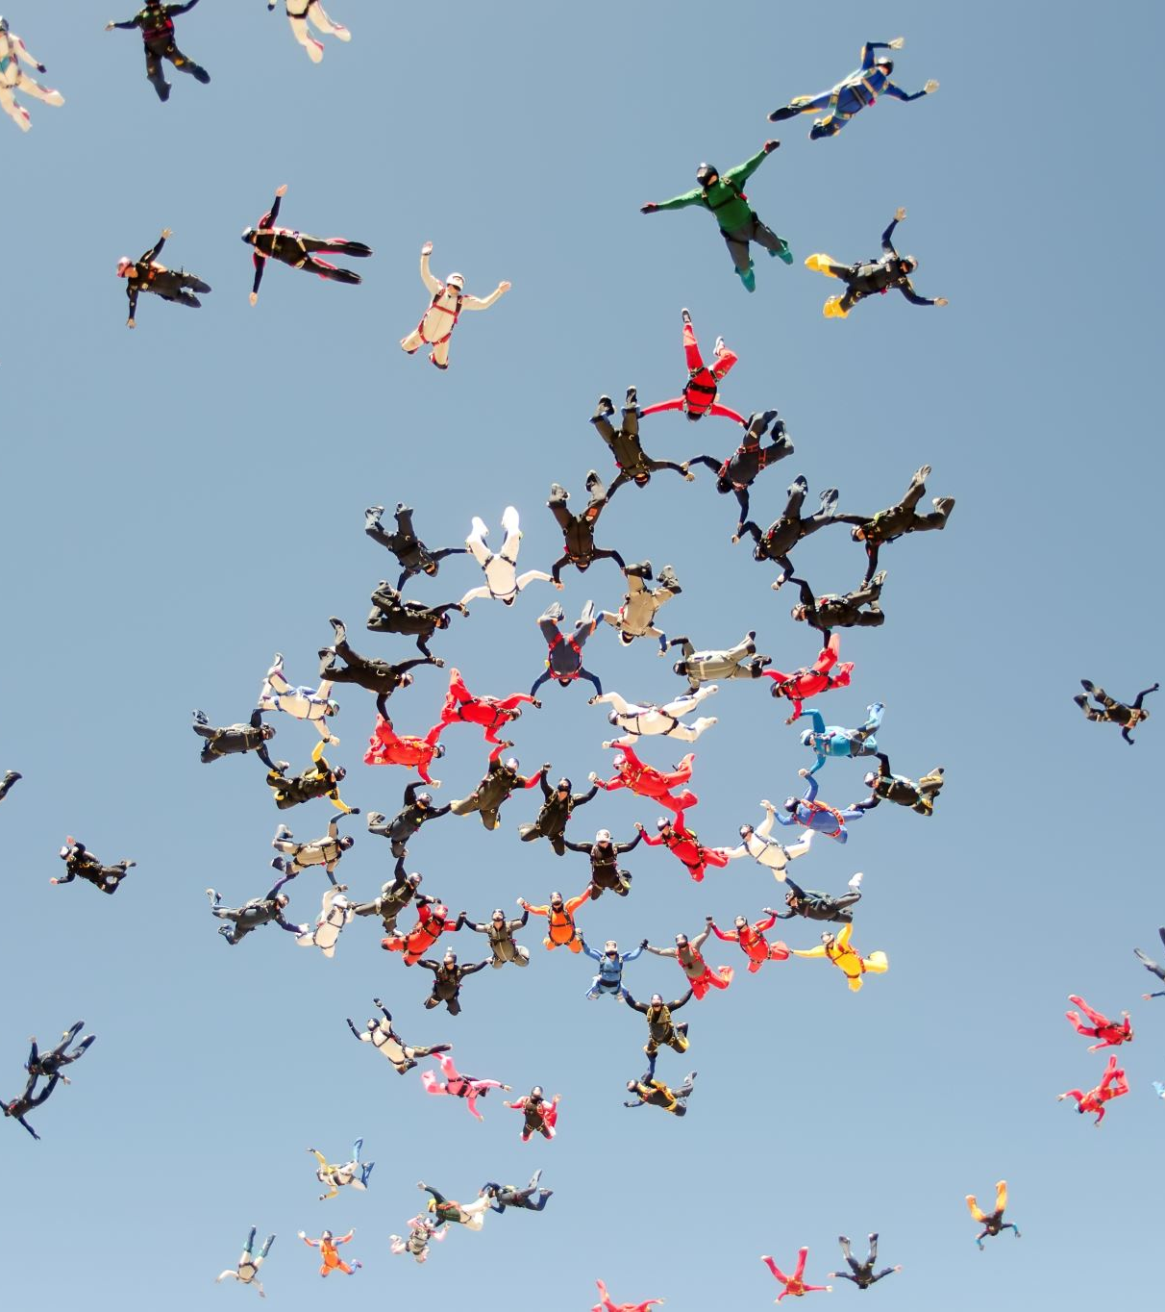
What is engagement?
Terms such as engagement, participation, co-creation are poorly defined and often used interchangeably
Both a state and a process
Exists along a continuum
Engagement is not only patient related but is a co-constructed through relationships with clinicians
Customer value co-creation - which goes beyond engagement, encompassing customer’s self-generate activities
Notes:
The literature supports the view that engagement is a complex issue, described as both a state and a process with many factors effecting patients / parents at any given time during their healthcare journey
This meaningful 2way interaction is common amongst other engagement definitions
value co-creation describes the benefits realised from integration of resources through activities and interactions with collaborators in the customer’s service network
Engagement – varies , burden of Rx,
Co-production

Slide 5
Literature review
Models of engagement
Behavioural components include adhering to treatment regimes, attending appointments;.
Cognitive conceptualisations relate to expectations, believability in treatments
Affective aspects of emotional involvement and trust
Notes:
Engagement is multifaceted
engagement is an outcome (service user) and an event / process – vary over time. Ebb / flow
Behavioural components include ensuring manageability, self-efficacy and confidence;
cognitive conceptualisations relate to providing coherence, willingness and conviction re. interventions,
with affective aspects providing hope and support.
Participation
Participation is outlined in the International Association of Public Participation (Bellows, 2015) using 5 levels from informing (no patient active participation) to level 5 empowered, where decision making is a joint process, patients having equal voting on decision making committees.

Slide 6
What is co-production look like
Co-production of services is much more than consulting people; they have an equal part in service conception, design, steering and management.
Capturing the voice of people and communities who access health and care
diversity -including underrepresented communities
strategy development ensured co-planning and co-design, the implementation of this work will require co-implementation and co-evaluation between people
Ref AHP Strategy 2022
Notes:
More than delivering the right care at the right time by the right person” but be aspirational and aim for extending this to “ providing the right care that the patient needs in the manager the patient desires at the time the patient desires”
OECD study estimated that one fifth of healthcare spending makes minimal / no contribution to health outcomes . Huge waste of resources
Keeping patients and communities at centre of what we do.
How - working along side engagement inclusion team

Slide 7
Strategic overview –
Drivers for change
“All developed economies face problems with increasing pressure on health care budgets due to an aging population, development of new treatments, technological advances increasing demand for treatment and rising health care customer expectations” (McColl-Kennedy et al, 2017 b , p.2).
With a shift in focus from provider outputs to patient health and experiences outcomes
patient and public have a voice, shaping healthcare delivery through coproduction, cocreation and participation at individual and system wide level.
Notes:
Why bother? 3 min on table to ideas for why? Link to any national drivers
More than delivering the right care at the right time by the right person” but be aspirational and aim for extending this to “ providing the right care that the patient needs in the manager the patient desires at the time the patient desires”
OECD study estimated that one fifth of healthcare spending makes minimal / no contribution to health outcomes . Huge waste of resources
Keeping patients and communities at centre of what we do.
How - working along side engagement inclusion team
Creating a valuable experience and improved outcomes through patient-centred care and public involvement has been a central them in recent UK health policy in England .
through transforming organisational culture and operational processes, patients and their families, are viewed as active participants in their care, added value through engagement and co-creation is possible – leading to better health outcomes m, qof l, economic savings
Focus on what matters for the patient and family

Slide 8
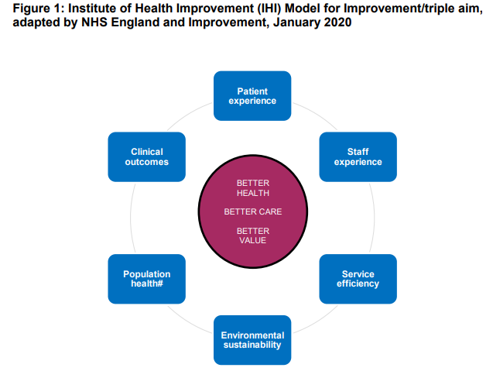

Slide 9
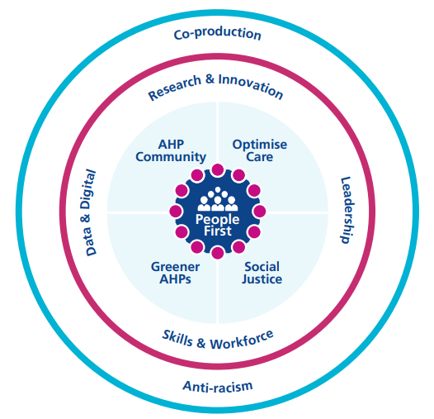
The AHP Strategy for England: AHPs Deliver (2022-2027)
Notes:
Co-production
Co-production of services is much more than consulting people;
they have an equal part in
service conception, design, steering and management.
Five areas of focus
Five ‘areas of focus’ have been identified for the next five years, each
complemented by a set of ambitions
Focus on people
Optimising care
Social justice – addressing health inequalities and care inequalities
Environmental sustainability
Strengthening and promoting the AHP community

Slide 10

What's the point effective engagement and co-production?
For the patient / family
For staff
Service
Organisation
Population

Slide 11
Benefits of engagement |  | Reference
Engagement | Increase functional after d/c, increased attendance and adherence, lower levels of depression, realise sleeping patient resources. | Bright et al, Lopes and Alves 2019, Phoenix et al 2019 Palumbo, 2016, Rathert et al, 2020
Person centred | Reduce hospital stay | McColl-Kennedy et al 2017 ,
Participation | Reduce system waste | Palumbo, 2016, Hurst 2019
Co-production | Increase appropriateness and effectiveness of interventions Positive correlation value co-creation / patient well being Better outcomes/ lower costs | Pham et al 2021, St John 2013, Lam and Bianchi 2019, McColl-Kennedy et al 2017 (1a), Hurst 2019, Rees 2021. Burns 2014, Ozcelik et al 2021, Sweeney 2020, Phoenix et al 2019
Self-management | Reduce number of health care visits in LTC | McColl-Kennedy et al 2017

Slide 12
I like videos short and sweet
I have watched many where services provided was not what was shown…it made me feel let down due to higher expectations or overwhelmed because I was overloaded with information.
Too much technical information and medical language is confusing
Video information to prepare for first therapy appointment
I really enjoy in formation videos that include [parents] perspectives too.
Make it fun and current
I can’t stand it when in order to access information you require a million different login details

Slide 13

What stops engagement and co-production from happening well?

Slide 14
Barriers to engagement and co-production
Key themes
1. Communication
2. Emotional support
3. Decision making
4. Organisational
5. Logistics
6. Systems.
Notes:
.

Slide 15
Notes:
Decide on 5/6 categories of cause for the problem
(Materials, methods, equipment, environment, people)
Generate a list in each category
Draw additional bones as necessary.
Keep asking WHY?

Slide 16
Reducing the barriers - Individual
Co-Production
Assets
Capabilities
Mutuality
Networks
Blur Roles
Catalysts
Notes:
Assets – Strengths, attitude, Lifestyle, resources
Capabilities - skills
Mutuality – Partnership working
Networks – Who else can support you?
Blur Roles – therapeutic relationship
Catalysts – Shared goal, vision

Slide 17
Reducing the barriers - Service
Co-Production
Assets
Capabilities
Mutuality
Networks
Blur Roles
Catalysts
Notes:
Assets – Strengths, attitude, Lifestyle, resources
Capabilities - skills
Mutuality – Partnership working
Networks – Who else can support you?
Blur Roles – Working together – equalising power relationships, The professional is not always right
Catalysts – Shared goal, vision

Slide 18
Reducing the barriers - Community
Co-Production
Assets
Capabilities
Mutuality
Networks
Blur Roles
Catalysts
Notes:
Assets – Local system, funding, buildings, services
Capabilities - skills, workforce, community
Mutuality – True Partnership working
Networks – Who does what, who else can be involved
Blur Roles – Equalise the power – all have the same voice
Catalysts – Shared goal, vision, incident, grant, disaster, passion

Slide 19
Tools to Help
https://www.academy.solent.nhs.uk/resources
Particularly
  Stakeholder Mapping
  Experience based design
  5 whys

Slide 20
What is the problem?
If I had an hour to solve a problem and my life depended on the solution, I would spend the first 55 minutes determining the proper question to ask, for once I know the proper question, I could solve the problem in less than five minutes.
Albert Einstein

Slide 21
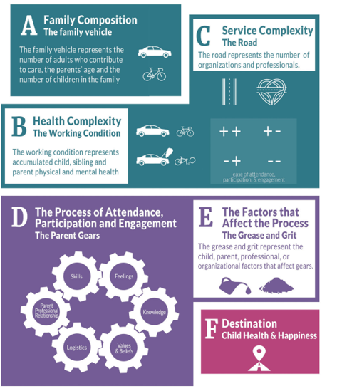
The Phoenix Theory of Attendance, Participation and Engagement (Phoenix et al 2020).
Notes:
describes a metaphorical journey towards child health, encouraging a family centred approach, incorporating some of the key feature of best practice described above. I compared this model to existing data and concluded that it is comprehensive model which effectively recognises many variables influencing engagement

Slide 22
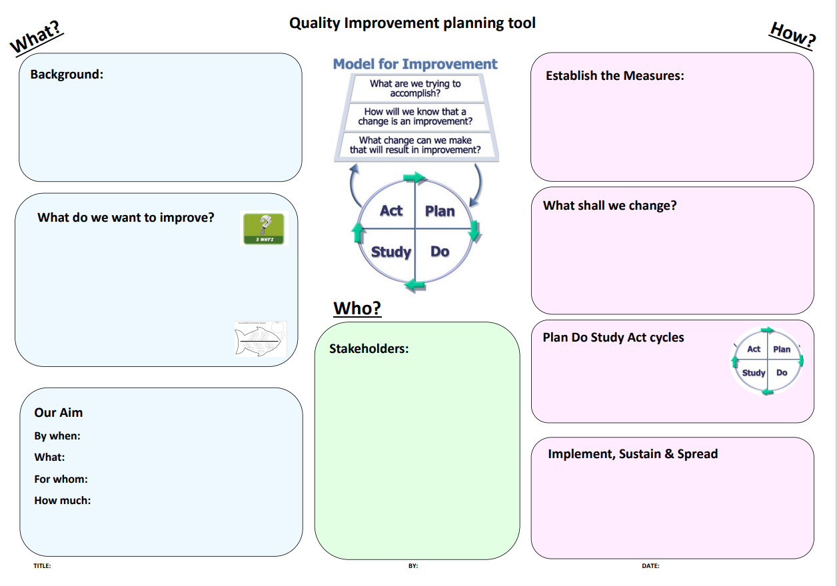
First Step – What will you do?
Confirm which improvement you are doing

Slide 23
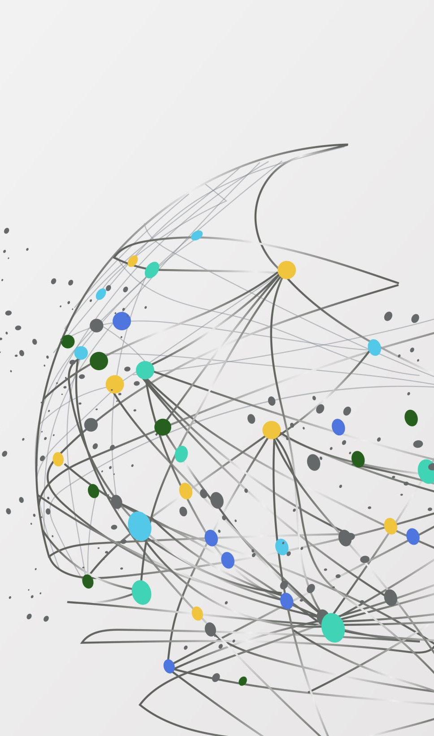
What is your definition of engagement and co-production?

Slide 24

questions
Feedback form

