Slide 1
Shining a light on patient pathways
CSP South Central Regional Network event, 2/10/23
Dr Helen Wharam, Advanced QI Methodologist
Notes:
Start 9.30am

Slide 3
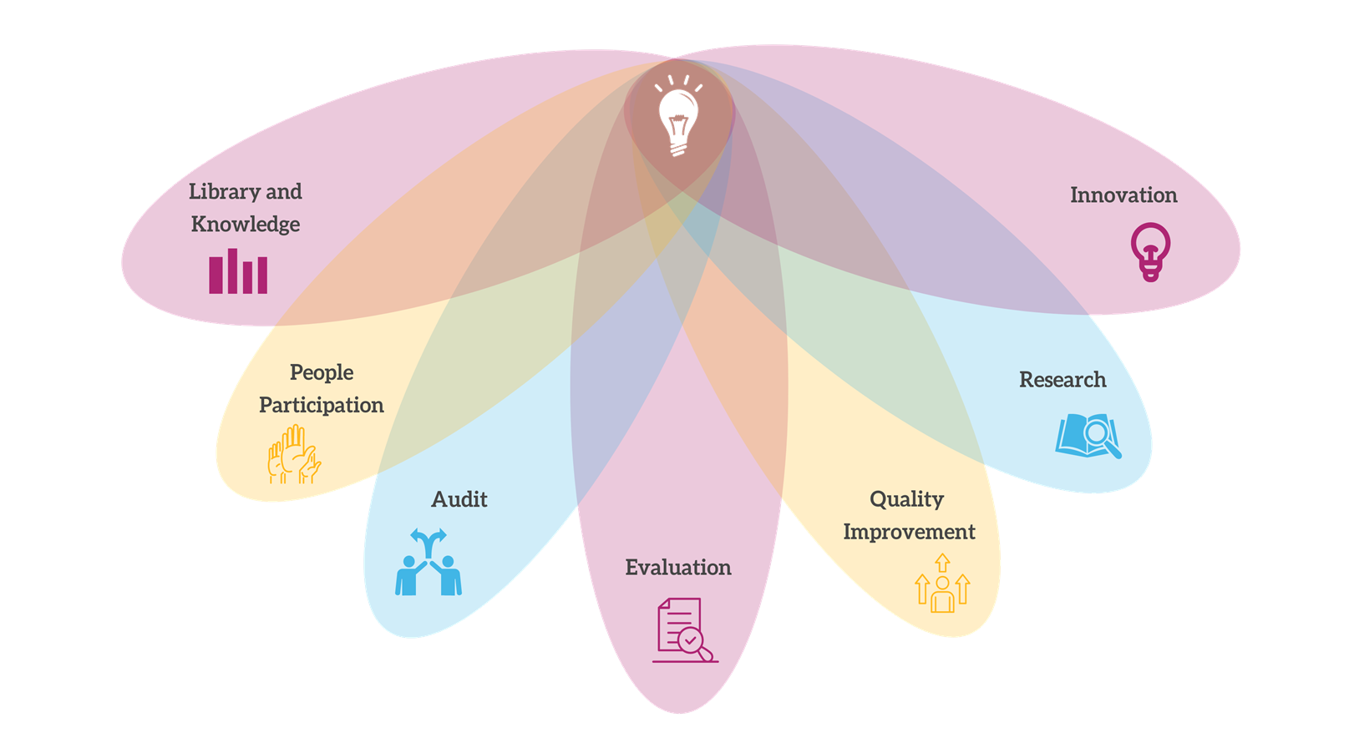
Workshops
Resources
Bespoke support
Dragon’s den
Shared learning
Networks
Communications & media

Slide 4
Who you are
Your service
What D&C challenges your service is experiencing
Notes:
Start 9.10am, finish 9.30am, 15 mins

Slide 5
Understand and manage capacity
Understand, manage and plan for variation
Map system pathways
Understand & manage demand
Understand & manage waiting lists
Notes:
Need to do everything you can to work within existing resources
Manage demand = reduce DNAs where rebooked, short notice cancellations where slot is lost, move demand, do less
QI methods = increase efficiency = reduce error rates and waste etc.

Slide 6
Pathways
What is a pathway?
Notes:
Start 10am

Slide 7
Pathway / System Mapping
high level, end-to-end pathway map
map what is currently happening
Include all:
referral routes and mechanisms
discharge points
key milestones
process steps
Notes:
Start 10am

Slide 8
Each process step has …..
4 key metrics
Demand
Capacity
Activity
Backlog
a queue of waiting patients
A, B, C, D

Slide 9
Each process step has …..
4 key metrics
Activity
Backlog
Capacity
Demand
A, B, C, D

Slide 10
You now have a foundation for
improving data capture
managing variation
optimising flow
ensuring timeliness of care
workforce planning
= improved demand and capacity management

Slide 11
MSK West pathway map
Urgent = 2 wks
Urgent = 2 wks
Patient has 2 weeks to book
Referral received to admin list timescale: urgent 24 hrs, routine 48 hrs
Routine = 4 wks
Routine = 4 wks
Urgent new patient assessment
Urgent referral Admin contact
Discharge, not used SOS
Referrals not accepted
Urgent patient books appt
IMAT
Waiting list
Waiting list
Routine referral Admin contact
Discharge with SOS (3 months)
CPPP group
Referral received
Referral triage
Patients discharged if don’t contact service
Follow up appointments
Routine RAS referral Admin contact
Exercise Rehab Instructor
Referrals/transfers elsewhere
Routine patient books appt
Discharge no further treatment
Routine non RAS referral Admin contact
PT Assistant
Key:
No data required
Data required
Exit point
Don’t know what doing with?
Queries/comments
Routine new patient assessment
Process: daily, allocated time + ad hoc (fire fighting); total time required unknown – plan data collection & percentiles, SPC
Who: B7s, IMAT + others ad hoc
? Rejection rate for referrals –reduced?
When is pt added to systm1?
Waiting list data needs to be split for routine and urgent
Merging so have one urgent and one routine list would improve flow
? are patients being double counted – triage + admin list?
Lower limb group
Follow up appts:
Time = 30 mins
No distinction by band
Plan: stratify LOS, then calc av no follow ups for stratified data
DNA, service/pt cancellation rates?
Need to look at data quality
New Pt ax:
Urgent wait from triage = 6 weeks
Routine wait from triage = 12 weeks
No division by band
Time = 45 mins
DNA, service/pt cancellation rates?
Approx 30-40% patients discharged from both lists after 2 weeks; is this high given triage time?
Need improved process for closing discharged patients on Systm1
Multiple referral sources, detail not required
? SOSs – how may are used?

Slide 12
Pathway queues
GP referral
SEN referral
Queue
Queue
Health Visitor referral
Dr clinic appt
Nurse clinic appt
Follow up clinic(s)
MDT triage
MDT review
Queue
Queue
Queue
Queue
Discharged
Discharged
Discharged

Slide 13
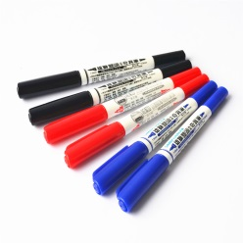
Pathway mapping tips
Identify key stakeholders
Define first and last steps
Map the current clinical pathways
Start at high level and expand as necessary
Define mapping process i.e. Use “Post It notes” or Microsoft Visio
Consider engagement with an external facilitator
Notes:
Quick and dirty; who does what; what you do in 80% of cases
By value we mean – any activity that improves patient care and experience; value is defined by the “customer”, patients are our customers but also other stakeholders including staff; non value added steps are those which introduce waste e.g. delays, waits, adverse incidents

Slide 14
Pathway mapping – have a go!
GP referral
SEN referral
Health Visitor referral
Dr clinic appt
Nurse clinic appt
Follow up clinic(s)
MDT triage
MDT review
Discharged
Discharged
Discharged

Slide 15
For a pathway to be effective
All of these things should continuously flow:
Patients and their families/friends
Staff
Equipment
Supplies/materials in
Waste out
Medicines
Information

Slide 16
Keep it simple!
Numerous pathway “events” can
result in long through put times which generate new needs
generate delays and poor patient experience
increase admin requirement
require more capacity
increase opportunity for system/process failure

Slide 17
Understand and manage capacity
Understand, manage and plan for variation
Map system pathways
Understand & manage demand
Understand & manage waiting lists
Notes:
Need to do everything you can to work within existing resources
Manage demand = reduce DNAs where rebooked, short notice cancellations where slot is lost, move demand, do less
QI methods = increase efficiency = reduce error rates and waste etc.

Slide 18
Introducing the Solent Veterans service and its patient process
Notes:
Start 11.30am

Slide 19
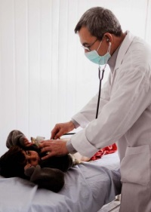
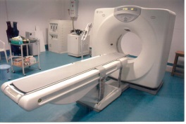
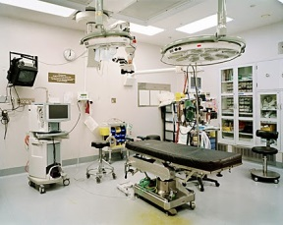
How the Veterans process works
Veterans waiting to enter the system
GP referral
Outpatients
Follow up
Discharge
Diagnostics
Surgery
Patient pathway

Slide 20
Your workstation

Slide 21
Round 1 ……..

Slide 22
What happened at the Solent Veterans Service How did it feel
Notes:
Reflections on having more resources:
More resources does not equal more output
Rate limiting step
Uneven allocation of resources
Some idle time at bottleneck
Peaks and troughs magnified
Very stressed at bottleneck
Determined to make it work but can’t

Slide 23
How can we treat more patients
Round 2 ……..
Notes:
½ teams do waiting list initiative
Waiting list initiative
Allocating resources to one point in the system
½ teams move additional resource around
Service line manager keeps moving extra resources around to where they think they are required

Slide 24
What happened at the Solent Veterans Service How did it feel
Notes:
Reflections on having more resources:
More resources does not equal more output
Rate limiting step
Uneven allocation of resources
Some idle time at bottleneck
Peaks and troughs magnified
Very stressed at bottleneck
Determined to make it work but can’t

Slide 25
Key take away
Both demand and capacity are variable
Create peaks and troughs of workload
Sometimes
not enough capacity due to increased demand
excess capacity due to reduced demand
If we don’t manage this waiting lists will grow
negative impact on patient outcomes, patient and staff experience
Additional resources at one fixed point doesn’t always help
Helicoptering in resources is rarely successful

Slide 26
The impact of variation
The more variation you have the harder it is to ensure:
capacity and demand match
patient flow is smooth
waiting lists and waiting times remain stable
understand
minimise or manage
plan activity appropriately
Notes:
Variation in both demand and capacity; whilst you can’t control all variation, you can predict normal variation which means you can plan for it; additionally you can also be aware of, and try to minimise, service created variation

Slide 27
Understand variation
Externally Created
Service Created
Seasonal Variation
External system changes
Public Health Initiatives
Pandemics!
Innovation
Working hours of staff and how staff leave is planned
Blocking appointments for “other” work
Scheduling of staff training
Autonomous practice
Batching
Carve out & queues
Notes:
Variation affects healthcare service demand and also our capacity to respond to demand for a service:
Scheduling of services: keep people waiting = build up of a queue
Carve out
Working hours of staff and how staff leave is planned
Grouping work and dealing with it in batches

Slide 28
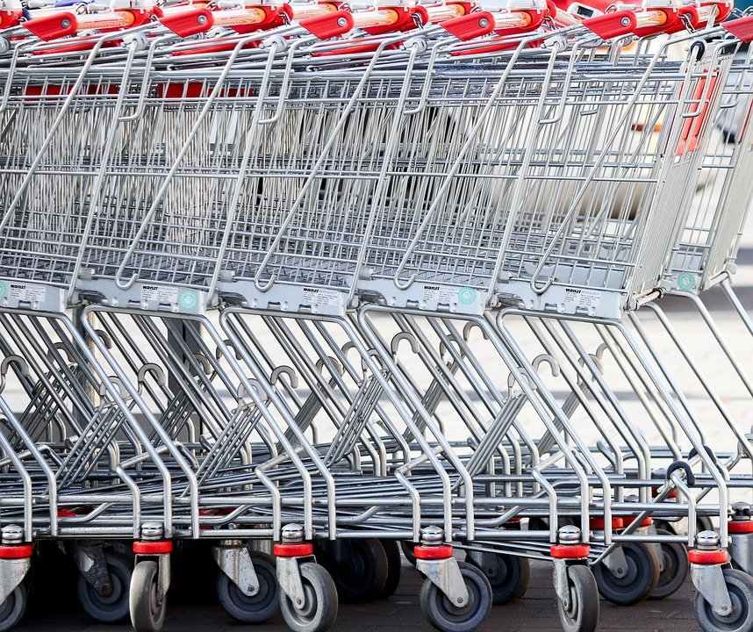
Reduce queues
Paying at the supermarket
Airport check-in
Notes:
The mathematics of queuing tells us that the greater the number of queues and the level of carve-out, the greater the propensity for delays, variation in care, and waste in the system. Multiple queues make it impossible to match the capacity to demand.
Supermarkets, multiple queues, lots of variation between queues, some move faster than other, peaks and troughs in workload of cashiers with some with long queue others with no queue
At airports, many airlines now ask customers to form a single line whilst waiting for the next available check in desk = steady flow and consistent work rate for staff
More queues = more variation = more patient appointments needed or longer waiting times for patients

Slide 29
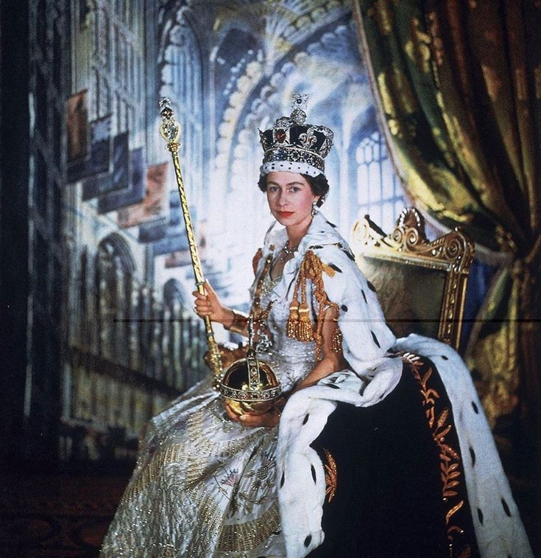
Queen Elizabeth II Lying-In-State
single queue from Westminster to Southwark and then a zigzag queue in Southwark Park
10 miles long at it’s maximum
planning for the queue supported by Professor Keith Still and Masters students
developed using crowd science

Slide 30
Queen Elizabeth II Lying-In-State
accessible queue for people with a disability or long-term health condition
= minimal prioritisation
queue was closed when reached max size and another queue to join the queue was created
= against government advice

Slide 31
Pathway queues
GP referral
SEN referral
Queue
Queue
Health Visitor referral
Dr clinic appt
Nurse clinic appt
Follow up clinic(s)
MDT triage
MDT review
Queue
Queue
Queue
Queue
Discharged
Discharged
Discharged

Slide 32
Podiatry Service
Increasing waiting lists and waiting times
Perception of insufficient emergency slots
Negative impact on staff and patient experience
Pathway mapping identified 46 queues (waits)
Notes:
New patient and follow up appointment pathways were process mapped
A list of all clinics was created and validated
All podiatry clinic specialties were identified

Slide 33
Podiatry service
Community site 1
Community site 2
Community site 3
Notes:
Findings: 30+ clinics at range of sites across Southampton and Portsmouth
Patients were only offered an appointment at the clinic site closest to their home

Slide 34
Podiatry service
Community site 1
Community site 2
Community site 3
Notes:
Reduced queues by offering patients a choice of clinic site to attend = improved management of variation in referral rate

Slide 35
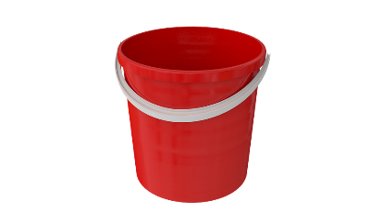
Carve out
Available resource is carved out into different “buckets” reserved for sub-groups of patients with different clinical needs or priorities = creating more queues
Priority 1
Priority 2
Priority 3
Priority 4
Condition 1
Condition 2
Condition 3
Condition 4
Clinician A
Clinician B
Clinician C
Clinician D
Notes:
May need to do some clinical prioritisation but should keep to minimum. Typical response to increasing queues is to introduce extra prioritisation steps, slots are reserved for more vulnerable groups of patients; shunts patients around, creates complex referral criteria and booking rules, delays in process and wastes resources

Slide 36
Podiatry service
Routine care
Follow ups
Ulcer care
Domiciliary care
Nail surgery
Urgent care
Orthotics
Notes:
Podiatry team example – clinicians had their own patient groups creating carve out and additional patient queues
Created more queues and more variation

Slide 37
Podiatry service
Routine & follow ups
Ulcer care
Domiciliary care
Nail surgery
Urgent care
Orthotics
Notes:
Podiatry team example – clinicians had their own patient groups creating carve out and additional patient queues
Created more queues and more variation

Slide 38
Podiatry Service
46 queues reduced to 18
improved flow
reduction in waiting times
Notes:
New patient and follow up appointment pathways were process mapped
A list of all clinics was created and validated
All podiatry clinic specialties were identified

Slide 39
Reducing queues: triage
Locality A
Locality B
Locality C
Referral
Referral
Referral
Triage
Triage
Triage
1 hr 55 mins per day
4 hrs 32mins per day
2 hrs 55 mins per day
Total time required across 3 localities = 7hrs 43 mins per day

Slide 40
Reducing triage queues
Locality A
Locality B
Locality C
Referral
Triage
3 hours 20 mins per day
Saving of 4 hrs 23 mins

Slide 41
Reducing queues & carve out
less complexity (steps and processes) in the system
reduces waiting times
fewer appointment slots needed to meet demand
uses capacity more effectively
reduces impact of clinic cancellations, annual leave, staff sickness
reduces in the time dedicated to managing waiting lists
improves staff and patient experience
Notes:
Finish 13.20pm

Slide 42
Reduce or eliminate batching
Group or set of usually similar objects or people that are sent off, handled, or arrive at the same time
creates artificial delays
introduces more variation in demand
disrupts natural flow of activity
results in backlogs
managing waiting lists becomes more difficult
Example = processing referral paperwork on 2 days per week
Notes:
Aim to make batch size (number of patients or tests processed together) as small as possible

Slide 43
Batching
Form yourselves into equal sized teams
Make one person responsible for timing
Imagine you are either a famous:
pop group
group of actors from a film/theatre production
group of musicians
In your downtime you routinely sign autographed photos for your fans

Slide 44
Podiatry service batching

Slide 45
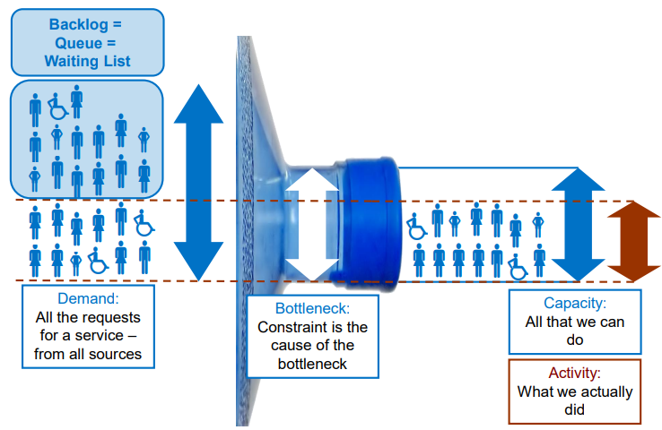
Eliminate bottlenecks
Courtesy of NHS Elect

Slide 46
Bottlenecks
bottlenecks are the part of the system which limit pathway flow
section on your pathway map where have the greatest backlog and/or longest waits
“pushing” patients up the pathway
want to “pull” patients up pathway = delivering care on demand
use Theory of Constraints to systematically improve bottleneck
Notes:
= apply QI methods (theory of constraint)

Slide 47
Eliminating Bottlenecks
Theory of Constraints
Identify | Map this part of the pathway in detail; get to root cause (consider using 5 Whys)
2. Exploit | Improve processes; reduce waste = exploit what you have
3. Support | Review all other activities in the process and align to the change e.g. policies, measurement
4. Elevate | If the constraint still exists consider what further actions can be taken to “break” it. This may include investing resources in it which may require capital expenditure
5. Repeat | Go back to step 1 and immediately address the next constraint
Notes:
= apply QI methods (theory of constraint)

Slide 48
5 Whys to
understand the bottleneck root cause
WHY
WHY
WHY
WHY
WHY
Keep asking why
at least 5 times
until get to the true root cause of an issue
Notes:
TROLLEY EXAMPLE
No regular checks to wear and tear
No maintanence schedule – creating a schedule will help prevent this happening again.
Don’t do a one of repair…as likely to happen again

Slide 49
The patient was late in theatre, it caused a delay. Why?
There was a long wait for a trolley. Why?
A replacement trolley had to be found. Why?
The original trolley's safety rail was worn and had eventually broken. Why?
It had not been regularly checked for wear. Why?
WHY
WHY
WHY
WHY
WHY
Notes:
The root cause - there is no equipment maintenance schedule.
Setting up a proper maintenance schedule helps ensure that patients should never again be late due to faulty equipment.
This reduces delays and improves flow.
If you simply repair the trolley or do a one-off safety rail check, the problem may happen again sometime in the future.

Slide 50
Eliminating bottlenecks
Warning!
When you remove or modify a bottleneck, you may find a bottleneck forms in another part of the process
Keep reviewing the whole pathway
If you have more than one bottleneck, start at the end of the pathway and work backwards
Notes:
Finish 13.41pm

Slide 51
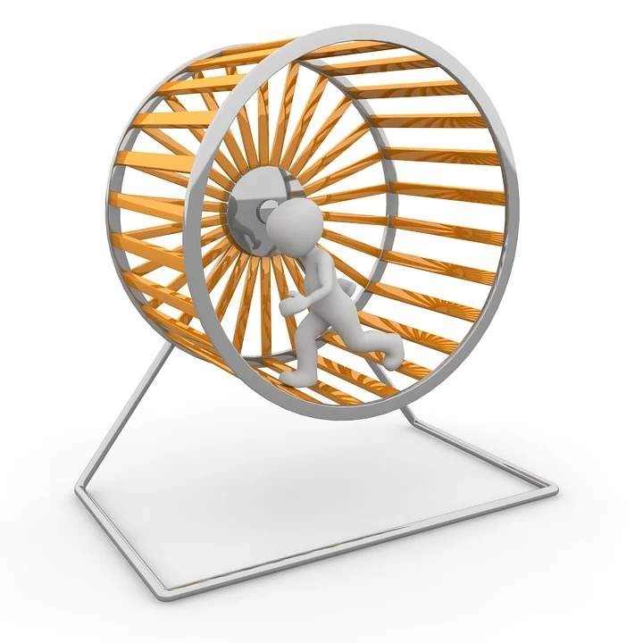
Moving forwards
“If you always do what you always did, you will always get what you always got.”
Albert Einstein
“The secret of change is to focus all of your energy, not on fighting the old, but on building the new.”
Socrates
Notes:
Start 9.15

Slide 52
I wish …..
Reflect on the content covered and structure your thoughts around the phrases:
I wonder …..
(What if)
I like …..
Notes:
Start 10.50am, allow 15 mins, finish 11.05am

