Slide 1



The Evolving World of Advancing Practice
What does it mean for physio’s?
Advanced Practice Physiotherapy Network
May 2023

Slide 2
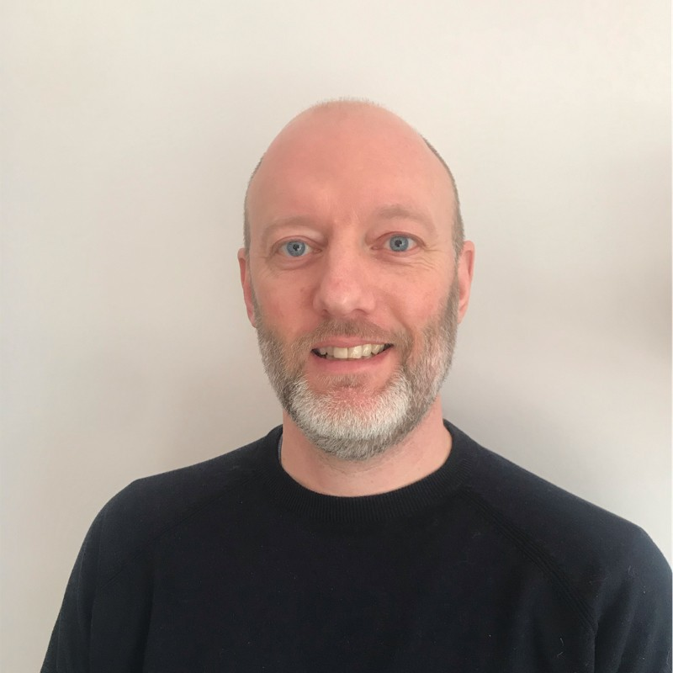
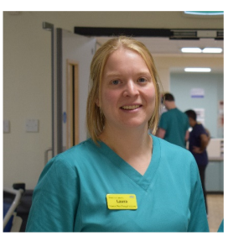
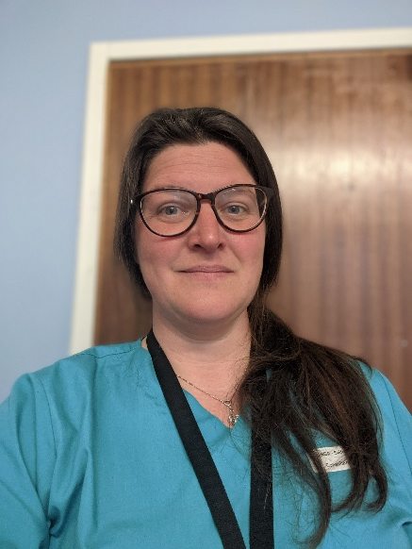
Who’s who
Nick Worth
North West Regional Advancing Practice Supervision and Assessment Lead at NHS England
Michelle Angus
Co-chair APPN
Consultant Physio
Northern Care Alliance
Laura Groom
Consultant Physio LUFT
Education Officer APPN
Advanced Practice Physiotherapy Network

Slide 3
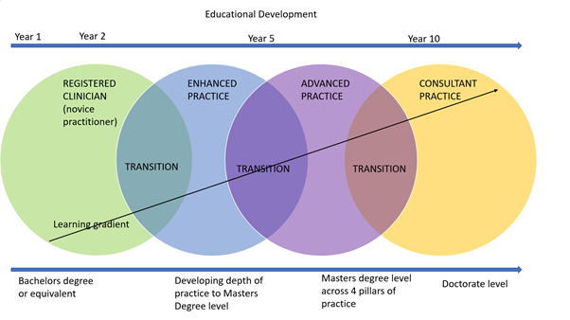

Slide 4

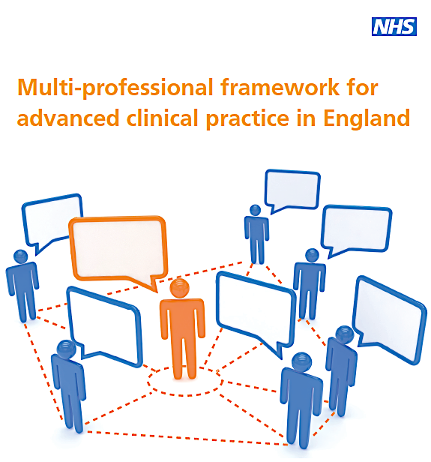

Slide 5
NURSE
OCCUPATIONAL THERAPIST
SPEECH & LANGUAGE THERAPIST
PARAMEDIC
PHYSIOTHERAPIST
Multi Professional ACP Framework 2017
1.11
Evidence the underpinning subject-specific competencies & demonstrate application
Knowledge
Skills
Behaviours
relevant to role setting & scope
@NHS_HealthEdEng

Slide 6
Policy Drivers
The HEE Mandate 2019/20 included the need to build a more flexible workforce
The Centre was established to:
Set standards
Accredit
Quality Monitor
Support and recognise
Promote public and peer confidence.
Maintain
https://assets.publishing.service.gov.uk/government/uploads/system/uploads/attachment_data/file/815411/hee-mandate-2019-to-2020.pdf
Notes:
Set standards for advanced level practice education & training.
Accredit programmes that meet and maintain those standards.
Quality Monitor multi-professional advanced practice education and training.
Support and recognise registered health and care professionals working at or towards advanced or consultant level practice.
Promote public and peer confidence in Advanced Practice in consistent, robust and transparent ways.
Maintain a public directory of registered health and care professionals who demonstrate and maintain the standards and accredited education providers.

Slide 7
WE ARE THE NHS:
People Plan for 2020/21 - action for us all
August 2020
Advanced Clinical Practice (ACP)
In 2020/21, HEE funded a further 400 entrants to ACP training in England, supported by the Centre for Advancing Practice
Aim: to build on the success already seen in using ACP practitioners to greater effect in multi-disciplinary teams, in primary and secondary care.
Innovative roles: contributing valuable clinical support in critical care and emergency medicine
Mental health: boosting the number of ACP practitioners
Cancer: developing an ACP qualification in oncology
Developing clinical pharmacists: linking to ACP and research training
https://www.england.nhs.uk/wp-content/uploads/2020/07/We_Are_The_NHS_Action_For_All_Of_Us_FINAL_24_08_20.pdf

Slide 8



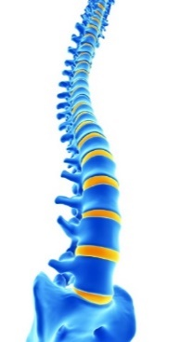

Accreditation of advanced clinical practice: a multi-methods analysis to inform implementation
Noblet T, Heneghan N, Hindle J, Rushton A

Slide 9



Routes to Gain Centre for Advancing Practice Recognition
Education programme accredited by the centre which meets its standards of education and training
Centre’s equivalence route that demonstrates how they have met the requirements – educational level 7

Slide 10
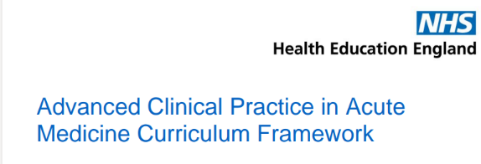
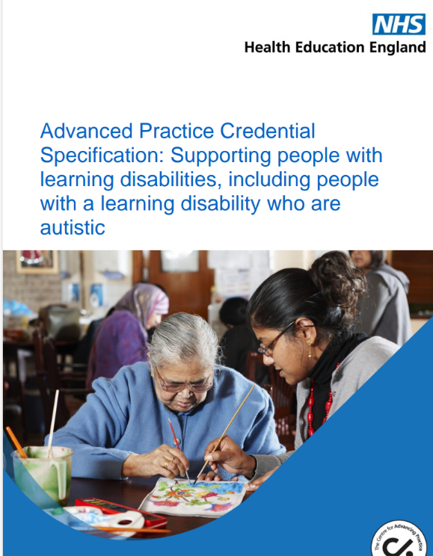
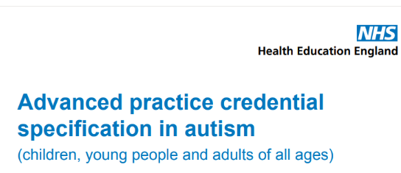
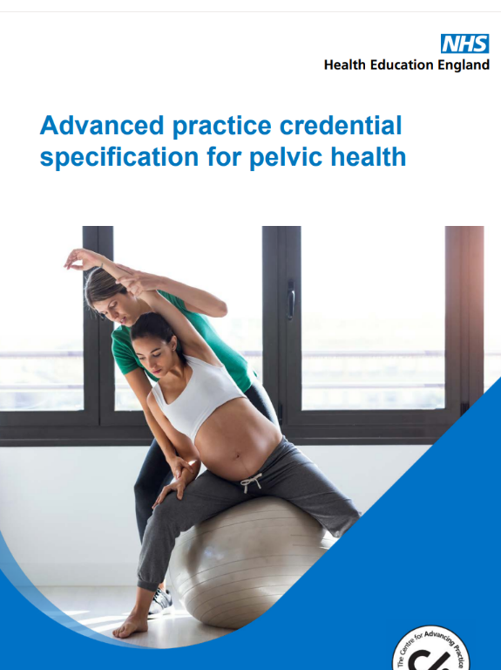
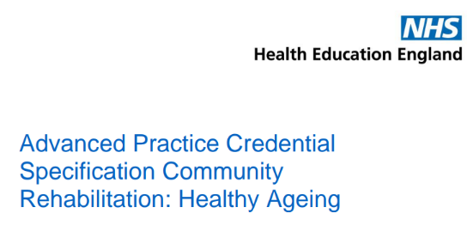
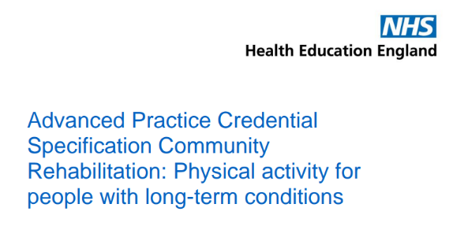
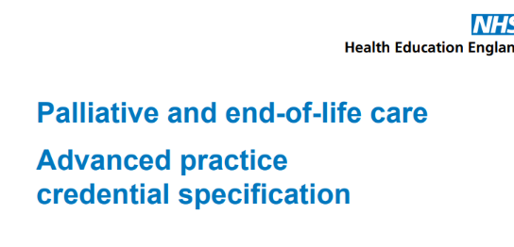
Credentials
Acute medicine
Autism
Community-based rehabilitation: Healthy ageing
Community-based rehabilitation: Physical activity for people with long-term conditions
End-of-life care
Learning disability
Mental health
Musculo-skeletal conditions
Neurological rehabilitation
Older people
Pelvic health
Public health
Surgery

Slide 11
HEE
Department Education & Quality
Strategic Oversight Group
ACP Faculty Leads
Stakeholder Groups
Programme/Centre Management
Education Development & Assurance
Education and Workforce
Credentials
Research
Portfolio
Accreditation

Slide 12
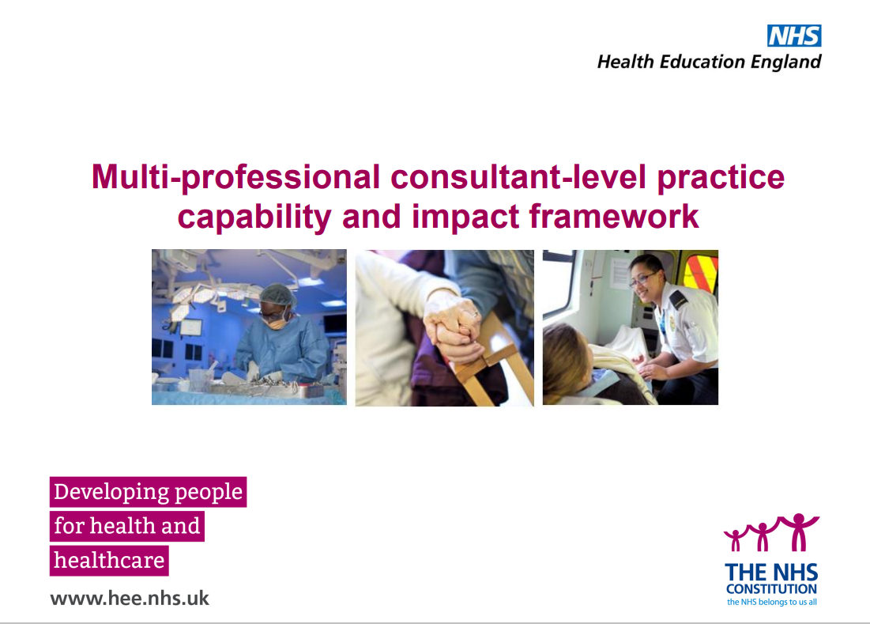

Slide 13
How can the APPN help?
Communities of practice for physios
  Networking
  Sharing good practice
  Strategic conversations
Case study examples
Mentorship/peer support
What else do you want from us?

Slide 14
Thanks
Advanced Practice Physiotherapy Network

