Slide 1

What does this mean for me?

Slide 2
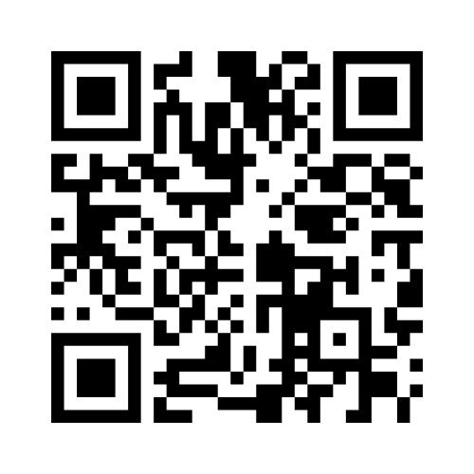
Mentimeter: 6351 2656
What does research mean to you?
work onboarding, training - Gather Expectations - Mentimeter

Slide 3
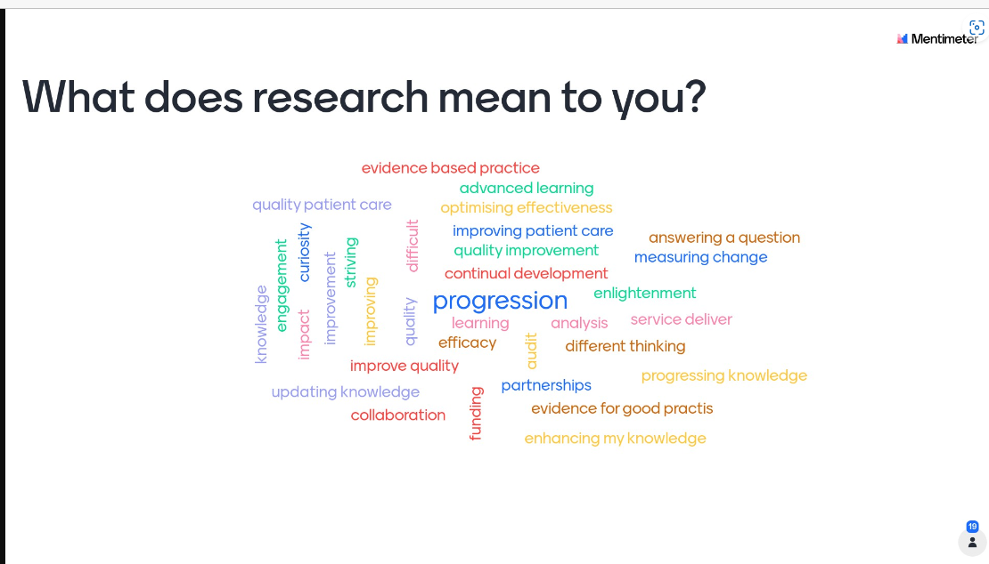

Slide 4

Research in the Workplace
Research and innovation is key to ensuring safe evidenced based practice to support the people who access our services. It enables us to make a difference, whether that is creating new knowledge, enhancing services, improving outcomes or developing our people. Suzanne Rastrick, Chief Allied Health Professional Officer England.
AHPs’ contribution to the health of the nation will be enhanced by this research and innovation plan which highlights raising the AHP profile, optimising evidence informed individualised AHP care delivery and priorities of equity, diversity and inclusiveness in research. Council for Allied Health Professions Research (CAHPR) national Strategy Board,

Slide 5


Allied Health Professions’ Research and Innovation Strategy for England
The strategy was published in 2022
Highlighted the importance of research to be accessible at all levels
Set out 3 visions
  Vision Statement One: Transformation of AHP professional identities, culture and roles.
  Vision Statement Two: Delivery of excellence in evidence-based Allied Health practice.
  Vision Statement Three: National strategic research agendas and priorities are explicitly inclusive of Allied Health research and innovation.
HEE Allied Health Professions Research and Innovation Strategy

Slide 6

What does that mean for me……
To increase the awareness of benefit of research and ensuring practice is evidence based from pre-registration level
Opportunities to undertake research placements to increase exposure research
To encourage AHP to engage in research/evaluation studies/service improvement/dissemination of evidence.

Slide 7
SO HOW?????
Connect with Research department and see if trails in process
Tap into colleagues doing MSC/PHD and see if there is any scope to support
Undertake QI training at local/national level
Complete service evaluation studies – eg; compare 2 treatment methods already in circulation
Complete QI projects – these can be small or large it does not matter.
Complete MSC/PHD/Fellowship

Slide 8
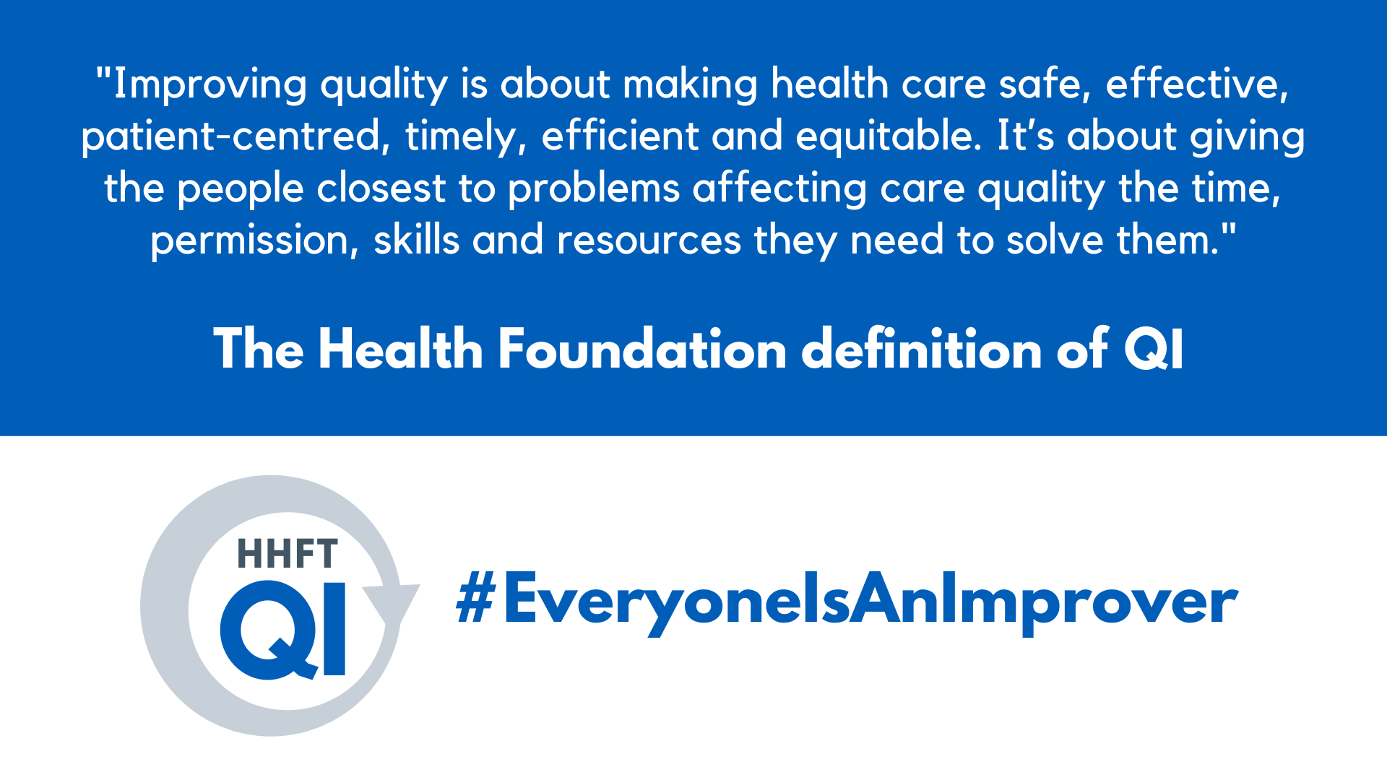

Slide 9
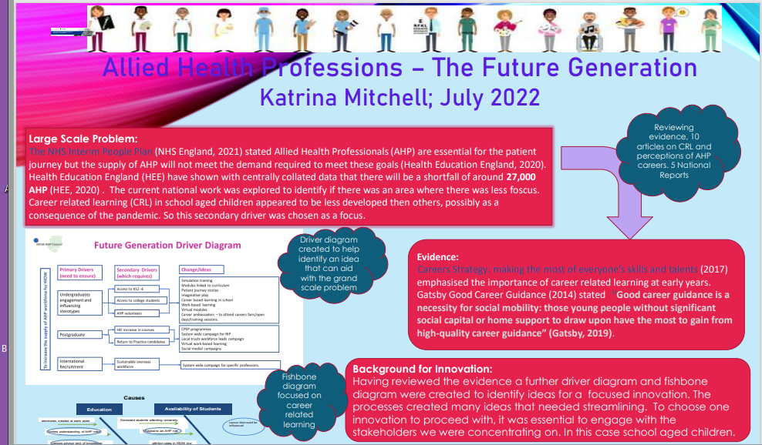
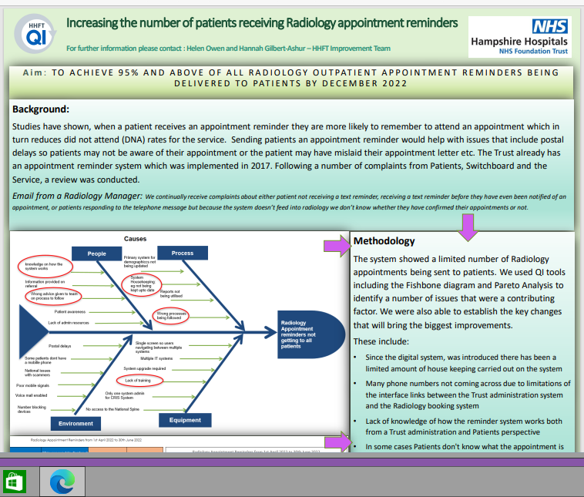
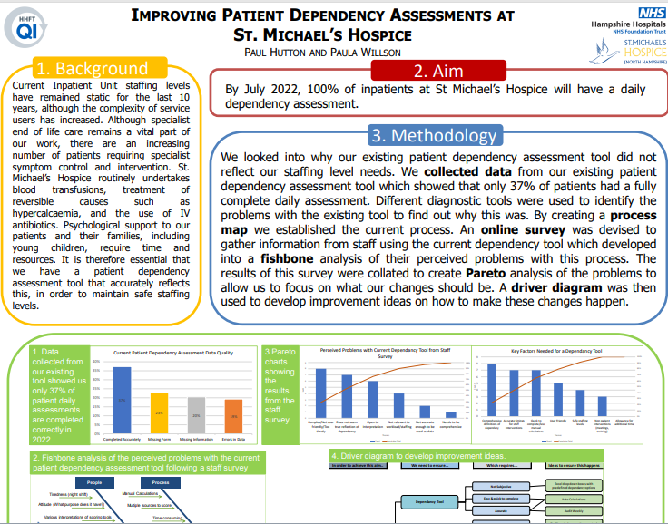
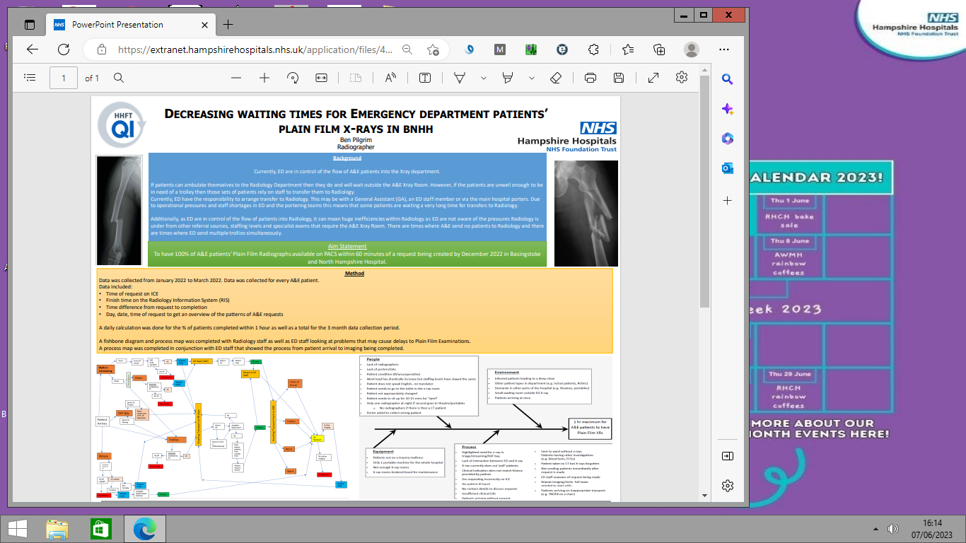
Examples

Slide 10
My Research Journey:
As a Band 5 and 6 –
mainly linked to audit
Experienced Band 6 –
completed MSc and my dissertation was a service evaluation process.
joined the ATOCP and exposed to more research option
Connected with my R&D dept and assisted with multi-centre trials
Connected with PI for ART and supported with the data collection
Band 7 – completed QI bronze and silver and opened my eyes to QI process and completed further QI projects
Secondment: Fellowship – future generations project
Project management courses and workforce development projects

Slide 11

WHAT NEXT??.........

