Slide 1
UHB Loss of rehab space
Beth Sykes
Clinical Specialist Physiotherapist
Physiotherapy Lecturer
CSP Workplace Steward
bethan.sykes@bcu.ac.uk
@beth_the_physio
Rebecca Lamb
Senior Physiotherapist
(Trauma Team Lead)
CSP Workplace Steward
rebecca.lamb3@uhb.nhs.uk
@becky64168022
Notes:
Welcome
Link with speakers who have already presented
Note Karen Middleton’s tweet: large Acute NHS Trust with inadequate rehab space, acknowledge this is a national issue
As a result this may all sound very familiar, and we would love to hear thoughts and experiences from the room
Acknowledge CSP work around right to rehab campaign/long covid rehab/critical care rehab/community rehab/pulmonary and cardiac rehab
Important to say it is difficult to summarise 6 months of work in 30 minutes – emails on screen
Also important to say how amazing our SNO Emma Lenehan has been throughout this process

Slide 2
QEHB Therapy Services

Slide 3
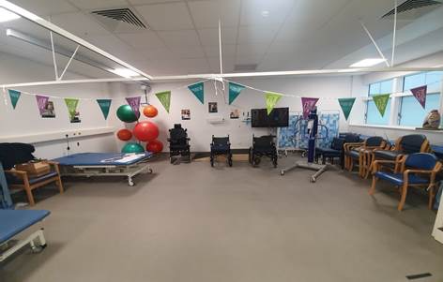
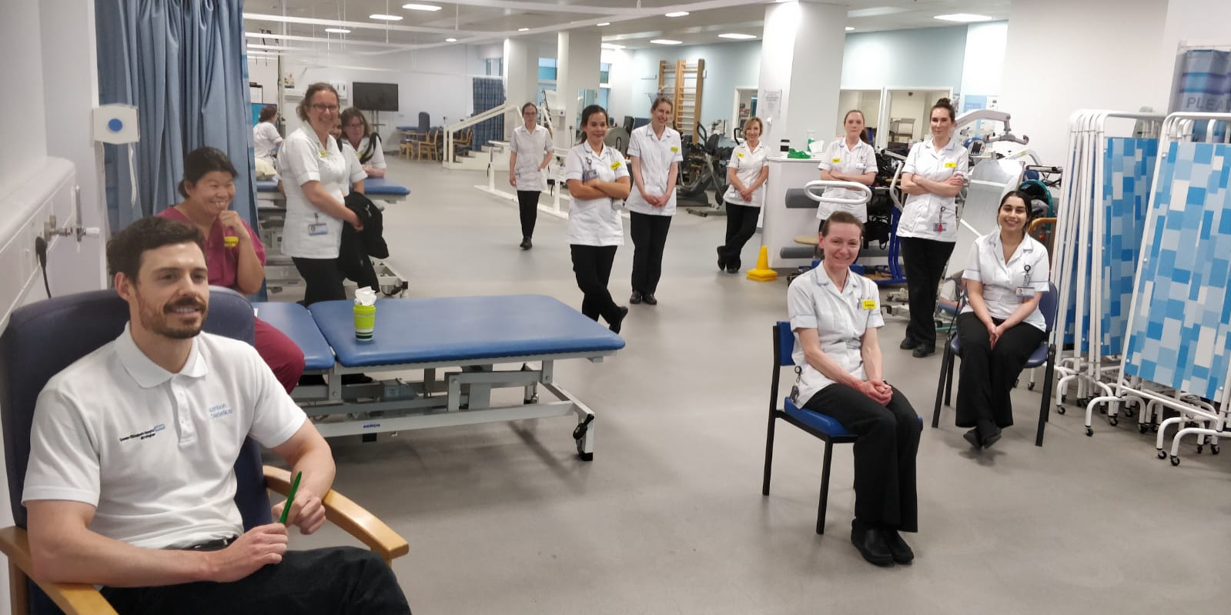
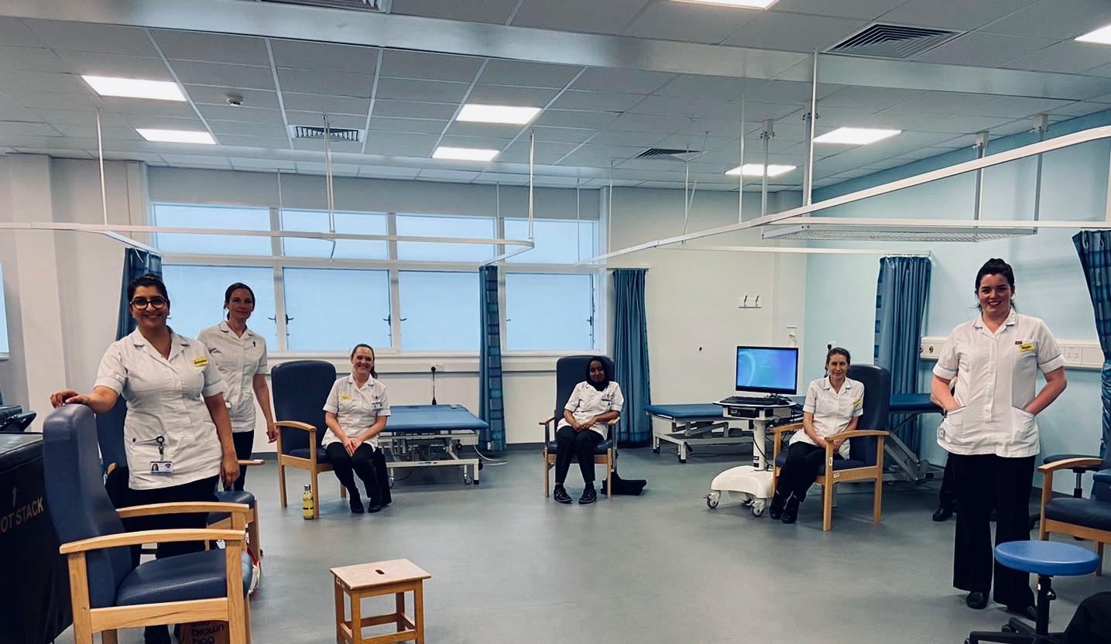
Facilities to be PROUD of
Notes:
Therapy services extremely fortunate to have purpose-built assessment and rehab facilities for both inpatients and outpatients:
Outpatient gym with sprung floor, accommodating a number of classes (balance/advanced balance, ilizarov classes etc)
Outpatient cubicle assessment space with staff bases
Range of exercise equipment
Inpatient rehab space, accommodating specialties such as major trauma, pulmonary and cardiac rehab, neurology, oncology and haematology, burns and plastics, surgery, organ transplants rehab and prehab, and military patients
Range of exercise equipment, tilt tables, parallel bars, stairs, biodex, resistance machines, 7 bobath plinths
This space shared with other AHP groups, facilitating excellent patient care and departmental cohesion
Space, equipment and opportunity to rehabilitate a range of patients have also been cited as key drivers for applicants attracting them to work at the Trust

Slide 4
An Evolving Issue
Notes:
Therapy Services co-located with ED and AMU since 2010 when building opened
For past 5 years or so, therapy space has been vulnerable to conversations around re-configuration of space:
Pre Covid - pressure on front door services, corridor waits and ambulance off load delays leading to considerations to increase size of ED blueprint. Therapy Services North Suite faces ambulance bay, so became obvious target for conversations
Beginning of Covid - requirement for social distancing and re-deployment of outpatient physiotherapy staff to wards/ITU meant that North Suite space was lost to ED to manage volume of presentations and create hot & cold triage systems
During Covid – WMAS concern to CQC re: offload delays, with divisional decision to re-locate Therapy Inpatient South Suite services in order to create an SDEC (same day emergency care) and ambulance offload areas – where 1 paramedic crew would stay with 4 patients, allowing the other 3 crews to get back out on the road
Therapy Services sitting within the same division as acute & emergency medicine, service vulnerable to the urgent decision making required to manage front door pressures

Slide 5
The Sticking Points
Notes:
Throughout all of these periods, our biggest difficulty has been demonstrating use of the space in the context of:
Historical workforce deficit resulting from absence of therapy representation in business cases, capacity expansion etc
Growing unmet patient need, increasing patient complexity, increasing staff burnout, greater Trust focus on flow
Reduction in number of experienced/skilled staff to undertake and pass on rehabilitation skill and knowledge
- Staff re-deployed into other clinical areas reducing service capacity to deliver rehab
Workforce absence during covid
Infection control guidance around using space between patient groups throughout pandemic
Time required to transport patients from wards to gym space - Previous trial of portering system
1,215 inpatient beds (168 qualified physios, growing support worker workforce), and continuing to grow with additional capacity created and estates work ongoing
What has been clear throughout all of our work, is members desire to deliver high quality therapy services, INCLUDING rehab and the right to rehab to patients across all specialties
DESIRE is strong, ability to deliver needing attention

Slide 6
June 2021
QE Therapy Services given 3 day notice given to vacate our space
Potential alternative space found but no agreement yet in place
Removal company date secured before staff consulted

Slide 7
Rep Team Response
Immediate request for delay in decision outlining lack of consultation and required risk assessments
Liaison with AHP union representatives
Contact & meet with SNO
Discussion with members to capture concerns and anticipated impact
Information collected via direct CSP steward email inbox
Liaison with Therapy Director and Divisional Management

Slide 8
Rep Team Response
Letters of concern sent to CEO, freedom to speak up guardian, Divisional and Therapy Directors, Governors
Held member meetings: decision made to submit collective group grievance
Rep Team completed physical visit to all teams to share information, discuss issues with range of staff grades, collate signatures, reassure fears re: grievance on personal record
Group grievance from 130 members, relating to lack of process, particularly around Health & Safety Law and lack of Equality Impact Assessment (EIA)

Slide 9
Rep Team Response
Trust concern for patient safety at front door met with our concern for safety of patients already in our care – responsibility to maximise recovery and prevent avoidable harm
Staff keen to express that Physiotherapy service supports ALL divisions and patient groups, yet decision being made without consultation with wider stakeholders to explore impact on other services
Subsequent grievance investigation with HR, Investigating Executive, SNO and Rep Team

Slide 10
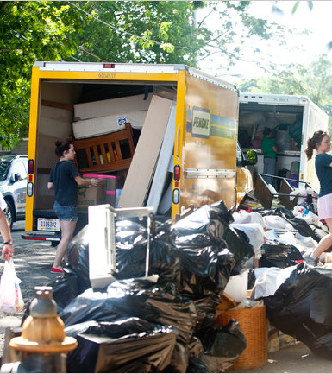
Moving Day
Patients being treated in gym as removal company packing up
Clinicians assisting to move equipment
New space issues:
Excluded several patient groups
Estates issues
Further away from main department
Significant rep time to review space and complete assessments
Notes:
Ongoing issues with this new space, as well as others that have been created since to allow restoration and recovery of MSK services
New therapy spaces also as a result of additional ward capacity – re-purposed old theatre space….problematic
Department now fragmented, with workforce that is demoralised and frustrated at their inability to provide rehab in the way they would like/a way that attracted them to the profession
Significant retention issue – grievance contributing factor

Slide 11
Grievance Outcome
The Trust failed to consult – partially upheld
Risk Assessments were not completed prior to decision – upheld
EIA was not completed prior to decision – upheld
QIA was not completed prior to decision - upheld
Notes:
Partially upheld with rational of urgency of decision required
Space loss if still considered temporary – a recurring theme across the Trust

Slide 12
Grievance Outcome
Profile of Physiotherapy raised
Improved engagement from Division acknowledging contribution of therapies
Retrospective risk assessments completed
Alternative space secured, as well as additional ‘temporary’ space
Huge rehab focus at AHP day presentations to demonstrate need and impact
Unmet need data collection, and subsequent business case submissions
HR relationship and engagement
Notes:
Partially upheld with rational of urgency of decision required
Space loss if still considered temporary – a recurring theme across the Trust

Slide 13
Representation of Members
Huge department with 168 CSP members
Loss of space relevant to all
Diverse spread from those with 20-30 years experience, right through to new graduates, from a range of backgrounds
Conscious of some of the challenges this brings:

Slide 14
Representation of Members
Huge department with 168 CSP members
Loss of space relevant to all
Diverse spread from those with 20-30 years experience, right through to new graduates, from a range of backgrounds
Conscious of some of the challenges this brings:
Ensuring communication is pitched at the right level
Ensuring communication reaches everyone via a method they find accessible
Arranging members meetings that are accessible to those with childcare needs, working part time hours, on-call commitments etc
Providing additional support for staff new into the profession who may need further detail for context and comprehension of workplace issues

Slide 15
Diversity as a Rep Team
Lacking diversity from protected characteristics perspective:
UHB data shows workforce is becoming increasingly diverse, particularly at bands 3/4/5/6
Aim for this to translate into progressing diversity of workplace stewards
Work from CSP diversity networks also likely to impact drive and desire for representation
Notes:
In the interest of the theme of the day, we can’t ignore that within our team, despite our achievements, we lack diversity
In the instance of loss of rehab space, the issue impacts us all and professionally we were able to share experience, use lived experience from our patients and our own practice, and reference the evidence base to support our collective action
However in relation to workplace issues around equality and diversity matters, I am not as confident that our members would feel able to speak up, feel represented, and may be unclear what diversity training their workplace stewards had undertaken
Impact of voluntary role

Slide 16
Diversity as a Rep Team
Diversity of Rep Team across AfC bands and clinical specialities:
Diary flexibility/responsiveness
Departmental presence
Perspectives shared from inpatients, outpatients, rotational and static reps with collective understanding of impact of loss of space – difficult to achieve with an single workplace steward
Notes:
Outpatient team very keen to having their voice heard – they had already been through loss of space and felt response was not as significant

Slide 17
Notes:
And finally, a thank you to those of the Team that haven’t been able to attend today

Slide 18
Our Reflections
The support, power and flexibility of having a rep TEAM was key to our success
Don’t wait until issues to arise: start capturing the impact of your services and space now
Document conversations and events, and ensure space is a recurring agenda item in all departmental forums
AHP representation at Exec/Directorate level is key – national progress but a long way to go
Promotion of associate membership needed – support workers voice essential, particularly in rehab matters
Notes:
There is a huge amount of exceptional work happening at UHB – achievements by the workforce despite significant distress and chronically feeling undervalued

Slide 19
UHB Loss of rehab space
Beth Sykes
Clinical Specialist Physiotherapist
Physiotherapy Lecturer
CSP Workplace Steward
bethan.sykes@bcu.ac.uk
@beth_the_physio
Rebecca Lamb
Senior Physiotherapist
(Trauma Team Lead)
CSP Workplace Steward
rebecca.lamb3@uhb.nhs.uk
@becky64168022
Notes:
Questions?
Happy for you to contact us

