Slide 1
ICU Rehab
Rehabilitation, patient self-management & strength – South-East coast CSP event
Wednesday 9th November 2022

Slide 2
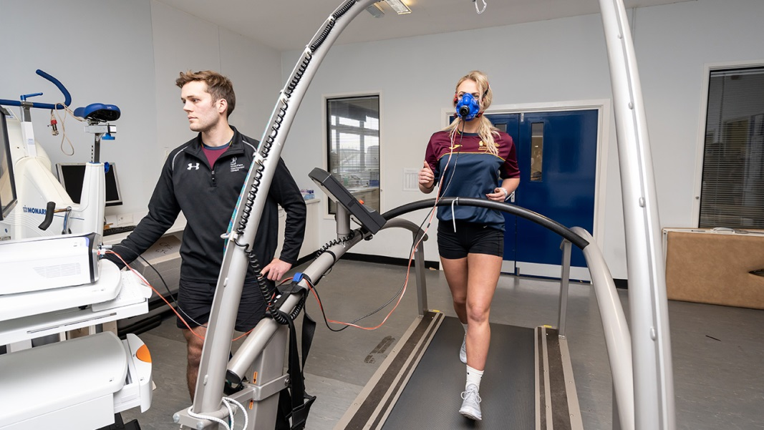

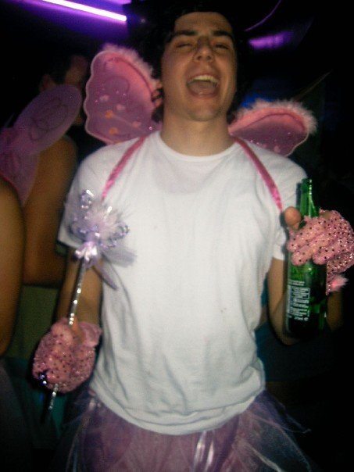
So, who am I!?
Dan Geere
Team Lead Inpatient Respiratory Physio Team
St Richards Hospital, Chichester
BSc Sport & Exercise Science

Slide 3
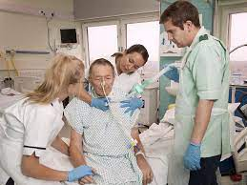
Moving on quickly….
MSc Physiotherapy (Pre-Reg) UOB
Junior rotations, specialised into respiratory, paediatrics and now lead 13 person inpatient respiratory team
  ITU
  Respiratory
  Cardiac
  Surgical
  Paediatrics
10 bed ICU
Fascination for rehab, especially post-critical care rehab

Slide 4
What does Critical Care Rehab mean to you?
Go to menti.com
Use code 69767437
Answer with 3 things that come into your head!
Keep it clean!

Slide 5
CCR – how, why, where, when?
Historically, CCR was limited…
  PROM
  ‘standard care’
Advances in CC is multifactorial
  increased survival
  the recognition of prolonged physical and psychological morbidity after critical illness – Post-Intensive Care Syndrome (PICS)
Robust research has been undertaken to not only provide information on risks of critical illness but also reasoning for CCR and to confirm its safety

Slide 6
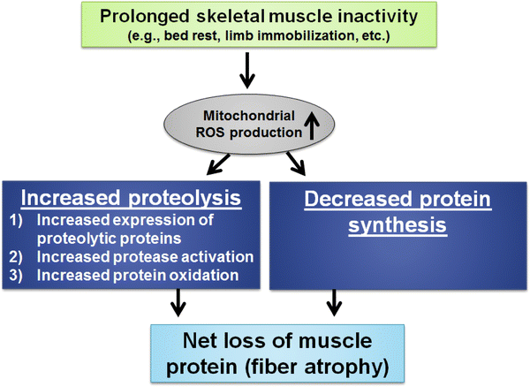
Why….
  Told to by guidance and standards! (NICE, ICS, FICM)
    Reduce ITU and hospital LOS (~2-3 days)
    Reduce morbidity and disability
    Reduce risk/impact of PICS (physically and psychologically)
  Minimise risks of bed rest – multifactorial
    Muscle weakness (Mass >2-4% per day!)
      Disuse atrophy
      ICUAW – polyneuropathy and myopathy
        Starts early and rapidly, correlates with degree of MOF and associated with failure to wean from ventilator
  Delirium management

Slide 7
When…
For all patients admitted to a critical care setting
Obviously, medical stabilisation and treatment is the priority
However, rehab starts as early as clinically possible…
Short Clinical Assessment tool to identify triggers or risk factors for issues requiring complex rehab needs
2+ identified = on to CCR pathway – Comprehensive Clinical Assessment
Triggers which may indicate risk of developing physical and non physical morbidity:
Obvious significant physical injury.
Multiple MSK injuries.
Neurological impairment.
Pre existing Psychological factors.
Anticipated long stay.
Malnourished.
Risk factors
Paralysis/sedation.
Nightmares/anxiety/withdrawal.
Chronic respiratory disease.
Pre existing mobility problems.
MOF/sepsis.

Slide 8
How…
Comprehensive Clinical Assessment
  Identify individual rehab needs
  2-4 days of admission to ICU
  Use of PICUPS tool – 14-item tool to establish rehab needs (Gold Standard)
    Local tool
  Document findings
  Set SMART goals
  Refer to appropriate MDT services (SLT, OT, Dietitians, Psychology)
Weekly MDT goal setting
  Tuesday/Friday
  Patient input if able
Comprehensive clinical assessment
To include as appropriate:
Physical problems (weakness, reduced functional activity, exercise tolerance, pain, reduced ability to self-care, breathlessness).
Sensory problems (vision, hearing, pain, sensation).
Communication problems.
Social care / equipment needs.
Nutritional requirements.
Non-physical problems ie. sedation, anxiety, cognitive problems, sleep disturbance.

Slide 9
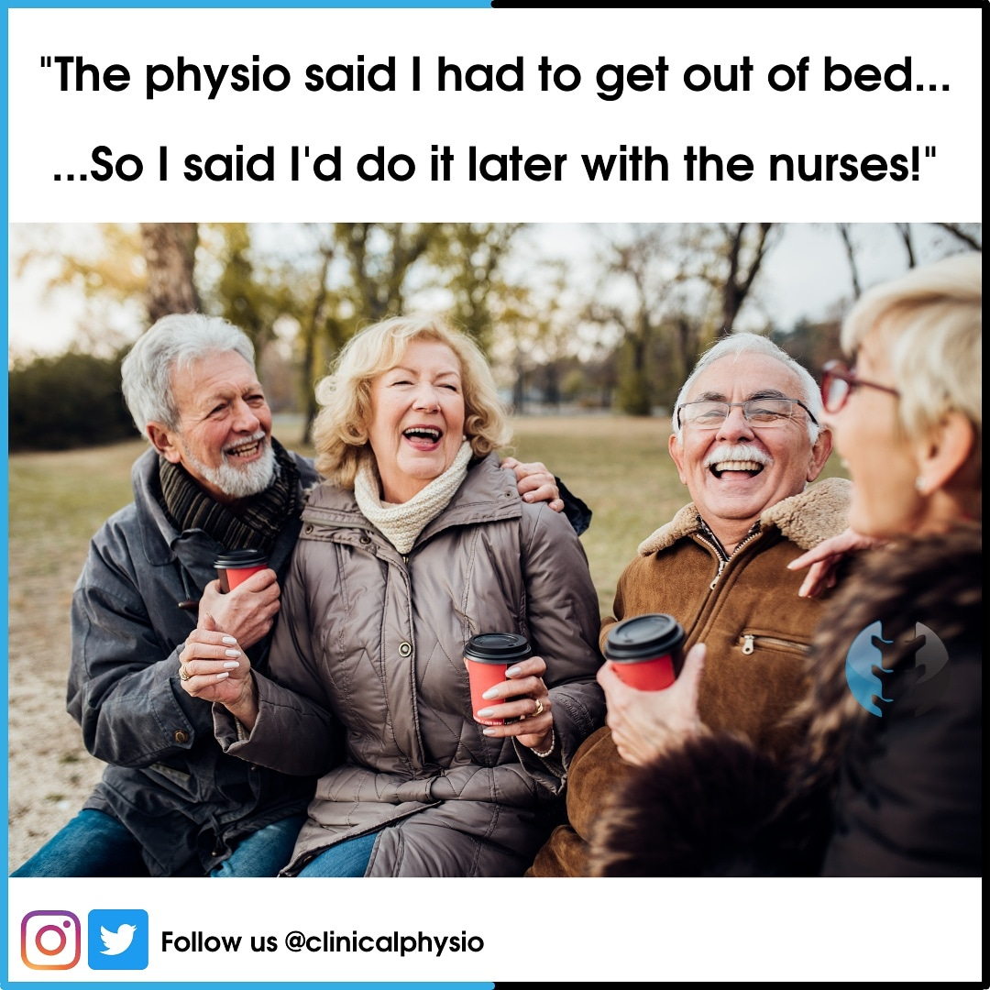
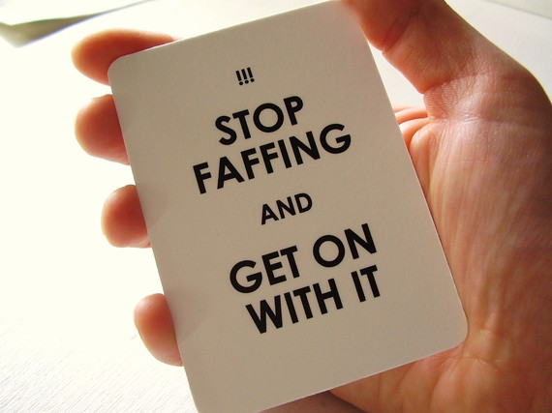
When/How…
As early as clinically possible!!!

Slide 10
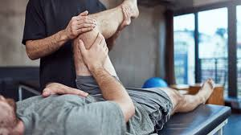
How…
PROM/ A-AROM/ AROM exs
  Individualised prescription and so very varied
  Normal rules apply! (ACSM guidelines)
Postural control very important
  Link to weaning
Progress to SOEOB/seating systems
  Sedation and GCS level (RASS)
  Activation of neuro tracts
Ensure linked to functionality
  Mobility
  ADLs
Liaise with family to create ‘all about me boards’

Slide 11
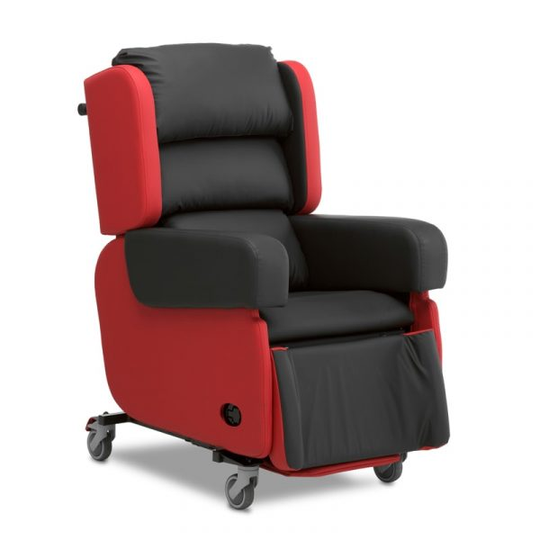
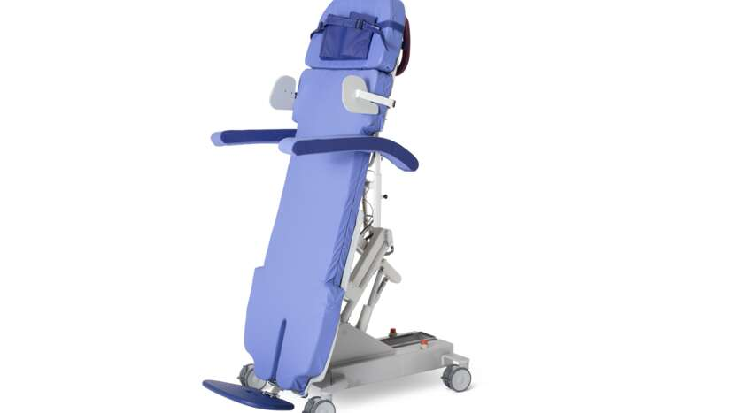
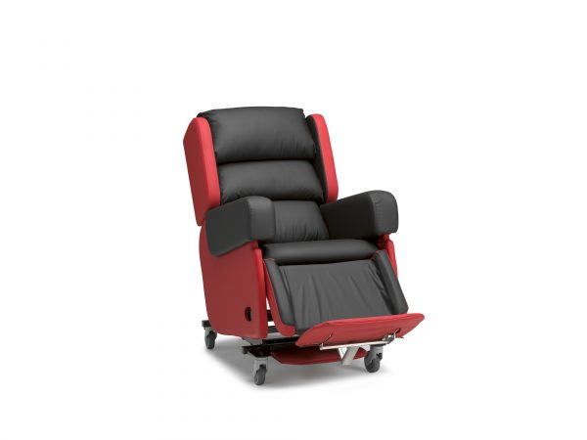
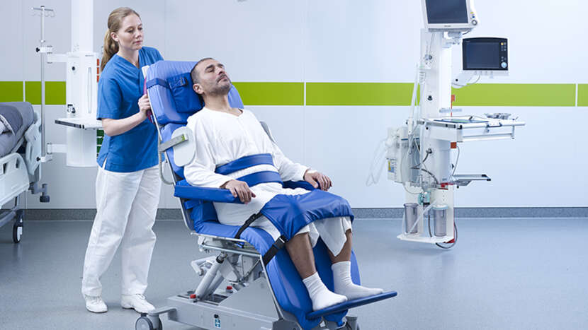
How… Seating systems
Sara Combolizer
Tilt in space chair
‘Magic chair’
Patslide or hoist transfer
Will generally use very early stages (Tubed/trache)
No need for sitting balance/low GCS
Can be used as tilt-table later down the line
To facilitate rehab once patient more involved
Supports sitting balance due to tilt

Slide 12
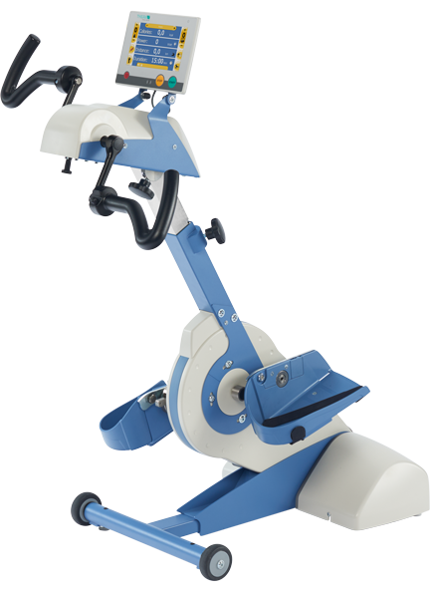
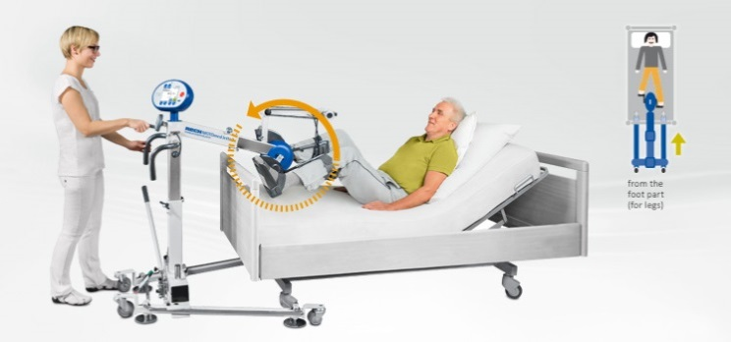
How… Exercise bikes
MOTOmed Letto2
MOTOmed Viva2
Movement therapy in supine
Arms or legs
Passive/Active-assisted/resistance
Use very early on in rehab
Chair based
Arms or legs
Passive/Active-assisted/resistance

Slide 13
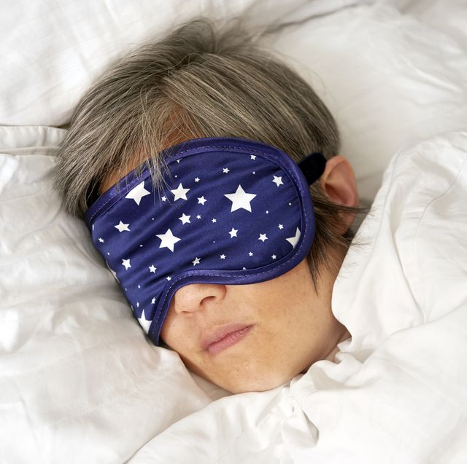


Delirium Management
Regular Assessment
  CAM-ICU
  GCS
  RASS
Early Rehab!
Sleep
  Eye masks
  Ear buds
Reorientation
  Clocks and dates
  Quiet environment
  Pictures of loved ones
  Visitors
  Communication
  Entertainment – TV, radio
Medication
  Pain management
Engagement in goal setting
Cognitive stimulation
  OT
Trips off unit
  Outside
  Gym
Patient diary

Slide 14
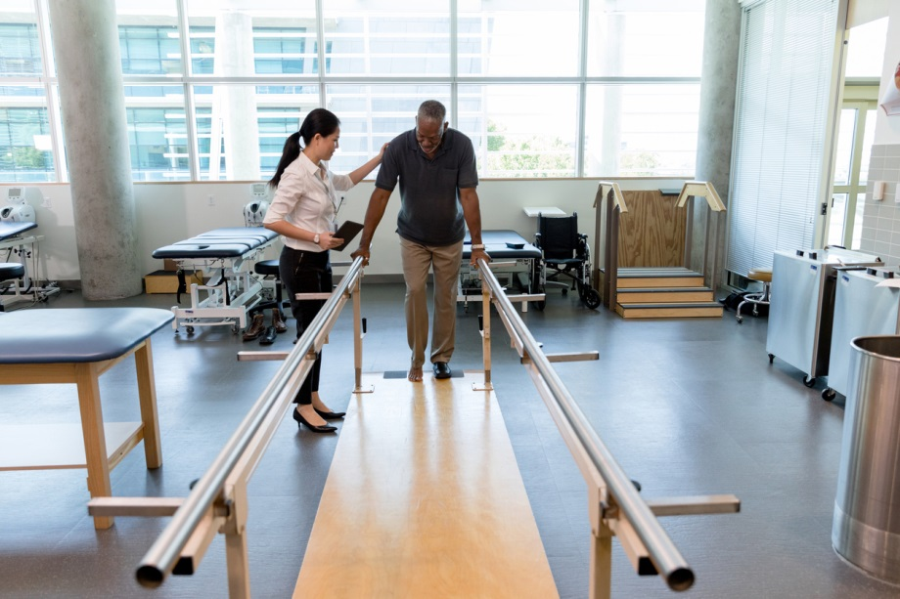
Patient pathway through to discharge
Thorough handover to ward staff
Comprehensive Clinical Reassessment (PICUPS)
  Up to date Rehab Prescription
  Goals set and r/v weekly with MDT
  ITU Steps booklet
  MDT services referred/engaged
  Start discharge planning
Input from ICU rehab staff for continuity
Access to specialist equipment as needed
Establish onward pathway needed
  I/P rehab
  CRB
  Home with CRT
  Placement (Short/Long stay)

Slide 15
ITU Follow up
GAD-7 and HAD at discharge and clinic
Outreach nurse telephone follow up
  Day 1 of discharge
  Patient Diary
3-4 month access to MDT follow up clinic
  Intensivist
  Outreach nurse
  Physio
    HEP
    Rehab classes
    CRT referral
  Access to Dietician/OT/SLT as needed
  Patient diary

Slide 16
References
ICS Framework - Responding to COVID-19 and beyond: A framework for assessing early rehabilitation needs following treatment in intensive care National Post-Intensive Care Rehabilitation Collaborative
PICUPS Rehabilitation (ics.ac.uk)
The Faculty of Intensive Care Medicine - LIFE AFTER CRITICAL ILLNESS A guide for developing and delivering aftercare services for critically ill patients LACI Life After Critical Illness 2021.pdf (ficm.ac.uk)
NICE. Rehabilitation after critical illness. NICE Clinical Guideline 83. National Institute for Health and Care Excellence, London, UK 2009. 2. Overview | Rehabilitation after critical illness in adults | Guidance | NICE
NICE. Rehabilitation after critical illness in adults. Quality Standard QS158. National Institute for Health and Care Excellence, London, UK 2017. Overview | Rehabilitation after critical illness in adults | Quality standards | NICE
The Faculty of Intensive Care Medicine – Guidelines for the provision of Intensive Care Services (GPICS 2.1) 2022 GPICS V2.1 Final.15.7.22 (1).pdf
NICE. Rehabilitation during the patient’s critical care stay. 2022 rehabilitation-after-critical-illness-rehabilitation-during-the-patients-critical-care-stay (1).pdf
McWilliams, D et al. Enhancing rehabilitation of mechanically ventilated patients in the intensive care unit: A quality improvement project. J of Crit Care 2015 30: 13-18
Snelson, C., Jones, C., Atkins, G. et al. A comparison of earlier and enhanced rehabilitation of mechanically ventilated patients in critical care compared to standard care (REHAB): study protocol for a single-site randomised controlled feasibility trial. Pilot Feasibility Stud 3, 19 (2017)
Dirks ML, Wall BT, van de Valk B, Holloway TM, Holloway GP, Chabowski A, et al. One week of bed rest leads to substantial muscle atrophy and induces whole-body insulin resistance in the absence of skeletal muscle lipid accumulation. Diabetes. 2016;65(10):2862–75.
Batt J, Dos Santos CC, Cameron JI, Herridge MS. Intensive care unit-acquired weakness: clinical phenotypes and molecular mechanisms. Am J Respir Crit Care Med. 2013;187:238–46.
Puthacheary Z, Rawal J, Mcphail M, Connolly B, Ratnayake G, Chan P, Hopkinson N, Padhke R, Dew T, et al. Acute skeletal muscle wasting in critical illness. J Am Med Assoc. 2013;310:1591–60
De Jongue B, Bastuji-Garin S, Durand MC, Malissin I, Rodrigues P, Cerf C, Outin H, Sharshar T. Respiratory weakness is associated with limb weakness and delayed weaning in critical illness. Crit Care Med. 2007;35(9):2007–15.
Brower RG. Consequences of bed rest. Crit Care Med 2009;37:S422–8 [Suppl.].

Slide 17
Thank you for listening
Any questions…
Dan.geere@nhs.net

