Slide 1
Equality, diversity and inclusion (EDI)
Dr Pameleta Ricketts

Slide 2
Outline of session
My journey
EDI at HCPC
Takeaway messages

Slide 3

NOT

Slide 4
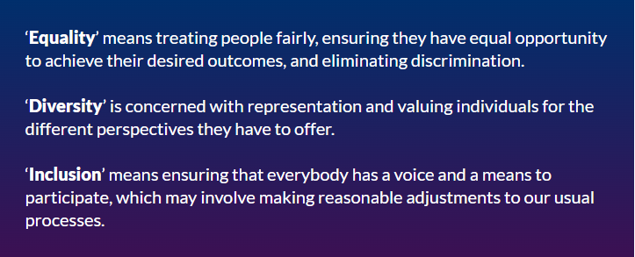
Notes:
Equity and Belonging

Slide 5
Health and Care Professions Council (HCPC)
HCPC aims to be recognised as an organisation that actively upholds and promotes best practice in equality, diversity and inclusion and be an active ally for change.
Improving the quantity and quality of diversity data is an important step towards achieving this aim.
HCPC EDI Strategy 2021- 26

Slide 6
Equality Act 2010
Provides a legal framework to protect the rights of individuals and advance equality of opportunity for all.

Slide 7

HCPC has a legal duty promote equality of opportunity, eliminate unlawful discrimination and foster good relations between key equality strands. These include age, disability, gender, race, religion or belief, sexual orientation, gender reassignment, pregnancy and maternity.

Slide 8
HCPC Strategic Aims
Proactively seek opportunities to exceed its legal obligations to eliminate discrimination, harassment and victimisation and ensure equity of opportunity for registrants, service users, HCPC colleagues and HCPC partners.
Significantly improve the quality of data and insights to inform understanding and knowledge of the diversity and experiences of registrants, service users, HCPC colleagues and partners in order to identify and address how they are impacted by HCPC policies, processes and decisions.
Ensure decision-making, within all its regulatory processes, is free from bias and discrimination and that everyone who has contact feels valued and respected.
Ensure that registrants, service users, HCPC colleagues and partners feel equipped and confident to, and do, speak out when they see bias or discrimination, and to ask questions and challenge in a way that encourages constructive conversation and supports positive change.
Influence inclusive cultures and diversity amongst registrants and within the institutions that employ them, and those that educate and train future registrants.

Slide 9
Strategic aims (con’t)
Internally, as an organisation, HCPC will:
Promote and harness the rich diversity of colleagues and partners, ensuring a diverse workforce and representation at all levels.
Develop and embed an inclusive culture, that encourages and values diversity and the uniqueness and experiences of colleagues and partners, enabling them to be themselves and bring their whole self to work.

Slide 10
Success will deliver the following outcomes:
Stakeholders are assured that HCPC are doing all they can to eliminate discrimination, harassment and victimisation and advance equity of opportunity for registrants and colleagues.
HCPC can evidence that data informs its policies, processes and decisions and that stakeholders report the positive impacts.
People feel confident in speaking out when they see discrimination or bias.
HCPC publish contemporaneous and detailed information about the EDI data it holds and the action they are taking across all of it’s functions.
HCPC regulatory decision making is fair and free from bias.
HCPC actively listens, learns and is transparent about its EDI challenges, holds itself accountable for progress, and sets an example to all of it’s stakeholders.

Slide 11
Successful delivery of the strategy requires your support and input:
Complete diversity data at registration, registration renewal or log on any time via the Portal to update your details. The data you provide helps to identify and inform patterns and trends on issues such as fitness to practice and pay gap reporting.
Have your say during consultations.
Join the HCPC EDI Forum to find out
If you would be interested in joining the forum, please email edi@hcpc-uk.org

Slide 12

My Journey:
The good the bad and the ugly

Slide 13
Takeaway messages
Diversity isn’t something to be feared. Embrace it!!
If you don’t know, get to know!
Respectfully ask and listen with fascination
Importance of genuine allyship
Importance of civility and compassionate leadership
Speak up
Challenge
Zero tolerance to racism, discrimination, bullying and harassment.

Slide 14
Thank you
Any Questions

