Slide 1
Responding to the public health needs of diverse communities in Birmingham
Dr Justin Varney
Director of Public Health
Birmingham City Council
October 2022

Slide 2
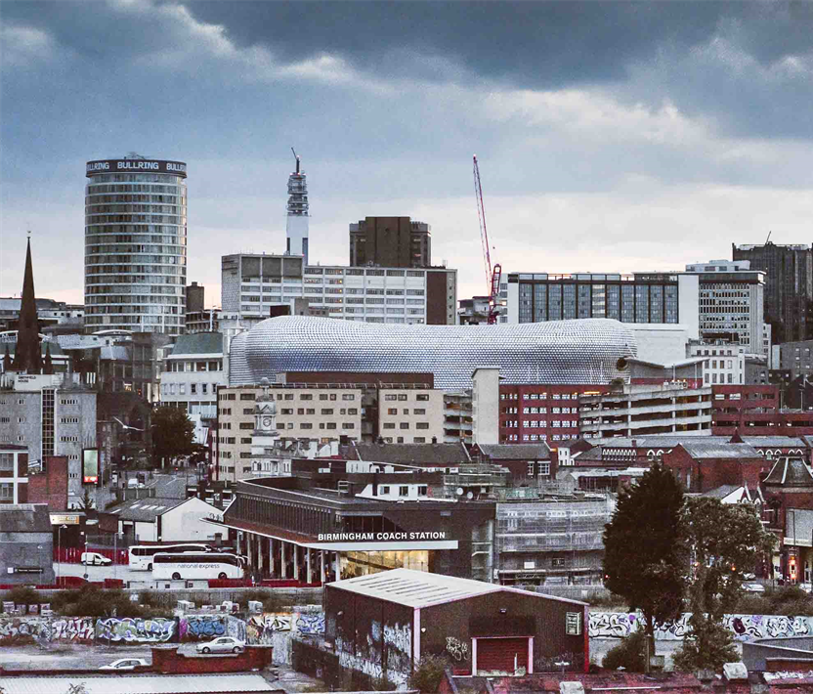
A bit about Birmingham and Public Health….
Birmingham
England’s second city, 1.2m population
30% are aged under 25yrs, over 40% come from ethnic communities
Majority of areas of the city are deprived and amongst the most deprived in the country, just under twice the proportion of households in Birmingham are classified as being overcrowded compared to nationally.
7.8% of working age adults are currently unemployed compared to 4.6% nationally and there are over 58,800 workless households in the city.
10yr life expectancy gap across the city between the most affluent and most deprived communities, and across the city both men and women die earlier than the England average.
Premature death primarily driven by potentially preventable conditions such as coronary heart disease, respiratory illness and infant mortality.
Over 40% of adults in Birmingham do not meet the recommended levels of weekly moderate physical activity, 7.7% more than the national average.
Public Health in Birmingham is a strategic function of the Council and the wider city partnership.
Director of Public Health is part of the Corporate Leadership team, the function is part of the Strategy, Equality and Partnership Directorate.
DPH sits as a member of the NHS Integrated Care System Partnership Board alongside the cabinet member.

Slide 3
Thinking about diversity, inclusion and inequality

Slide 4
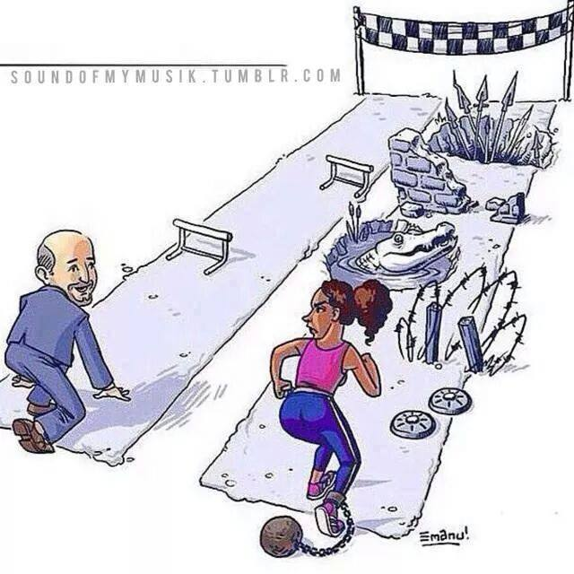
Not all journeys through life are the same...

Slide 5
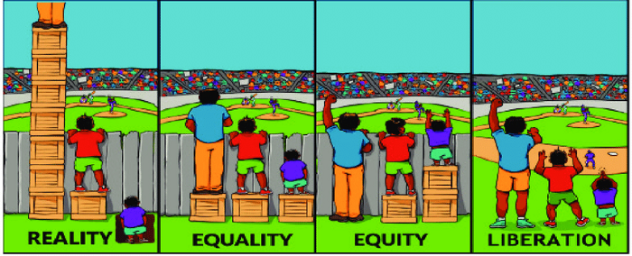
Structural Inequalities
Notes:
“Health inequalities are unfair and avoidable differences in health across the population, and between different groups within society.
Health inequalities arise because of the conditions in which we are born, grow, live, work and age. These conditions influence our opportunities for good health, and how we think, feel and act, and this shapes our mental health, physical health and wellbeing.”
- NHS England

Slide 6
Inequalities in Communities
Communities of place
Communities of identity
Communities of experience
Inequalities exist within Birmingham between different communities of identity, both between those with specific characteristics and those without and comparing our communities with outside the city. These could be based on gender, ethnicity, sexual orientation, age, faith/belief, disability, etc.
Inequalities exist within Birmingham between different communities of experience. These experiences may include veterans, care leavers, homeless people, people with substance misuse or severe mental health illness. Some of these may overlap for individuals.
Inequalities exist within Birmingham between different geographies, between the city and the West Midlands, comparing Birmingham and other Core cities or between the city and England.

Slide 7
Inequalities in Communities
Communities of place
Communities of identity
Communities of experience
Geographies of place:
West Midlands Region
West Midlands Combined Authority
Core Cities – 9 largest cities outside London
Birmingham & Solihull NHS ICS
Birmingham LA
Localities – 5 zones in B’ham
Wards
Primary Care Networks
Communities of identity:
Gender identity
Ethnicity
Sexual orientation
Age
Faith/belief
Disability
Communities of Experience:
Parents
Pregnant women
Homeless
Carers
Substance misuses
People living with the same disease

Slide 8
Our Approach
Seldom Heard Focus Group
Community Health Profiles
Deep Dive Needs Assessment
Intelligence & Insight
Intervention
Wider determinants & Service Provision
Health Commissions
Maternity Services
NHS Health Checks
Mental Wellbeing & Suicide Prevention Awareness
Food & Healthy Eating
Weight Management
Physical Activity

Slide 9
Intelligence and Insight

Slide 10
Public Health Evidence Reports: Statutory Reports
Joint Strategic Needs Assessment
A regularly refreshed snapshot of the health and wellbeing of the citizens of Birmingham and the factors underpinning this.
Highlights the inequalities at a high level across the city.
Draws together data from across the Council and public sector.
Annual Director of Public Health Report
Annual independent report of the Director of Public Health on a specific topic/focus area to shine a light on an issue.

Slide 11
Birmingham Evidence Reports
Community Health Profiles
Deep Dive Reports
Seldom Heard Voices
  Sikh
  Bangladeshi
  Muslim
  Lesbian
  Trans
  d/Deaf & Hearing Loss
  Sight Loss
  Nigerian
  Indian
  Caribbean Islands Commonwealth States
  Somali
  Kenyan
  Pakistani
  Veterans (published)
  End of Life (published)
  Learning Disabilities
  Dual Diagnosis
  Mobility Impairment
  Sensory Impairment
  Focus group methodology to increase insight to inform strategy development and understanding

Slide 12
Seldom Heard Voices
Some examples of the core SH focus groups:
Older adults in residential care
African & Caribbean communities
South Asian Communities
Chinese & East Asian Communities
Learning disabled communities
Young adults
Children in Secondary schools
Disabled adults – sensory impairment
Disabled adults – mobility impairment
Commissioned focus groups to capture insight and engage citizens from specific communities of identity and experience to inform strategy development.
Recognized the limits of online surveys as tools for engagement and need to be intentional in seeking input
Model has been used to inform the following to date:
  Creating a Healthy Food City Strategy
  Triple Zero Strategy
  Creating a Healthier Bolder City Strategy

Slide 13




Community Health Profiles aim to...
To find and review the physical health, mental health, lifestyle behavioural and wider determinants (social and economic factors) that exist in health in a specific community.
To collect and present this information using the 10 key priority areas identified in the Health and Wellbeing Strategy for Birmingham - Creating a Bolder Healthier City
To engage with the local communities on the evidence found and highlight the opportunities to address inequalities
To promote the use of these summaries for Local Authority and wider system use for community and service development.

Slide 14
Health and Wellbeing Themes
Getting the Best Start in Life
Mental Wellness and Balance
Healthy and Affordable Food
Working and Learning Well
Protect and Detect
Closing the Gaps
Active at Every Age and Ability
Ageing and Dying Well
Mitigating the Legacy of COVID-19
Green and Sustainable Future

Slide 15

Sharing Community Health Profiles
Written report & PowerPoint slide set
Published on the BCC Communities Pages
YouTube highlights video
Webinars for target community and wider partners
Following publication a community engagement partner is commissioned to co-produce solutions and response with the relevant community

Slide 16
Community Health Profiles 2022 – Muslim Profile
Muslim Profile
Weblink: Muslim community health profile | Community health profiles | Birmingham City Council

Slide 17

Getting the Best Start in Life
33% of the Muslim population of Birmingham are children.^{[6]}
46% of Muslim children in 2011 lived in the 10% most deprived local authority districts of England.^{[7]}
Muslim children had lower attainment in Birmingham at GCSE level than other groups – only 40% achieving 5+ GCSE’s grade C or above.^{[8]}
Maternal Health Experiences^{[9-15]}
Higher maternal and infant mortality rate.
Barriers in accessing maternity care
Need for culturally appropriate care
Communication issues
Notes:
[6] ONS (2011). Census Table DC2107EW
[7] . Birmingham City Council (2019) ‘Deprivation in Birmingham: Analysis of the 2019 Indices of Deprivation’ Economics Policy, Inclusive Growth Directorate
[8] . Abbas T. (2006). ‘Muslims in Birmingham, UK’ COMPAS, University of Oxford
[9] Knight M, Bunch K, Tuffnell D, Patel R, Shakespeare J, Kotnis R, Kenyon S, Kurinczuk JJ (Eds.) on behalf of MBRRACE-UK. Saving Lives, Improving Mothers’ Care - Lessons learned to inform maternity care from the UK and Ireland Confidential Enquiries into Maternal Deaths and Morbidity 2017-19. Oxford: National Perinatal Epidemiology Unit, University of Oxford 2021.
[10]: Kapadia, D. et al. (2022). Ethnic Inequalities in Healthcare: A Rapid Evidence Review. NHS Race Observatory. Available at: https://www.nhsrho.org/wp-content/uploads/2022/02/RHO-Rapid-Review-Final-Report_v.7.pdf
[11] Higginbottom, G., Evans, C., Morgan, M., Bharj, K. K., Eldridge, J., Hussain, B., & Salt, K. (2020). Access to and interventions to improve maternity care services for immigrant women: a narrative synthesis systematic review. Health Services and Delivery Research, 8(14).
[12] Khan Z. Ethnic health inequalities in the UK’s maternity services: a systematic literature review. Br J Midwifery. 2021;29(2):100-107.
[13] Firdous, T., Darwin, Z., & Hassan, S. M. (2020). Muslim women's experiences of maternity services in the UK: Qualitative systematic review and thematic synthesis. BMC Pregnancy and Childbirth, 20(1), 115. doi:10.1186/s12884-020-2811-8
[14] Ali, N. (2004). Experiences of Maternity Services: Muslim Women’s Perspectives. The Maternity Alliance. Available at: https://www.maternityaction.org.uk/wp-content/uploads/2013/09/muslimwomensexperiencesofmaternityservices.pdf
[15] Birmingham City Council (2022). 2020 Deaths in Birmingham. Available at: https://www.birmingham.gov.uk/download/downloads/id/11762/2019_to_2020_deaths_in_birmingham.pdf

Slide 18
Active at Every Age and Ability
Barriers to Physical Activity^{[32-35]}
43% of Muslims were classified as inactive (28% England average).^{[31]}
57% of Muslims report engaging in sport or physical activity in the past 28 days (75% England average).^{[31]}
Muslim participation in sport in the UK significantly lower than the population as a whole.
Cameras within the exercise facilities
Presence of male workers
Mixed-sex physical activity
Previous experiences of racism
Notes:
[31] Sport England (2020) Active Lives Data Tables
https://www.sportengland.org/know-your-audience/data/active-lives/active-lives-data-tables Accessed 21/04/2022
[32] Ige-Elegbade J., Pilkington P & Gray S. (2019) Barriers and facilitators of physical activity among adults and other adults from Black and minority Ethnic groups in the UK: A systematic review of qualitative studies Preventative Medicine 15 100952
[33] Sriskantharajah J., Kai J. (2007) Promoting physical activity among South Asian women with coronary heart disease and diabetes: what might help? Family Practitioner 24 (1) (2007) 71-76
[34] . Snape, R., & Binks, P. (2008). Re-thinking sport: Physical activity and healthy living in British South Asian Muslim communities. Managing Leisure, 13(1), 23-35. Retrieved from https://search.ebscohost.com/login.aspx?direct=true&AuthType=sso&db=s3h&AN=28462405&authtype=shib&site=eds-live&scope=site
[35] Ratna A., Lawrence S. & Partington J. (2016) ‘Getting inside the wicket’: strategies for the social inclusion of British Pakistani Muslim cricketers, Journal of Policy Research in Tourism, Leisure and Events, 8:1, 1-17, DOI: 10.1080/19407963.2015.1065267

Slide 19


Working and learning well
Housing
27% of Muslim households lived in social housing (17% all households).^{[36]}
Employment and Education
18% of working age Muslims in the UK were full time students (8% general population).^{[38]}
16% of Muslims in Birmingham were in full-time employment compared to over 30% of other religions/no religion.^{[39]}
7% UK Muslims were unemployed (4% general population).^{[39]}
Higher proportion of Muslim ‘other households’ (19.3%), including multigenerational households, than in the general population (7.9%).^{[37]}
Notes:
[36] Census 2011 ONS Table DC4204EW
[37] ONS Census 2011 Table DC1202EW
[38] . Office for National Statistics (2020). Religion, education and work in England and Wales: February 2020. Available at: https://www.ons.gov.uk/peoplepopulationandcommunity/culturalidentity/religion/articles/exploringreligioninenglandandwales/february2020
[39] . Office for National Statistics (2011) The Census 2011 Available as: https://www.ons.gov.uk/census/2011census

Slide 20
Interventions

Slide 21
Interventions
Weight Management
Mental Health Awareness & Suicide Prevention
  Targeted MHFA training provided to organisations working with specific communities including African & Caribbean, Central & Eastern European, Chinese, South Asian
  Suicide prevention awareness training to similar targeted communities
  Delicate Mind programme of bereavement support for primarily men in South Asian Muslim communities
Physical Activity
  Tola Time campaign focusing on active lives in African, Caribbean & South Asian in 10 least active wards in Birmingham
  CMO guidelines in South Asian communities
Healthy Eating
  Diverse Nutrition Association interpretation of Eatwell Guidelines through countries of commonwealth heritage with supporting resources
  Cook the Commonwealth campaign & WHISK resources

Slide 22
An inclusive approach to weight management
Communities of Place
Communities of Identity
Communities of Experience
Universal Digital – Weight Management App
Target Weight Management for Ethnic Communities
Weight Management for
Football Fans in Place
Targeted Weight management for Disabled Communities
Weight Management for Children & Families

Slide 23
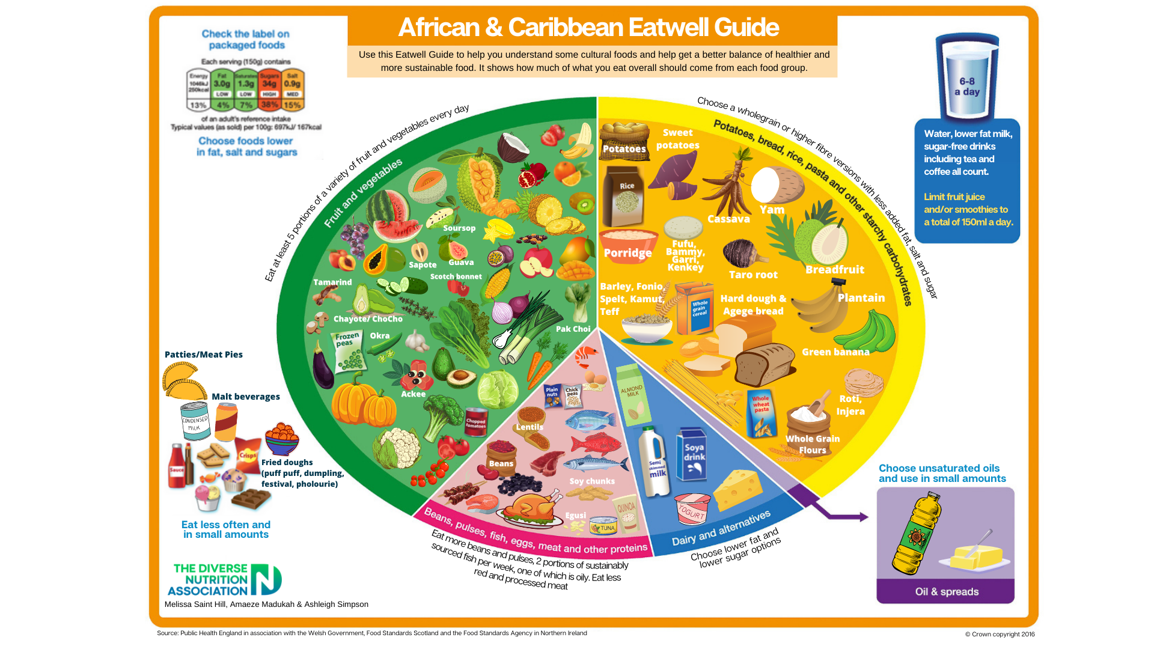
Culturally Competent EatWell Guide Resources
Working with the Diverse Nutrition Association, who developed the African & Caribbean Eatwell Guide, we are collaborating to develop a series of culturally competent versions of the EatWell Guide reflecting the diverse communities of commonwealth heritage.
These will be completed by the end of 2022 calendar year and further providers are been commissioned to support embedding and engagement activity to support them being utilised.

Slide 24
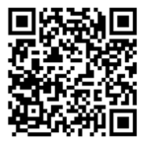

Cook the Commonwealth
Find the 72 communities here on Whisk
Inspiring everyone to get cooking, come together to share food, celebrate our diverse cultures, and to try new dishes.
Commonwealth country recipes :
  Simple meals that children could make
  Twists to introduce new flavours
  Inspiration for cook-off competitions with family and friends
  Dishes with minimal ingredients and equipment
All the recipes are available and free to download on the Whisk App, a recipe-sharing app which originated in the West Midlands. All you have to do is make a free account and simply search 'CWG' for hundreds of recipes for each Commonwealth country at your fingertips!
Please share on social media using #BLACHIR

Slide 25
Wider Determinants & Service Provision

Slide 26
Wider Determinants – Commission Model
Commissions are deeper explorations of inequalities in partnership with citizens with lived experience alongside the academic evidence base and focused on solutions and opportunities for action.
Focus explores in more depth the wider determinants and drivers of health inequalities and focuses more upstream and long term than other methodologies.
Two initial models:
  Birmingham & Lewisham African and Caribbean Health Inequalities Review
  Birmingham Poverty Truth Commission

Slide 27
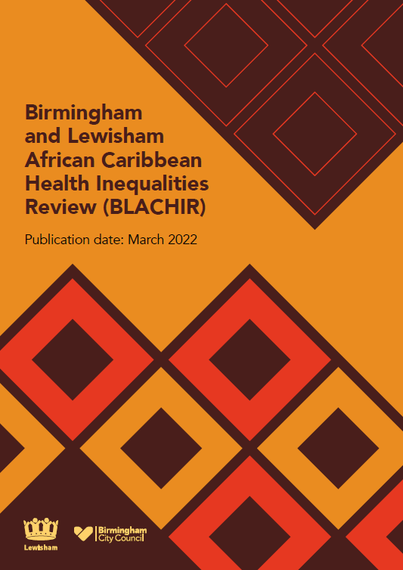
BLACHIR
2 years of activity
Hundreds of hours of work, engagement & collaboration
1 report
Many different futures…
Please share on social media using #BLACHIR

Slide 28


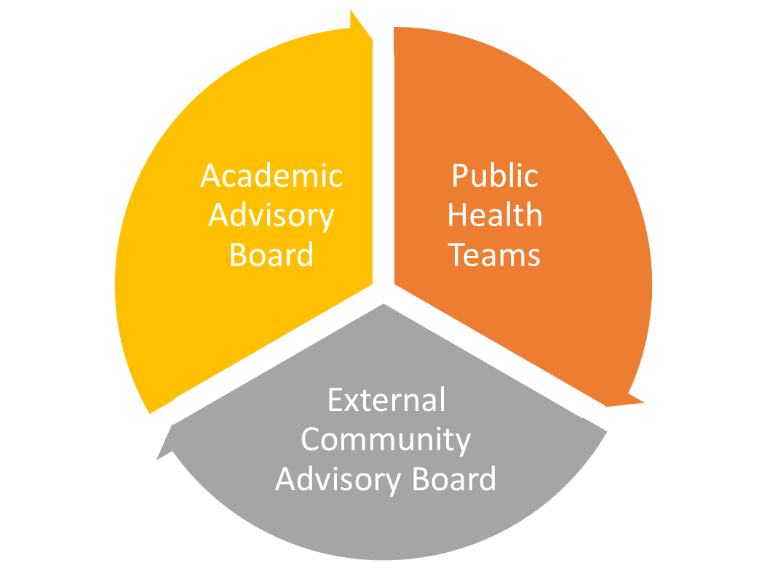
Background
Launched in 2020 as a partnership between Birmingham and Lewisham to explore and better understand the inequalities affecting African and Caribbean communities in our areas and co-produce with communities opportunities for action to break structural inequalities.
The Review was a new approach methodology working with an external community advisory board and an academic advisory board to develop recommended opportunities for action to achieve systemic change.
Please share on social media using #BLACHIR

Slide 29
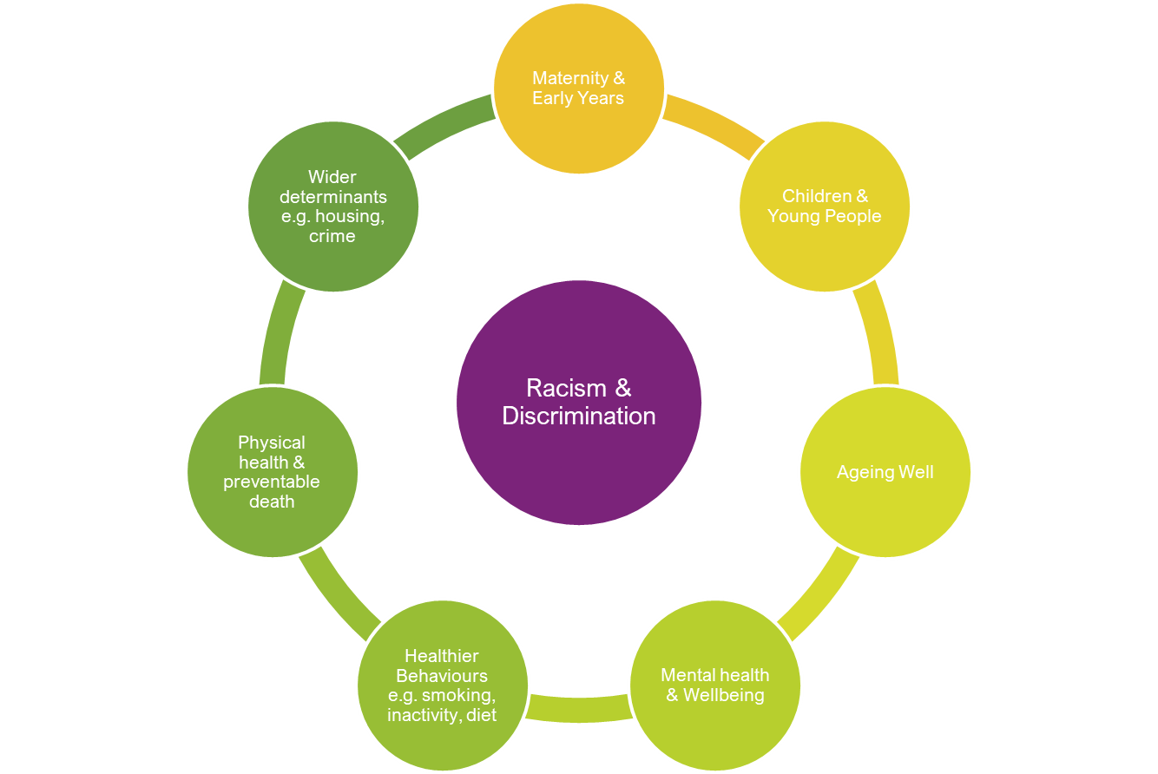
Thematic Exploration
A thematic approach was taken to considering the inequalities drawing on the life-course model and the recognised wider determinants of health.
For each theme there was a rapid evidence review, conducted either directly by one of the review teams or commissioned out. These were then discussed with the academic board to identify potential evidence-based recommendations that were then discussed with the community advisory board to reflect on lived experience and practical application.
Public consultation, which included workshops with young people, was also carried out to review the draft opportunities for action.
The review was completed on 31 January 2022 and the draft report was shared with and endorsed by the health and wellbeing boards in both localities in March 2022.
Please share on social media using #BLACHIR

Slide 30
7 key areas for action
Fairness, inclusion and respect
Trust and transparency
Better data
Early interventions
Health checks and campaigns
Healthier behaviours interventions
Health Literacy

Slide 31
39 Opportunities for Action
There are 39 opportunities for action across the eight themes. In some areas these opportunities are suggested as pilots of approaches as the evidence base and live experience supports action but there is limited evidence on effectiveness.
This reflects the lack of detailed and focused research into ethnic communities' specific needs and how best to respond to them. There is also an annex of recommendations for research questions that could help close some of these gaps for the future.
Please share on social media using #BLACHIR

Slide 32
Implementation Approach
BLACHIR Implementation Board being established and NHS ICS BLACHIR task force.
Engagement partners have been appointed to work with us and African, Caribbean communities and young Black men and young Black women.
Joint academic appointment with Newman university in memory of Dr Nicole Andrews.

Slide 33
Work focusing on provision
NHS Health Checks Population Health Management exploration of variation in uptake.
Maternity data deep dive linked to infant mortality programme leading to focused work with African and Caribbean women in West Midlands.

Slide 34

Key Learning
Diversity and inclusion is about us, not about ‘them’.
Layers of diversity and important, we must go beyond ‘BAME’ and ‘LGBT’ and ‘Disability’.
Engagement and active listening are key and take time and effort.
Work with others.
Don’t forget your own staff!

