Slide 1
First Contact Physiotherapy
Operational Case study
Bedfordshire MSK Service the story so far !!
Dr Simon Lowe MBChB, MRCGP, Dip Sports Med. Accredited GPwER
Ex-GP
Lead MSK Physician Circle Integrated Care
Tutor RCGP Joint injection course
Tutor Versus Arthritis Core Skills course

Slide 2
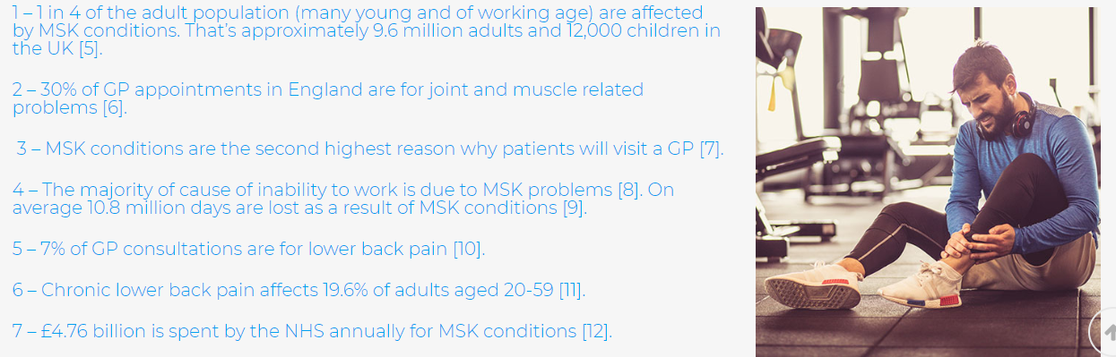
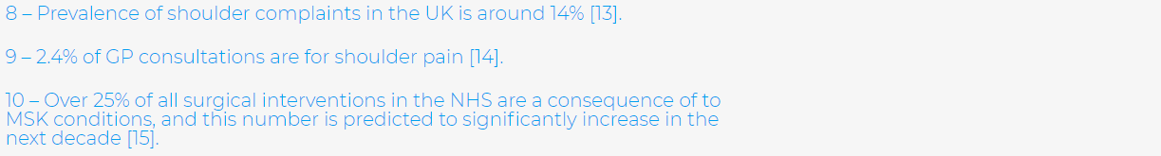
Why do we need to improve MSK services in Primary Care?

Slide 3
Quality of life is reduced more with an MSK problem than with any other long-term condition
0.9
0.79
0.68
No LTCs
LTCs (no MSK)
MSK (no other LTCs)
Low back pain is commonest cause of Disability 11% - 2010 survey
Quality of Life scores for GP Patient Survey respondents aged 45 and over, by type and composition of LTCs
Reference: ARUK ‘Musculoskeletal conditions and multimorbidity’.

Slide 4
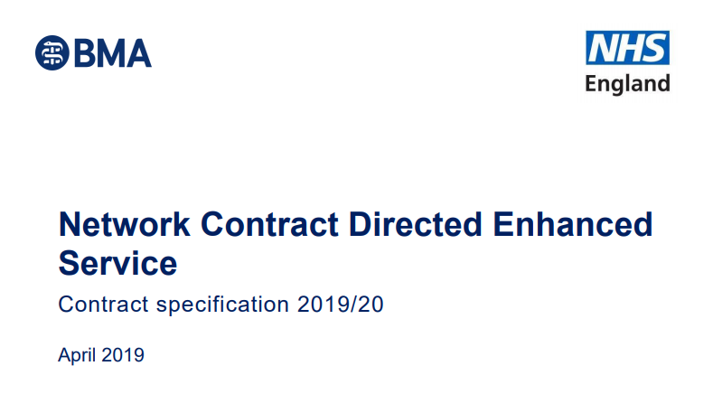
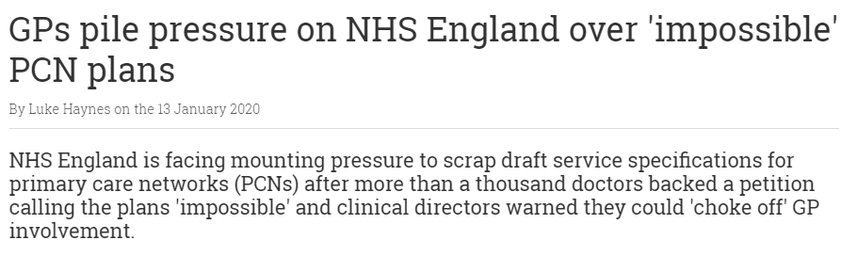
Reimbursement 70%/30% :
2019: Pharmacists and Social prescribers
2020: First Contact Physiotherapists, Physicians associates & Paramedics

Slide 5
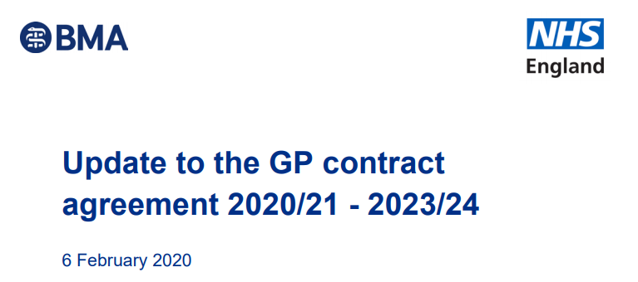
Change in funding to 100% reimbursement
Removal of contractual responsibility if scheme ceases
Addition of 7 additional roles; Pharmacy technicians , Care coordinators, Health coaches ,Dieticians, Podiatrists & OT (mental health professionals from april 21)
Funding 2020/21 100%
2020-21 7 FTE – ave £344,00
2023/24 20FTE – ave £1.13million
Enable them to build up the workforce they need
Different demographics may drive priorities in different areas

Slide 6
The National Agenda for FCP driven by……..
1 in 5 GP appointments involve MSK condition
Massive Shortage of GP’s
Need to expand the Primary Care team
FCP potentially gives speedier access to MSK assessment
Access to physical activity advice
Get It Right First Time
Some of the challenges!
Suggested 1 FCP per 10k population !!!
Not currently enough specialised Physiotherapists to meet need
Potential to create demand
Where is the evidence that reduces GP workload
Limited estates
Lack GP focus

Slide 7
Making the case!

Slide 8
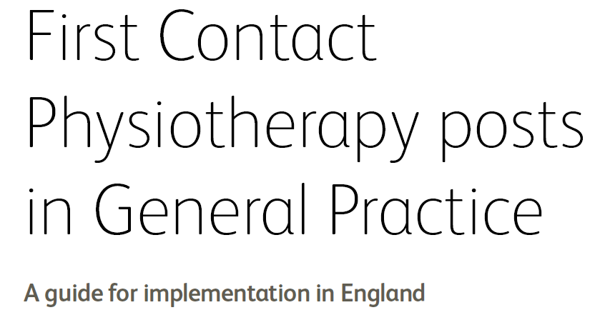

Introduction
“Physiotherapists providing a first point of contact service means that patients
presenting with a musculoskeletal (MSK) problem for a GP appointment are
offered an appointment with a physiotherapist instead. Physiotherapists
working in general practice are able to address the needs of a large proportion
of the patient population.(3) They have the clinical expertise and autonomy
to assess, diagnose and treat patients with a range of conditions.”

Slide 9
Need to demonstrate ?
1: Benefit to patient care
2: Reduced GP Workload

Slide 10
The role of the perfect FCP
Aim :
Improve patient pathway
  Shorter waiting times – MSK and non-MSK
  Better consultations !
  Resources , education events ,lifestyle interventions, mental health
  Identifying links with LTCs
Reduce GP workload
  Consultations often for several things
  Avoid reviewing with GPs
  ( de-skilling GPs)
Evidence based
  Ensuring FCP adequately trained eg: investigate appropriately
  Whose responsibility is the patient ?
  How do we prove benefit ?
  What criteria are we interested in ?

Slide 11
How do we ensure that providing FCP achieves aims?
Proving that FCP reduces GP workload
  Questionnaires to patients
  Review outcomes ( subjective)
GIRFT
  Avoiding duplication – appropriate triage incl FCP
Training needs of FCP
  Eg. rheumatology, CWP, imaging
Creating links with GP and allied staff so that FCP is value added
  Driving the development of good MSK Care
  Becoming an enthusiastic and valued member of PHCT
  Training AHP – minor illness , paramedics, physicians assistants
  MDT with GP complex cases –where is the time ?
  Taking a role in PHE exercise agenda
  Pushing the value of lifestyle interventions – PHE physical champion
  Patient education –resources , events
  Recognising that seeing patients all the time is not necessarily best use of time

Slide 12
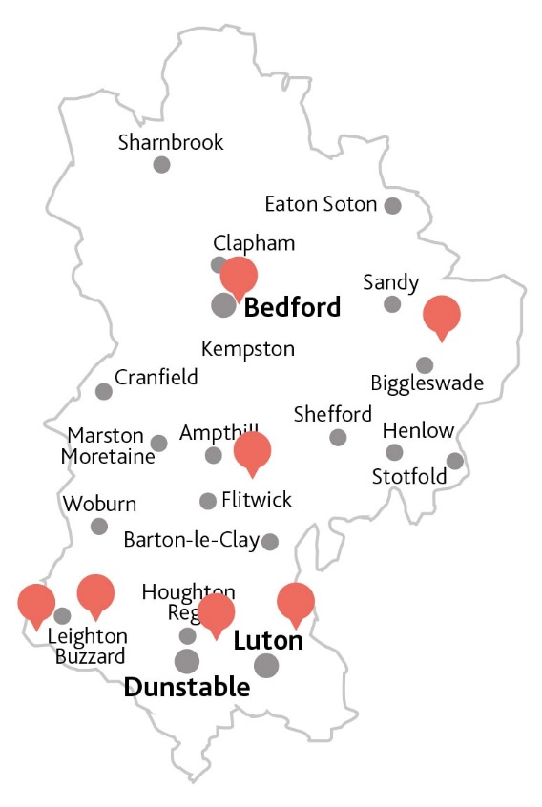
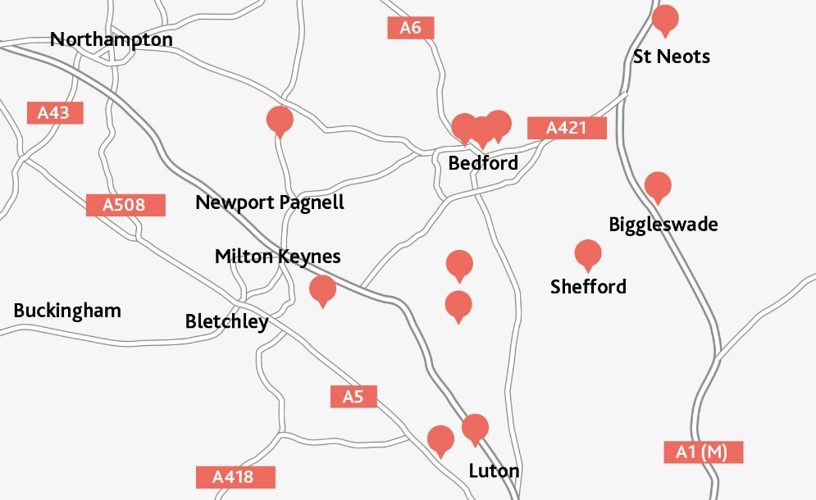
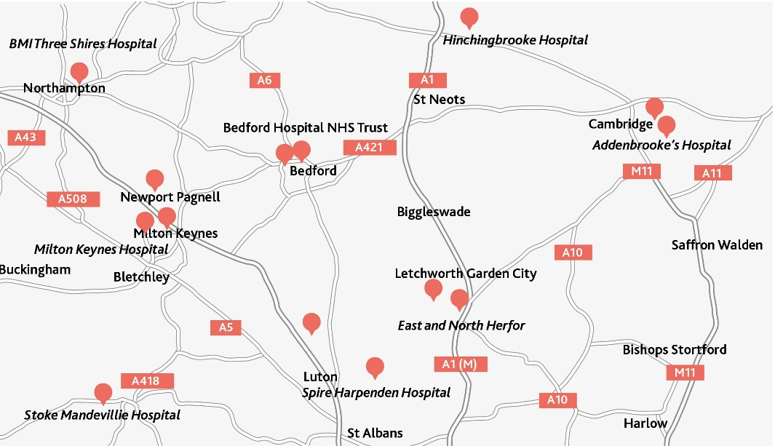
Bedfordshire MSK Service Experience
Community Activity
2016/17
9 Community hubs
13 Community Therapy locations
14 Secondary Care Providers

Slide 13
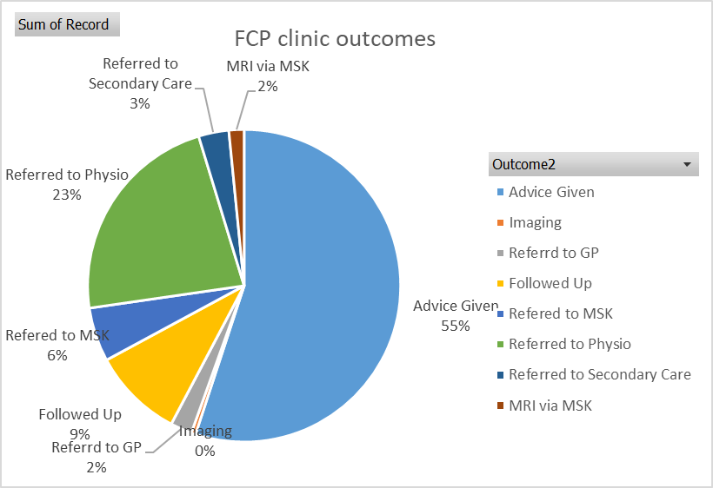
Pilot Outcomes
N= 447 Nov 2019- Bedfordshire FCP appointment outcomes

Slide 14
Bedfordshire MSK Service.
What are we doing to promote FCP model ?
contacting Clinical Directors /PCN Managers
arrange meetings with CDs
present proposal at Locality meetings
Offer one to one meetings to discuss individual PCN needs and challenges

Slide 15
Current MSK pathway
Patient presents in primary care
GP/ Nurse appointment
Advice
Medications
Time
Referral or self referral to MSK service
MSK Triage
MSK specialist knowledge
Physio
MSK clinic
Secondary care

Slide 16
Evolved MSK pathway
Patient presents in primary care
Receptionist screening
training
MSK specialist knowledge
GP
First contact Physiotherapist
Self referral
Other advanced practitioners eg nurse, paramedic
training
Lifestyle interventions
Self management resources
Education events
Referral or self referral to MSK service
Physio
MSK service
Secondary care

Slide 17
Thankyou
Any Questions , comments

Slide 18


