Slide 1


Innovating for increased visibility and opportunities in NMAHP Research
Linda Tinkler
Trust Lead for NMAHP Research
Newcastle upon Tyne Hospitals

Slide 2
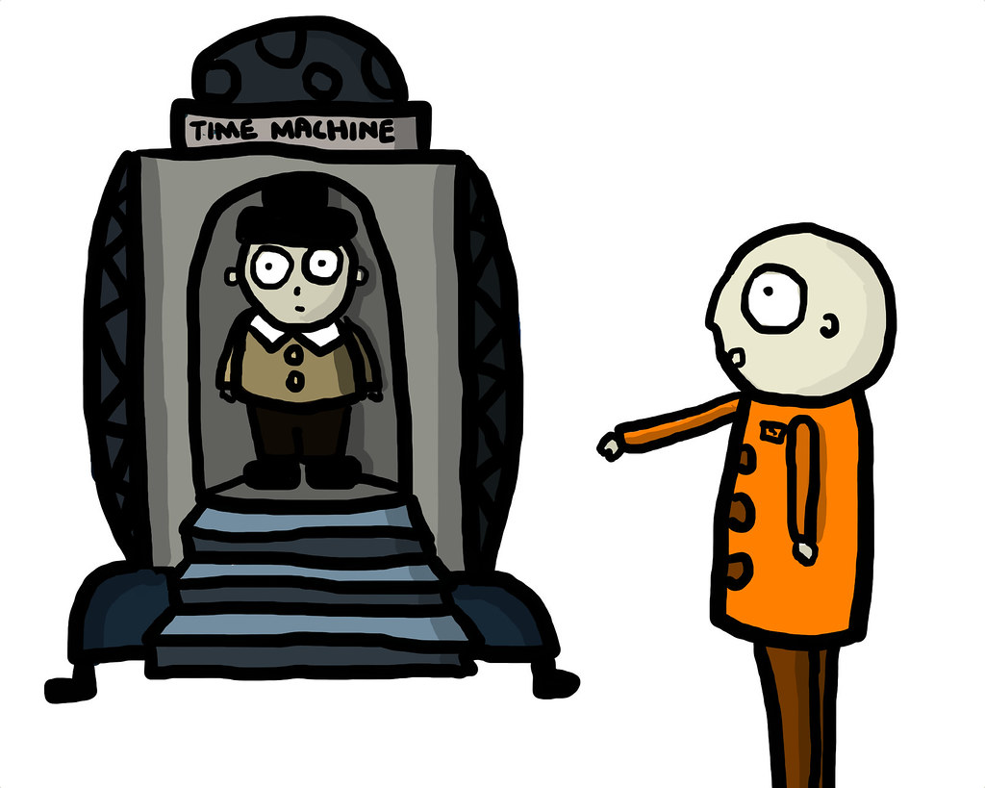


Slide 3


Slide 4
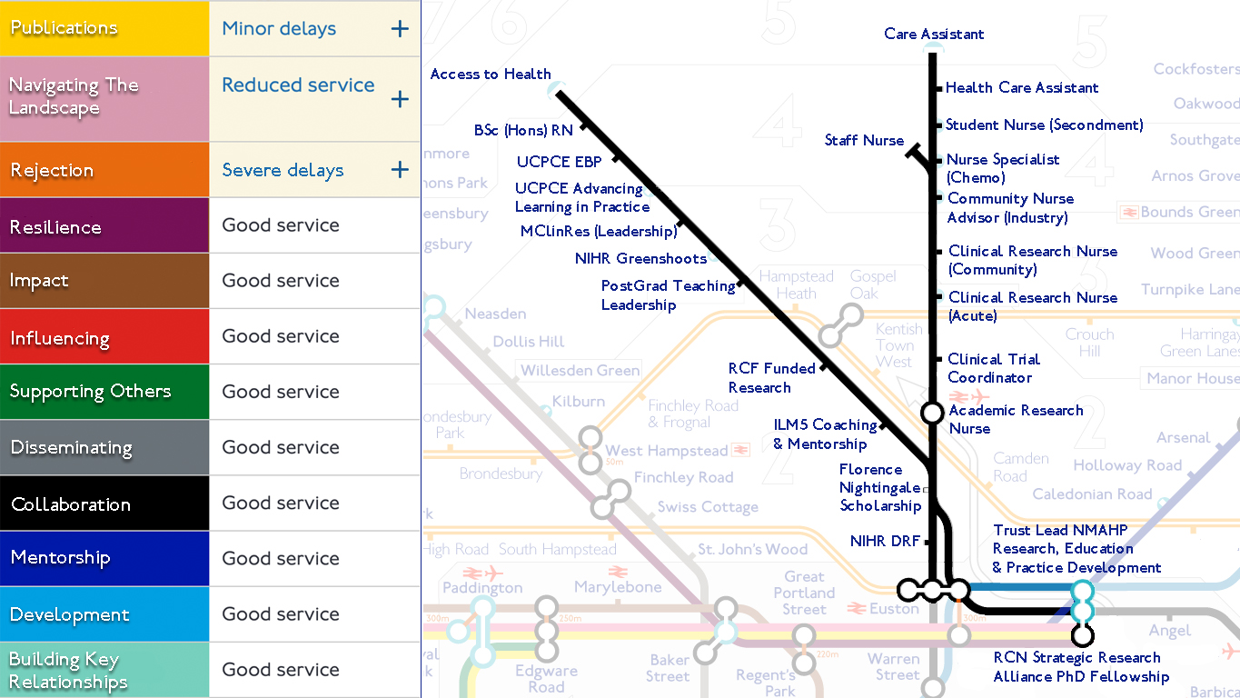

Slide 5

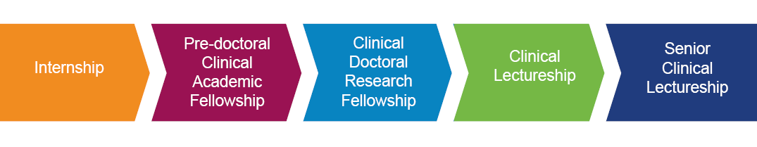

NIHR LCRN NENC Awareness of Clinical Research, Green Shoots, Leadership Pilot
HEE R&DNW Programme 2019
HEE/ICA North Pre-Doctoral
Bridging Scheme
Development & Skills Enhancement Award
HEE/ICA North Post-Doctoral Bridging Scheme
There are lots of other opportunities to….
NuTH Junior Research Internship
Chief Nurse Senior Research Fellowship
Notes:
My focus is on capacity and capability development in NMAHPs… what does that look like?

Slide 6


An introduction to George…
https://www.youtube.com/watch?v=6omlMJfDDdc

Slide 7

Dedicated and focused research capacity development for our Nurses, Midwives & Allied Health Professionals.....
#MakeSpace4Research
#OutstandingNewcastle

Slide 8


Spotting and sharing funding opportunities
Working with BRC
The 4 Ps Programme
Research Support clinics
Talent Spotting
PhD Support Group
Working with our NJRO
Mentorship
Working with our LCRN
#MakeSpace4Research
Collaboration with HEIs
Dedicated Strategy
Internships
YES! Early Research Support Group
Listening to our NMAHPs
One to One support
Supporting those coming along after us

Slide 9


Slide 10
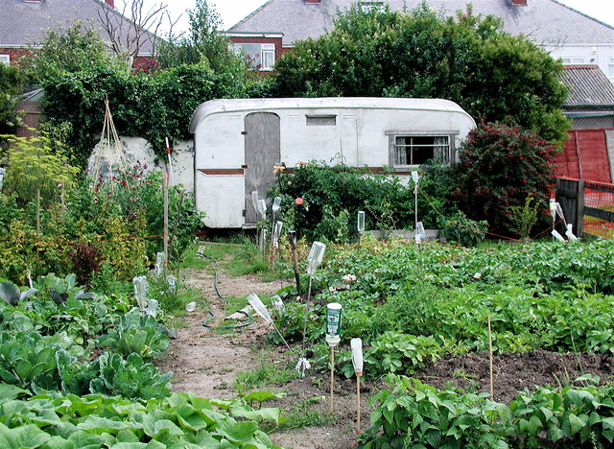

Slide 11

Next steps…
Think about the range of opportunities…
What can you do in your multiprofessional teams to support and develop each other?

Slide 12

Thanks for listening, please do not hesitate to get in touch and keep an eye out for opportunities…
Linda.tinkler@nhs.net
@TinkleLin

