Slide 1
Physiotherapists as First Contact Practitioners: An East Midlands Approach
Sarah Withers Head of FCP Implementation, CSP
@sarahwithers20

Slide 2
Opportunity

Slide 3
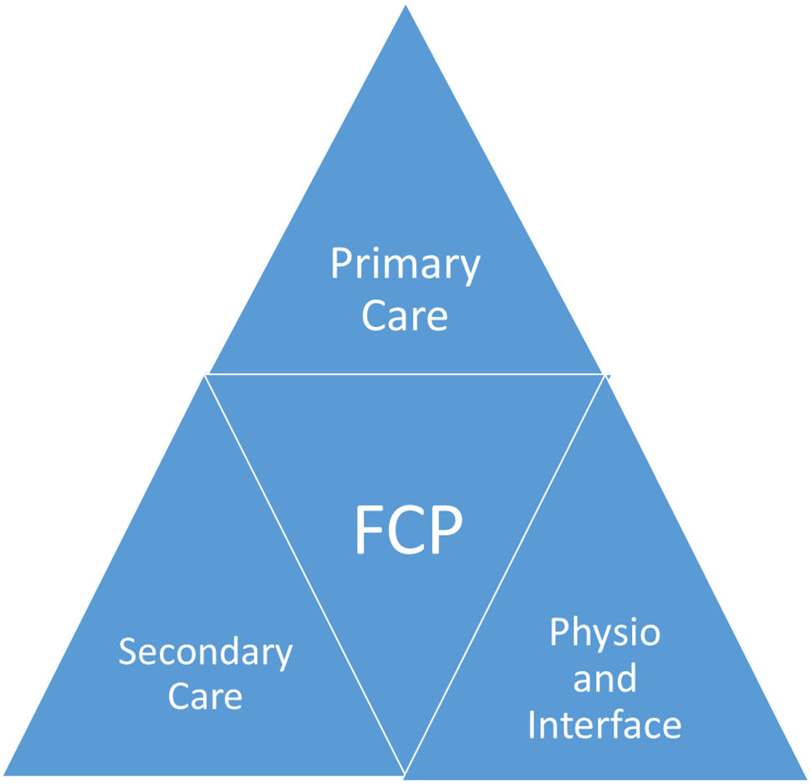
Areas of impact

Slide 4
Challenges
Implementation
Workforce and professional identity
Sustainable funding
Evaluation
Change

Slide 5
Effective-ness
Sustainability
Safety
Safety MSK skills
Resources
Concerns
Sustainability Funding
Future workforce
Effectiveness Patient & public expectations
Practice teams
Evaluation

Slide 6
Making changes
Start
Get involved – what’s needed
Tell the story – what and to who

Slide 7
Effective-ness
Sustainability
Safety
Shared protocols to support safe management of red flags and other serious findings that may require early intervention
Patient and practice information
Agreed procedures for: requesting and interpretation of imaging and other investigations, acting on results of investigations, injection therapy, independent prescribing, Patient Group or Patient Specific Directions
Format for clinic documentation, standardised examination tools, protocols for patient correspondence, communication with other services / stakeholders,
Procedures that ensure safety for all patients in respect of cover for annual, unexpected or sick leave i.e. to action results or follow up on urgent clinical matters
Set up for data collection to support service evaluation and audit
Regular mentorship for the FCP with a designated GP
FCP attendance at: GP meetings to discuss cases and share learning, MDT / pathway meetings to share and support system-wide learning
Appraisal and supervision meetings to enable goal and performance monitoring, peer supervision
Compliance with the MSK Core Capabilities Framework

Slide 8
Skills Building Knowledge Sharing
Common interests

Slide 10
Thank you for listening Enjoy the day
Join the discussion at www.csp.org.uk/icsp/fcp or email fcp@csp.org.uk

