Slide 1

What can the CSP do for you?
Leadership Development, Mentoring & Service Visits
Helen Sharma
Interim Head of Practice, CSP
@helensharmaPT
sharmah@csp.org.uk

Slide 2







Notes:
I have just stepped out of clinical practice. I worked for 16 years, acute Trusts, neurology.
Only once in 16 years did I interact with the CSP:
Change to contract – Trade Union
So I know how it feels to be stuck in all of this:
Increased demand
Budget constraints
Increased complexity
Workforce shortage
I think I engaged with this environment as well as I could. I drove quality improvement projects, coached and educated more junior staff and advocated for patients..
For me, what was missing was a clarity and confidence in my own leadership skills.

Slide 3
Leadership
This is a story about four people named Everybody, Somebody, Anybody and Nobody.
Change was needed and Everybody was sure that Somebody would do it.
Anybody could have started it, but Nobody did it.
Somebody got angry about that, because it was Everybody’s responsibility.
Everybody thought Anybody could do it, but Nobody realised that Somebody wouldn’t do it.
It ended up that Everybody blamed Somebody when Nobody did what Anybody could have.
Notes:
Leadership is and has been a very hot topic in the NHS. Why? Much to do with high profile failures of care where leadership (managerial and clinical) was very clearly lacking. E.g. Mid-staffs
Also to do with the pressing need for change and transformation of healthcare due to changing population demographics and finite resources.
But how often in our busy clinics do we see this……………………
For me, the key character in this is ANYBODY – Anybody can take the lead and anybody can make a change.
So, contrast that apathetical quote with this…..

Slide 4

Leadership…
… is the capacity to influence others through inspiration motivated by passion, generated by vision, produced by a conviction, ignited by a purpose.
^{Munroe, 2005}
Notes:
Leaders are people who make things happen. They are passionate about what they do.
Leaders persuade people to change the way they do things to benefit the patients that they treat/colleagues that you represent.
They care not only about the cause for which they are working, but also the other people who are involved in the effort. Passion for the work, for the team and for the patients are key to successful leadership in health and social care.
Leadership is about influencing:
Excellent influencing skills require a combination of communication, presentation and assertiveness techniques. It is about modifying your personal style and being aware of the effect you are having on other people.
Influencing is about being able to move things forward, without pushing, forcing, or telling others what to do. It is about having the confidence and willingness to use your skills to make things happen.

Slide 5
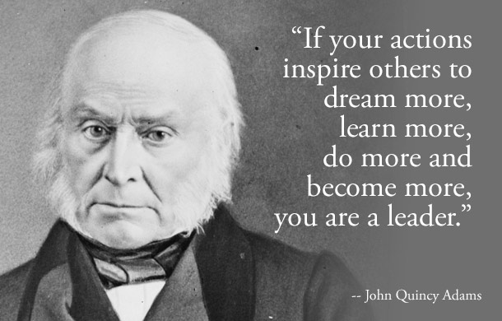

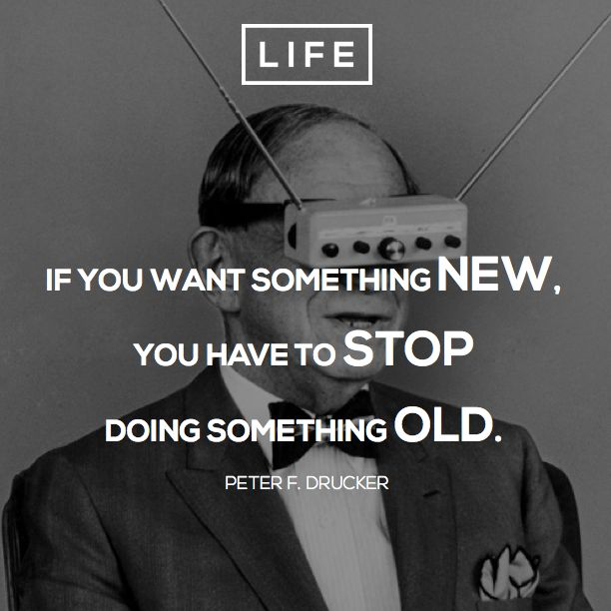
Inspire, Innovate, Impact
Notes:
So, thinking about my favourite character again - ANYBODY
This is NOT about salary or position, but about influence and impact
About doing the right thing, for the greater good, and leading by example
It takes courage
Leaders inspire people to follow, to innovate and to perform at a higher level
So, what tools do the CSP have to help you?

Slide 6
Leadership Development Programme
Workforce Development
Mentoring
scheme
CPD
Notes:
Today, I’ve been asked to specifically tell you about our Leadership Development Programme and also our Mentoring Scheme.
But, we have vast resources and bodies of work continuing in workforce development and CPD which also touch on Leadership.
Evolution in training – new models of training and education being developed, fit for future purposes and workforce / skills shortages.
Apprenticeships
Advanced Clinical Practitioner
experienced clinicians - supported by employer
ACP as an occupational role - knowledge, skills and behaviours include clinical practice, management and leadership, education and research
structured, supported development route into an advanced practice role, funded by their employer
underpinned by MSc in Advanced Clinical Practice
enables clinicians to undertake a Master’s degree part-time while practicing
minimum of 20% off-the-job learning from a full-time job role
end-point assessment - 20 credits
Advanced Practitioner
Consultant Practitioner

Slide 7
Leadership
Insight
Member Insight to understand perceptions of leadership
Perceptions?
Lack of training opportunities
Asks?
Bespoke leadership training for physiotherapists
Medical/nursing dominance of roles
Mentoring opportunities
Notes:
These two things came about through a piece of work with members several years ago.
Many other professions are represented in leadership roles where physiotherapists are not always present. Why?
The CSP conducted member insight work to further understand members’ perceptions of leadership.
We found:
Members valued the impact of effective leadership on their team and patients
Key barriers to more physio leaders include traditional structures and roles – including the medical and nursing dominance in health care leadership
Members felt there were fewer training opportunities in the current economic climate
Members wanted leadership development that was unique to physiotherapy

Slide 8

CSP Mentoring Scheme
Online platform
‘A one-to-one, non-judgemental relationship in which an individual mentor voluntarily gives time to support and encourage another. This relationship is typically developed at a time of transition in the mentee’s life, and lasts for a significant and sustained period of time’. (Home Office, Active Community Unit, 2001)
Notes:
So the mentoring scheme. This is an online platform where you can access a mentor or become one yourself. It is a particularly important tool for aspiring leaders or those in leadership positions.
It’s great if you are at the point in your career where you need some support from someone who is ahead of you in the challenge; to help you grow and show what’s ahead and how to deal with it.
But why is this good as opposed to your line manager, colleagues or formal appraisal process?

Slide 9

CSP Mentoring Scheme
Mentorship is holistic
Mentorship is individual
‘It is a two-way relationship that results in mutual learning’ (Guest, 2000).
Notes:
The difference between a mentoring relationship and a coaching-style relationship that you may have at work is that:
Mentorship is holistic – you are not working to tightly-focused goals, like during your appraisal and objective-setting. It’s about support, advice and encouragement to you as a person.
Mentorship is individual – you do not have to consider your Trust, department or team objectives in the process of your development.
Mentor – Make a positive difference, build your own leadership skills, expand your networks & ideas, learn from each other.

Slide 10

CSP Leadership Development Programme
University of Hertfordshire
University of Central Lancashire
Online application
48 places fully funded, part-funding available
  CSP Member
  HCPC registered
  Band 6 or 7
  Working in any sector
  An aspiring/future leader

Slide 11
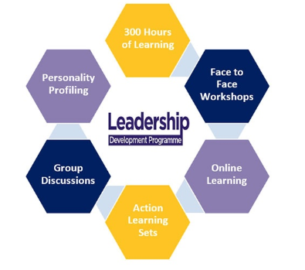
CSP Leadership Development Programme
M Level 30 credits
Over 2 semesters
Viva and Service Improvement Project
Leadership in context
Leading others
Leading services
Leading for impact (UH content)

Slide 12
Service
Visits
Notes:
But what if you want to just dip your toe in what the CSP has to offer?
What if you just want to meet us, look at opportunities and have a discussion?
We have a team of professional advisers who will come and see you where you are – anywhere.

Slide 13
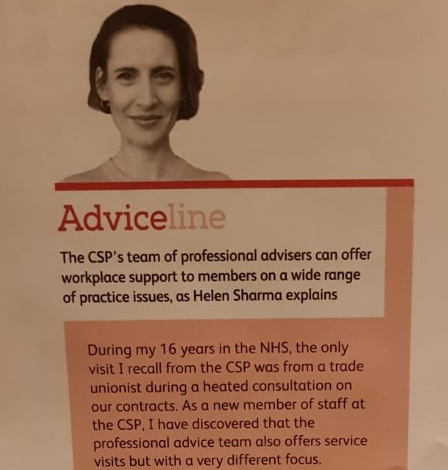
Service Visits
Developing relationships & support networks
Showcasing practice
Support for projects or change
CPD opportunity
The bigger picture……..
Notes:
Last year, when I started at the CSP I wrote a short piece for Frontline about this because I thought it was such a fantastic service, but one that I had no idea about.
I have now done several visits myself and can see the benefits from both sides.
For you:
Get a face and a name at the CSP (friendly, want to help, want to listen, not London-centric)
Develop a relationship so you can more clearly understand what the CSP has to offer for you as an individual, service or region
If you have a new or innovative service, something you are really proud of, we can help showcase this.
If you are struggling with managing change, starting or progressing a project – we can help troubleshoot
But this isn’t all. In engaging with us in this way, you are contributing to the bigger picture.

Slide 14

Service visits
Ensures CSP is not detached from practice
Shaping our organisation – we need to be relevant
Builds networks to inform current work programmes
Supporting influencing at local level
Notes:
Healthcare is moving at an incredibly fast pace and we as your professional body need to constantly check-in and verify with our members. We need to make sure that the idea of how it is in practice is actually the reality. Also, although we have some physiotherapists on the staff team and some who still practice, it is impossible to represent all the clinical specialities and all the regions of the UK internally. We therefore need to have contact with members to understand issues on the ground and make sure we are as relevant as we can be across the board.
A service visit also enables us to make a contact, beyond the membership number and email we hold for you in our data system. It helps us to build a network of clinicians who can help us inform the work we do and who can influence at a local level.
Examples

Slide 15
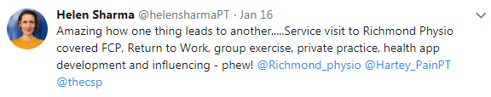
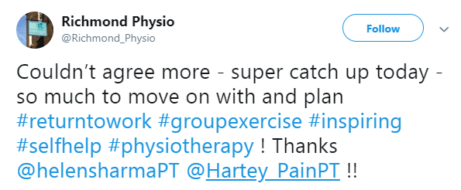
Service visits
Notes:
Farnham integrated care centre
Service visit was to collect information to write a case study on their First Contact Physio service to use as an example of good practice for our work on FCP with NHS England
Outcome – achieved, but also learnt about how the experience that the service lead had with approaching and influencing her CCG. She volunteered to be a contact for other services who need to know how to go about this. This has benefits for other members.
2) Richmond Physiotherapy
Service visit asked for to inform them about AHP Fit Note. This was done, but they also wanted to know about all these other things which we were able to discuss, signpost and give practical advice. Response was very positive.

Slide 16
^{www.csp.org.uk}

