Slide 1

The CSP’s Mission
^{Alex MacKenzie}
^{Chair of Council,}
The Chartered Society of Physiotherapy
^{Twitter: @AlexMacKenzie11}

Slide 2
Notes:
The CSP strategy has been developed to tackle these challenges. Our profession, thanks to its depth and versatility can transform the health and wellbeing of individuals and communities.
I also want to make clear that whilst I have focused here on the NHS, that the CSP is looking at healthcare in its widest settings and supports members wherever they work.
These are powerful statements. I was at a Physio event a couple of months ago, when Karen Middleton spoke about our mission and vision and there was a former patient there who spoke after Karen who said of the physios who had treated her, you transformed my life. So remember whilst it is written as a vision here, when you are working, that is what you are doing, transforming lives, maximising independence and empowering patients and populations
The start for the CSP strategy was:
CSP mission
Vision for Physiotherapy
Environmental analysis
As I was putting together this presentation, I was looking at a couple of talks I gave before Christmas about the work and direction of the CSP. We have been clear about our priorities, which I will talk about later, and it is vindication to see many of them born out in the NHS Long Term Plan

Slide 3

NHS England Long Term Plan - seizing the opportunity
Commitments for more physiotherapists working as FCPs and in primary care
Funded expansion of community multidisciplinary teams
Improved access to postnatal PT; more therapists at the start of acute pathways.
Notes:
NHS England’s long term plan – published January 2019 – places much clearer transformational focus on prevention and rehabilitation, with the physiotherapy workforce already considered a priority in delivering this
Contains an endorsement of the the FCP model, which I will talk about more in a moment,as part of new vision for integrated primary and community services, and a commitment to implementation beyond the existing pilots
Also within this vision, integrated community hubs, with physiotherapy workforce part of MDTs and in primary care networks servicing populations of 30-50,000: including in FCP roles and rapid response teams
Not all about primary and community care:
improve access to postnatal physiotherapy;
more therapy teams at the start of acute hospital pathways to reduce Delayed Transfers of Care;
promotion of self-care and –prevention through face to face and digital support;
promotion of rehab in all mayor condition pathways, and
testing and learning’ from generalist rehab for multiple conditions/morbidities
If we are talking about CSP influence, I think this is a great example. We have shown the impact of Physiotherapy and this has been recognized in this plan. It is no longer all about Doctors and nurses
However concerns about funding and workforce availability threaten the delivery of the plan’s vision. With all trusts expected to be in the black by 2021, Questions are being asked about - are the transformational changes feasible? Other areas of concern: lack of consideration of support workers; low profile of MSK in long term plan.
Next steps
NHS England and stakeholders developing a national workforce implementation strategy – CSP making the case for how to make the most out of physio professions’ expanding numbers.
NHS England expects each NHS organization and Sustainability and Transformation Partnership area to develop local implementation plans for 2019/20 by April 2019; with 5 year system implementation plans expected of STPs by Autumn 2019
{ONCE resources/strategy for CSP to support members in local implementation is developed – enter details here}

Slide 4

Where the profession is heading
We aim to position physiotherapy at the leading edge of transforming the delivery of health and social care throughout the UK.
Notes:
What is the Physio Offer? What can we show?
Increasing resilience
Reducing dependence
Expediting Care
Sharing Skills
The new LTP will see even greater emphasis on integrating care, creating sustainable systems (productivity) and asking professionals to work towards the top of their licence whilst shaping the role of others in support of that (e.g. support workers, carers, voluntary sector, community organisations). This will require new ways of working.
As a profession we need to ready for this taking on new roles,
Across the UK there are New and emerging educational route pre-grad and post grad including
Apprenticeships
Advanced Clinical Practitioner
Advanced Practitioner
Consultant practitioner
Also needto consider where we should physically be delivering services – transition towards care closer to home and away from hospital focused care.

Slide 5
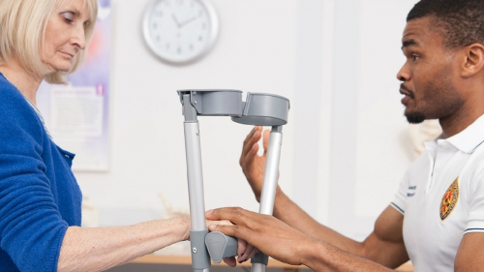
Being the first contact for individuals
First Contact Practitioners: Physiotherapists providing a first point of contact service in general practice in the community.
Notes:
This is a focus for the CSP
Physiotherapists have had a role in general practice since 1938. So, in a way, this isn’t new.
With an ageing population and increase in the numbers of people with multiple morbidities, the pressure and demands on primary care will continue to rise. GP surgeries now make 370 million consultations every year; 70 million more than five years ago. Despite this, GP numbers have remained relatively static during that time, if not decreased.
Physiotherapists providing a first point of contact service means that patients presenting with a musculoskeletal problem for a GP appointment are offered an appointment with a physiotherapist instead. Physiotherapists working in general practice are able to address the needs of a large proportion of the patient population.
They have the clinical expertise and autonomy to assess, diagnose and treat patients with a range of conditions, at this time we are focusing on the MSK, conditions. It has been estimated that MSK conditions alone account for around one in five GP appointments.
There are a range of case study on the CSP website
This is therefore an opportunity for physiotherapy services to support GPs and to build capacity and diversity in the primary care workforce through increasing physiotherapy roles in general practice settings.
We have been asked before if we are doing this to alleviate the GP crisis and the answer is no, we are doing this because it is the right thing to do. However, the timing with the GP crisis means people are listening to us, which is clear from the LTP and accept the business case FCP presents

Slide 6
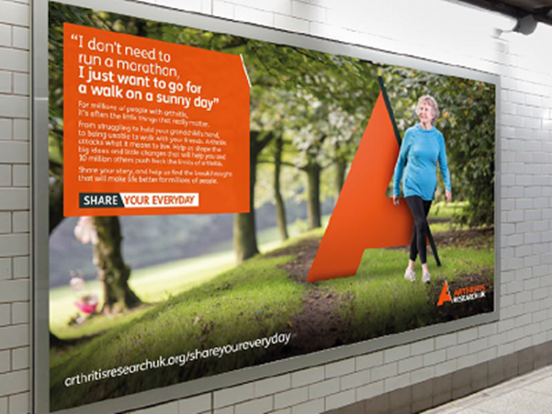
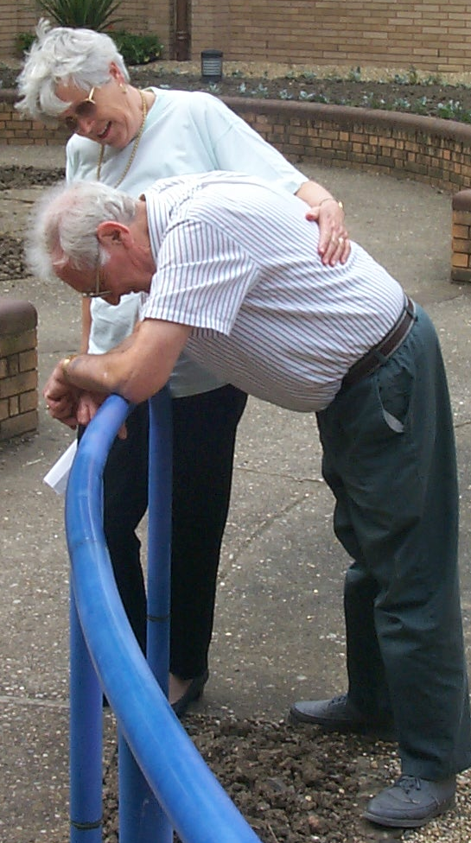
New models of community rehab
Supporting people to remain independent in the community #RehabMatters
Notes:
Rehab Matters campaign launched in 2017…
We know community services are chronically underfunded – Cinderella service
We also know with an aging population who have co-morbidities we need to do things differently.
We know rehabilitation works….we have the evidence;
People with COPD who attend pulmonary rehab classes spend 50% less time in hospital, and are 26% less likely to be readmitted
Physiotherapy group exercise reduces falls by 29% and individual exercise programmes by 32% among older people at risk of falling
Exercise can cut deaths from bowel cancer by 50% and reduce progression of prostate cancer by 57%
BUT we also know
60% of all the patients who NICE say should be in pulmonary rehab are never referred
45% of people who have had a stroke feel abandoned when they leave hospital
50% of people who have had a hip fracture are not offered rehab when they leave hospital and if they are, most wait for over four weeks
Clearly we need to rethink our offer and perhaps move away from rehab programmes that are condition specific to a model that reflects our aging population who rarely present with only one LTC. For most people with LTCs, life can be a spiral of increasing disability. A classic example of this would be combining pulmonary and cardiac rehab. Interestingly, The condition specific charities are also starting to talk in terms of more generalist programmes.
It is also about supporting the 3rd sector to continue working with these people after they have left the Physio service. We should not be precious about holding onto our patients when we cannot continue to see them indefinitely. Gyms would love to tap into the older people market. There are some projects around the country that are starting to house Primary care services within purpose built gyms and swimming pools complexes allowing patients to start their initial exercises with a physio, but to progress onto self management.
Physiotherapy has a key role to play in keeping people active and making sure we add life to years. As yet however what we are not great at yet as a society is following through and putting the same energy and focus into the business of recovery & rehabilitation, and prevention throughout our lives. This is what matters to people when they leave hospital; getting their lives back, getting mobile again, regaining the abilities to do things as they did before, and if working age getting back to work. These are fundamental and should be a fundamental focus of the healthcare system. This is what physiotherapy is all about.

Slide 7
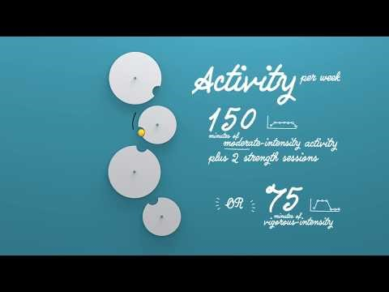

Involvement in public health
Physical inactivity is a major public health problem and something that CSP members want to tackle through a new campaign, ‘Love activity, Hate exercise?’
Notes:
When we talk about empowering populations, Public Health is a key target area.
Important benefits are emerging for public patient engagement, health promotion and advocacy using social medial channels.
Physical inactivity is a major public health problem and something that CSP members want to tackle through the campaign, ‘Love activity, Hate exercise?’ launched in July last year. I know not every Physio felt this was the appropriate title for a campaign by the CSP, however,
The campaign draws on insight from patients and members across the physiotherapy profession. This included physiotherapists with expertise in physical activity and behaviour change, to help identify the barriers that prevent patients from becoming more active.
As healthcare professionals, physiotherapy staff have an important role to play in promoting physical activity. We want to help you maximise these opportunities to discuss the benefits of physical activity and any barriers to it, so that exercise becomes more accessible to a wider range of people in your communities.
**This slide has an embedded #LoveActivty video**

Slide 8
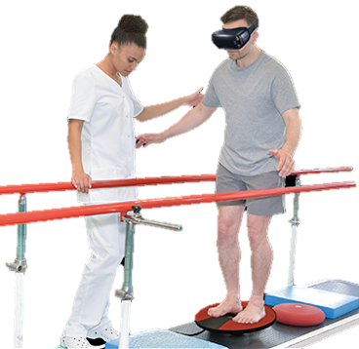
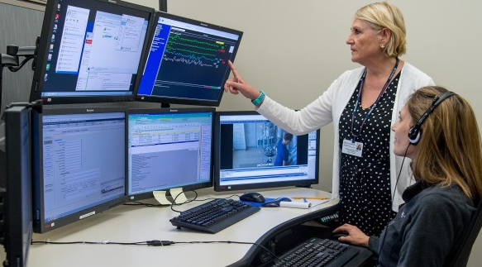
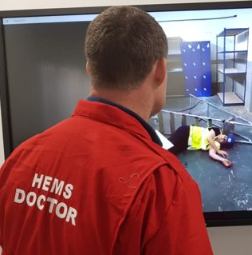

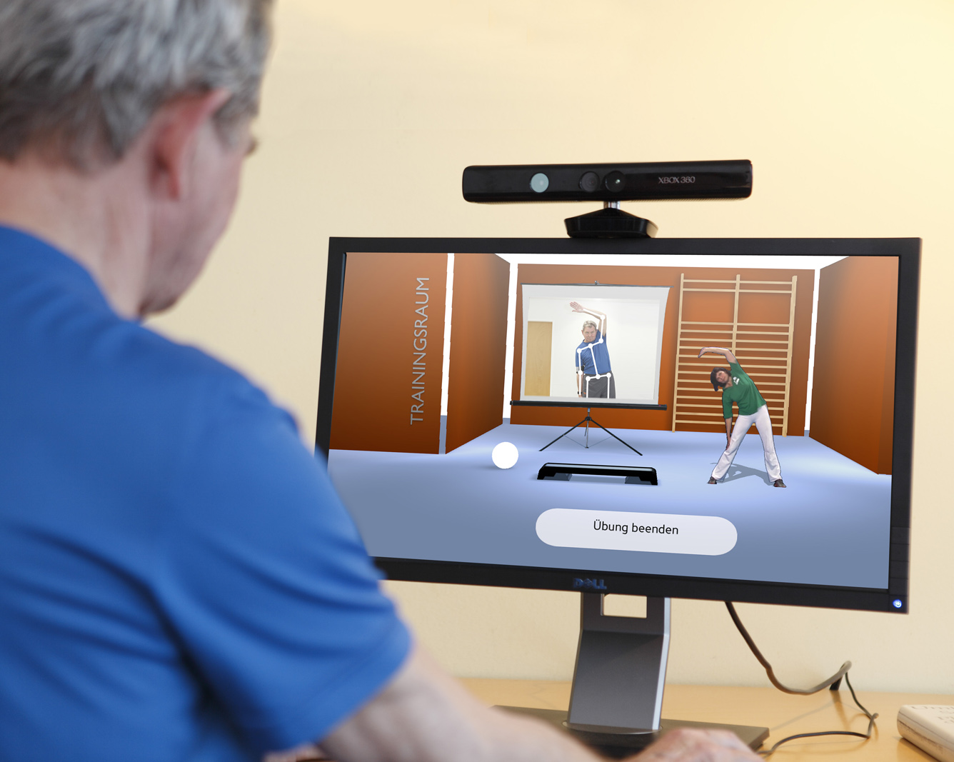
‘Teched up’ practice
The digital trends of connectivity, mobility and big data will impact health and social care and present new
opportunities for public physiotherapy provision & increased service accessibility in the community.
Notes:
We are now becoming more digitally connected.
Advances in digital technology within health organisations will create new ways for public physiotherapy services to deliver care and provide opportunities for greater collaboration between physiotherapists and other health professionals. Digital technology will provide an important platform for greater dialogue with the community that ultimately supports improved services.
Sustainability:
New digitally-enabled public physiotherapy will be particularly important to smaller, more local practice. The sustainability of smaller services will depend on maximising the potential of e-Health services to improve patient care, connecting the workforce with online professional support and development, and using technology to achieve greater efficiencies of service delivery. This can be particularly important in remote and rural areas, where they are often leading the way through necessity and we can learn from them.
Big data:
Public healthcare services will increasingly have access to insights made possible by ‘big data’ analysis. This analysis will bring together data from various sources such as state health systems, and healthcare organisations to inform the planning, delivery and evaluation of public health services. These new insights will influence how, where and to whom public physiotherapy services are provided.
Connectivity and mobility:
The ‘internet of things’ will offer ever more opportunities for collaboration amongst health professionals and engagement with patients. Physiotherapists will have the capacity to deliver public health services well beyond the walls of their physical facilities through mobile devices and video conferencing technology.

Slide 9

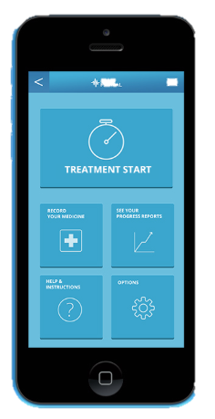
Proactive Intervention
The emergence of personalised medicine may create entirely new
areas of practice for physiotherapy services focused on prevention and early intervention.
Notes:
The growing influence of digitally connected, personal health devices and apps will create new opportunities for people to be engaged with their own health. Patients will be in the position to provide more detailed information to inform their decision-making and treatment options. Likewise, physiotherapists will be able to effectively track and monitor patient progress in real-time.
People can now buy DNA kits and send a sample of their genetic material away to get a report on their genetic profile, some of these services can include the likelihood of developing some conditions. Personalised approaches to care based upon an understanding of the patient’s genetic profile and responses is now possible.
The physiotherapy profession, along with many other medical groups, needs to act now to determine how the future of the profession can adapt to this new wave of personalised, genomic medicine.
Understanding genetic mechanisms involved in aging or disease through interventions such as physical exercise may open entirely new avenues or perspectives on protocols for prevention or management of common chronic conditions.
Physiotherapists already play an important role in the prevention and rehabilitation of many common diseases and disorders, and through genomics we can address the factors associated with non-communicable diseases with person-centred health service delivery in the community.

Slide 10
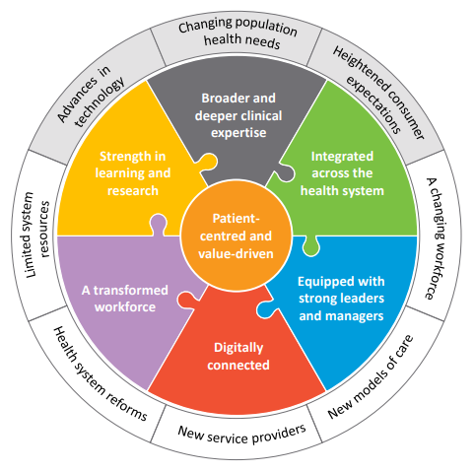
Change is only constant
The most difficult thing is the decision to act, the rest is merely tenacity. The fears are paper tigers. You can do anything you decide to do. You can act to change and control your life; and the procedure, the process is its own reward.
^{Earhart, 1936}
Notes:
Humans, by our very nature are creatures of habit, and as a result, change does not always happen naturally, or indeed, easily.
A changing NHS, and overall health and social care, will impact the diverse range of public physiotherapy services in different ways. We need to adapt in order to future proof physiotherapy for future generations of physiotherapists. We need to direct the change and not have it imposed upon us.
It’s easy to speak out, but it takes action to roll up your sleeves to change the ending to the story/narrative.
Dynamic healthcare will require physiotherapy services to be agile and responsive to changing circumstances.

Slide 11



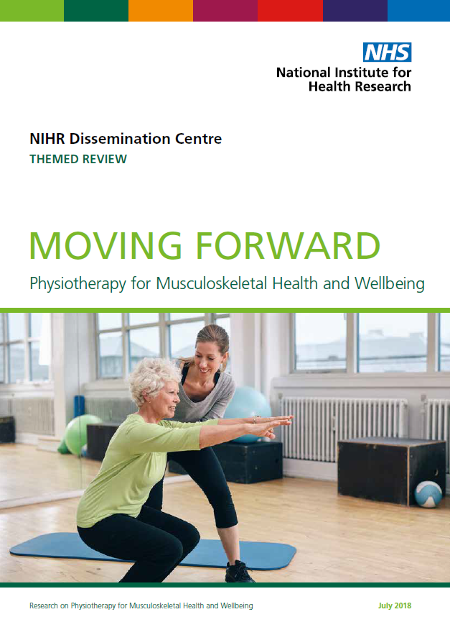

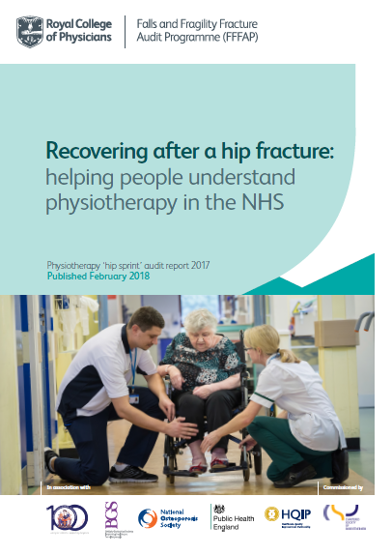
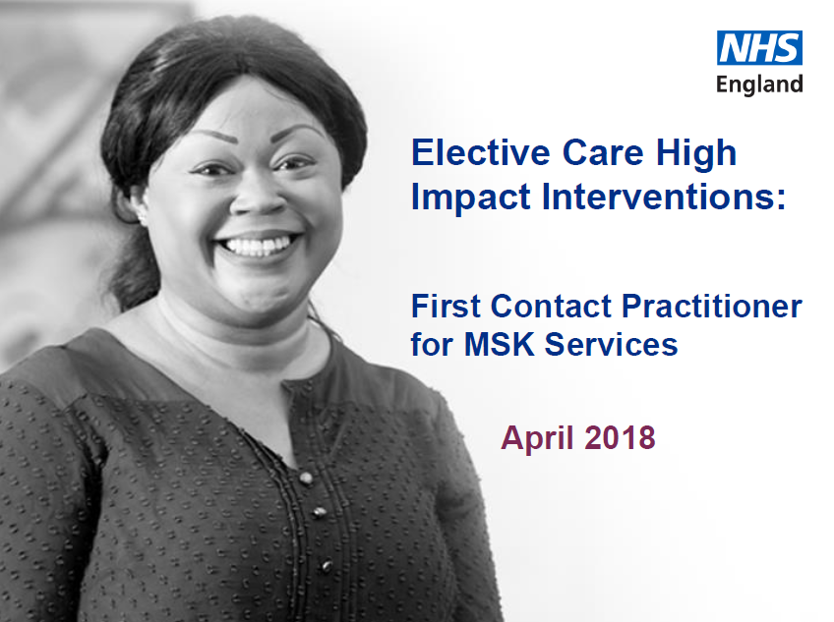
NIHR Signal: Exercise therapy may still improve balance when started a long time after a stroke
RIGHT EVIDENCE, BETTER DECISIONS
Notes:
These are some of the outputs of the teams working to bring evidence into practice
Moving Forward – is a collaboration with NIHR, and of high quality MSK research. We have now started a number of projects to improve dissemination and a focus on implemenation
Partnership with NIHR continues in promoting the support offered to members from the NIHR physiotherapy advocates to move into clinical academic careers. Also arrangements with Frontline mean a monthly ‘research findings’ feature .
Hipsprint – the largest audit of physiotherapy practice in England and Wales; 80% of eligible patients participated. This was in the absence of specific research evidence for dosage and response – and as part of the quality assurance work of the NHFD, CSP partnered with RCP in the hipsprint.
Report a number of key recommendations which have been developed into seven standards – these were launched at PUK last year.
CAHPR - enables Members to access events/support/advice with research via their local hub (UK wide), including resources such as 13 top tips on research topics.

Slide 12
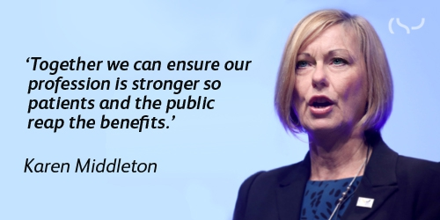
Notes:
Remember, when you talk about ‘The CSP’, you are talking about yourselves.
The employees of the CSP are just over 100. They do work hard for us.
But we have 57,000 members. If we all pull together, we are a force to be reckoned with. We can be the change and we can be the solution

Slide 13

Any Questions

Slide 14
^{www.csp.org.uk}

