Slide 1
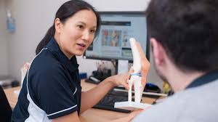
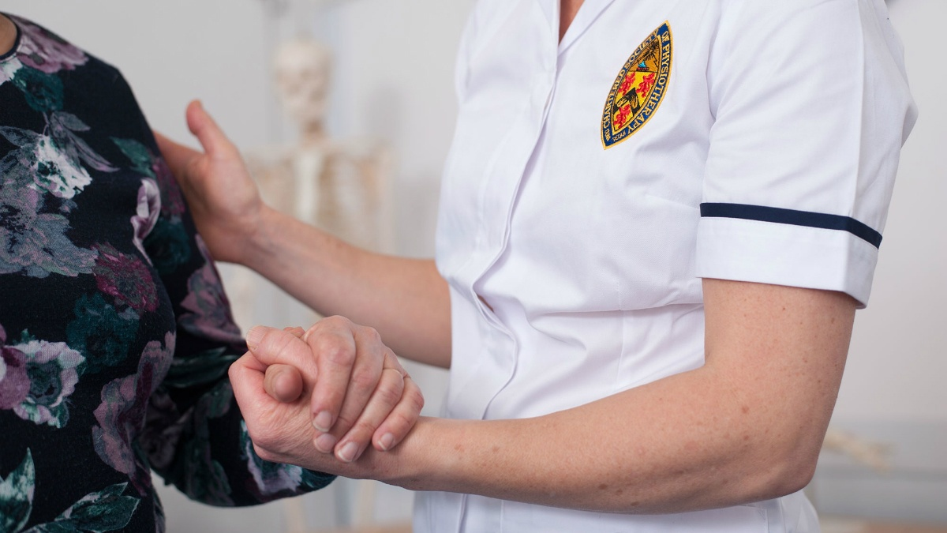


First Contact Physiotherapy
Megan Alden, MCSP, Transformation Manager, January 2019
NORTHAMPTONSHIRE HEALTHCARE NHS FOUNDATION TRUST
#weareNHFT

Slide 2
Agenda
Background
Drivers for change
The Proposal
SAF Assessment
The Service Model
The Pathway
Care Navigation
Evaluation
Implementation
Questions

Slide 3
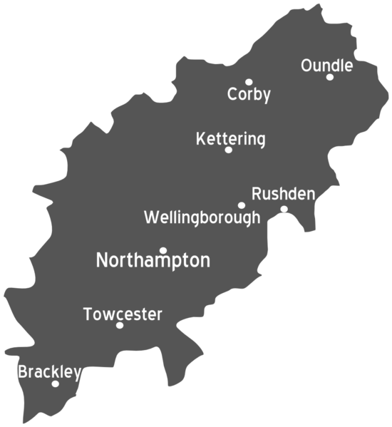
Background
Northamptonshire
Growing population of c.700k
Ageing rapidly
Mixed rural/urban
Increasing demand
‘Challenged’ health and social care economy
MSK Physiotherapy
5 Teams Countywide
Integrated ESP’s
4 GP Federations
Approximately 70 GP Practices
2 Acute Hospitals
Corby
East
Kettering
Northampton
W.borough
Daventry
South
Plus some out of county services

Slide 4
Drivers For Change
NHSE First Contact Practitioner Iniative
GP Forward View
Research Studies x 2
AHP’s Call to Action
Local Trust Strategy DIGBQ & STP
Increasing MSK Waiting Times
GP shortage, appointment pressures
Patient Pathway

Slide 5
Northampton Pilot of Same Day Physio
3 GP Practices (Northampton)
Average demand 22 patients per practice per month across 3 months.
2 ESP’s and 1 Band 6 (added)
66% patients discharged after their 1st appointment.
10% needed Diagnostics, 4% re-directed to the GP, only 20% referred to MSK Physiotherapy.
Positive feedback patients & Staff

Slide 6
The Proposal
Project Lead
-clinical background
-protected time
-project objectives
-project group/workshops
Engagement
-research/evidence
-guidance
-subject matter experts
-GP partners
-patient representative
Business Case
Strategic Executive Board
NHCP
GP Federation

Slide 7
Suitability, Acceptability, Feasibility
Suitable
Fits with NHSE Guidance for FCP
Acceptable
Patient Focused
Feasible
Appointment Model
Alignment with current MSK Physiotherapy, staffing, skill mix
MSK Pathway
Sustainable
GP and Care Navigators
Quality Care and Patient Outcomes
Locations- MSK bases/co-locations
Staffing
Outcomes
GP Federations
Investment

Slide 8
The FCP Service Model
First
Contact
Physio
Self Management & Exercise Advice
Screened by Care Navigators.
One Appointment: First Contact
Offered to appropriate patients for MSK complaint instead of GP
Specialist MSK Assessment
Diagnosis
Diagnostics & Prescribing (where appropriate)
Face to Face Appointment 30 Minutes
Referral to a course of Physiotherapy
Right Pathway Navigation
Timely appointment (4-5 days)
Skill Mix Specialist, Advanced & Extended Scope Physiotherapists
First Contact appointment in a First Contact Physio Clinic @MSK Base
Secondary Care Referral

Slide 9
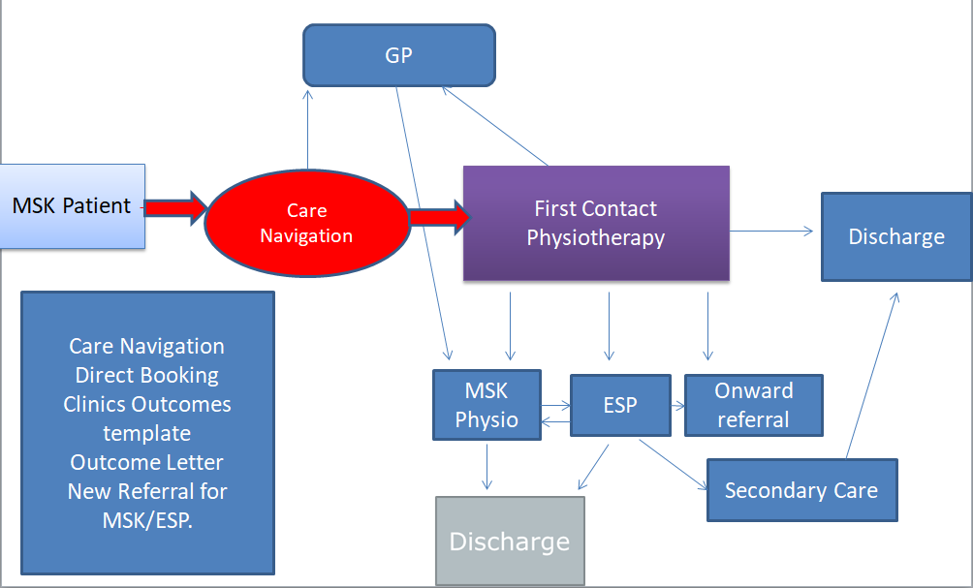
The Pathway

Slide 10
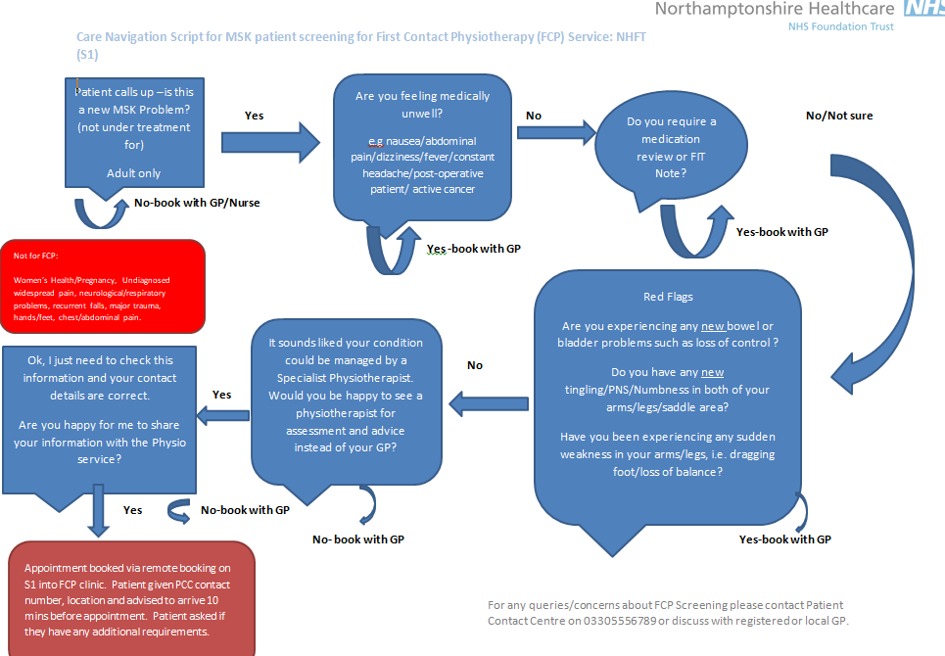
Care Navigation

Slide 11
Inclusion & Exclusion Criteria
Inclusion
Soft tissue & Joint pain/ injuries
Sports and minor injuries
Postural pain
Minor Trauma
Spinal pain
Tendon/Ligament problems
Acute on chronic conditions
Exclusion
-children
-women's health/ respiratory/ neurological problems
-major trauma
-medically unwell patients
-red flag (spinal) symptoms
-post operative patients/ under consultant’s care

Slide 12
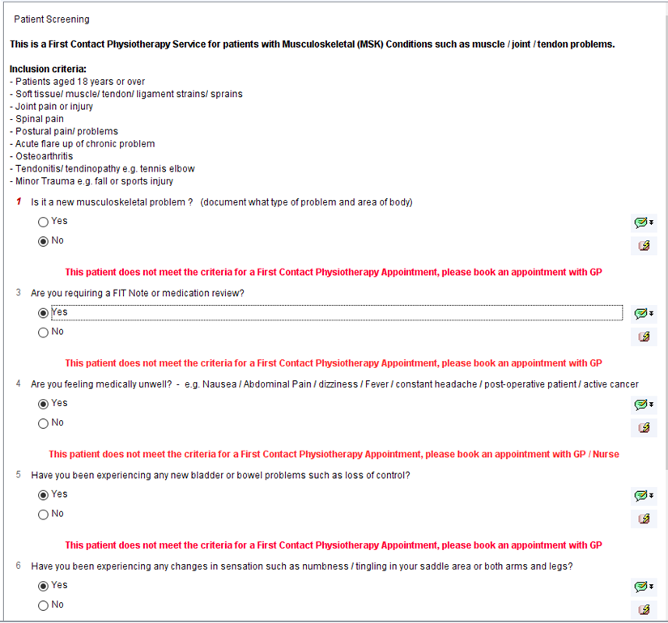
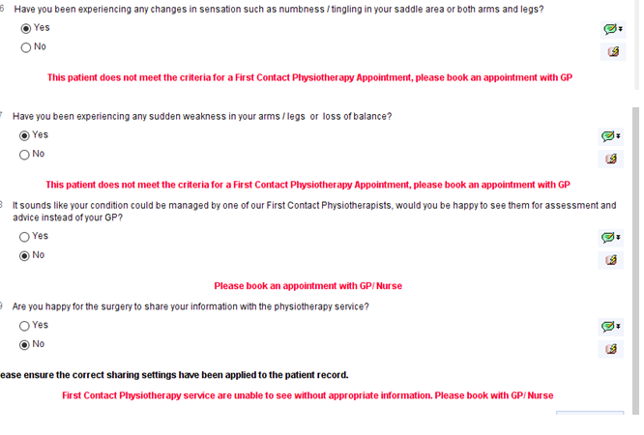
Care Navigation
Bespoke FCP Screening Questionnaire

Slide 13
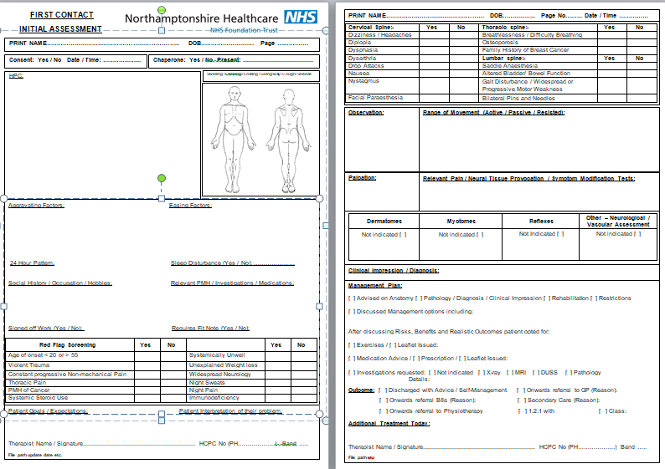
FCP Assessment Tool

Slide 14
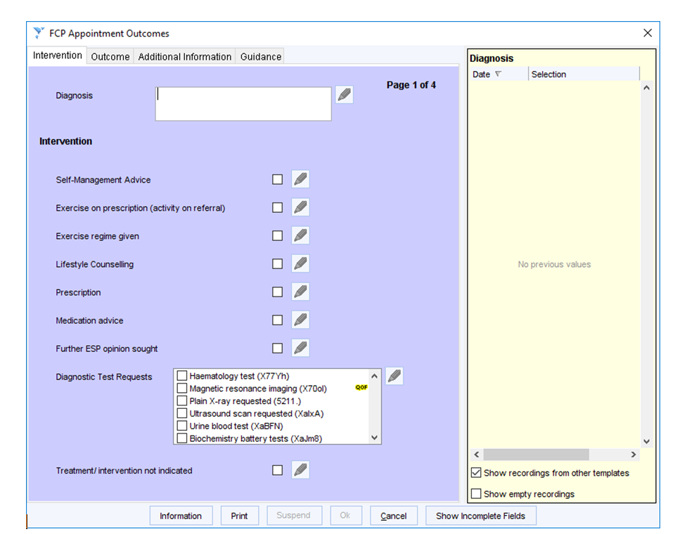
Evaluation
System One: Interventions

Slide 15
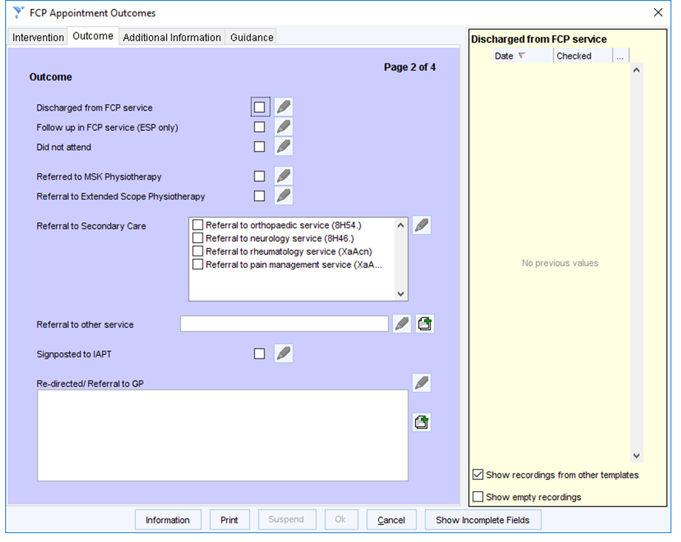
Evaluation
System One Appointment Outcomes

Slide 16
Evaluation
FCP Project Steering Group
Appointments Offered/Contacts
Patient Stories “before” and “after”
Patient Representative
Focus Groups
Patient feedback Questionnaire
I Want Great Care
Physio, Care Navigators & GP Feedback

Slide 17
Implementation
Training & Engagement
FCP Competencies
Recruitment
Staged Implementation with debriefs
Federation Model : partnership approach: investment and support.
Went Live in Wellingborough 14th January ☺
Feedback/ Review 3 months
Expand countywide over the next 12 months.

Slide 18

Questions?

Slide 19

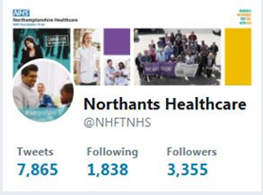

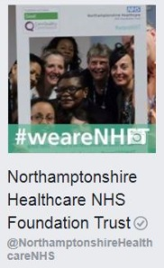

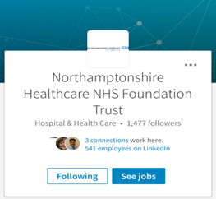


SOCIAL MEDIA
Tag us in to your posts & use #weareNHFT so we can share and like your posts
@NHFTNHS
@NorthamptonshireHealthcareNHS
Instagram
For service/department social media takeovers email commsteam@nhft.nhs.uk for info
Notes:
Social media is a fantastic way to let the world know what great work you’ve been doing and showcase a new initiative or events you are involved in or about to partake in. It targets people who are similar to your existing ‘customer’ base whilst allowing you to also reach new audiences; raising the profile of your ‘brand’.
Whenever, wherever you can and it is appropriate; ensure your audience know about the Trusts social media tags.
So what social media do we use?
Twitter - Engage with other users, including us – we’ll reply
Facebook - Tag us in to your posts & use #weareNHFT so we can share and like your posts
LinkedIn – Great for finding job opportunities
You Tube - Search Northamptonshire Healthcare NHS Foundation Trust to see what we’ve been up to
Instagram - gives people the chance to post photographs and tag us in photos that represent the care, the people, as well as capturing our trust sites in aesthetic ways. From liking and commenting, we aim for more engagement with our service users, carers, patients and staff and incorporate beautiful photos with information and inspiration.

