Slide 1
The Model Hospital: using data to reduce unwarranted variation in care
14th November 2018
Rosalind Campbell – AHP Productivity Lead, NHS Improvement
Rosalind.campbell1@nhs.net
@Roz_L_Campbell

Slide 2






We support foundation trusts and NHS trusts to give patients consistently safe, high quality, compassionate care within local health systems that are financially sustainable

Slide 3
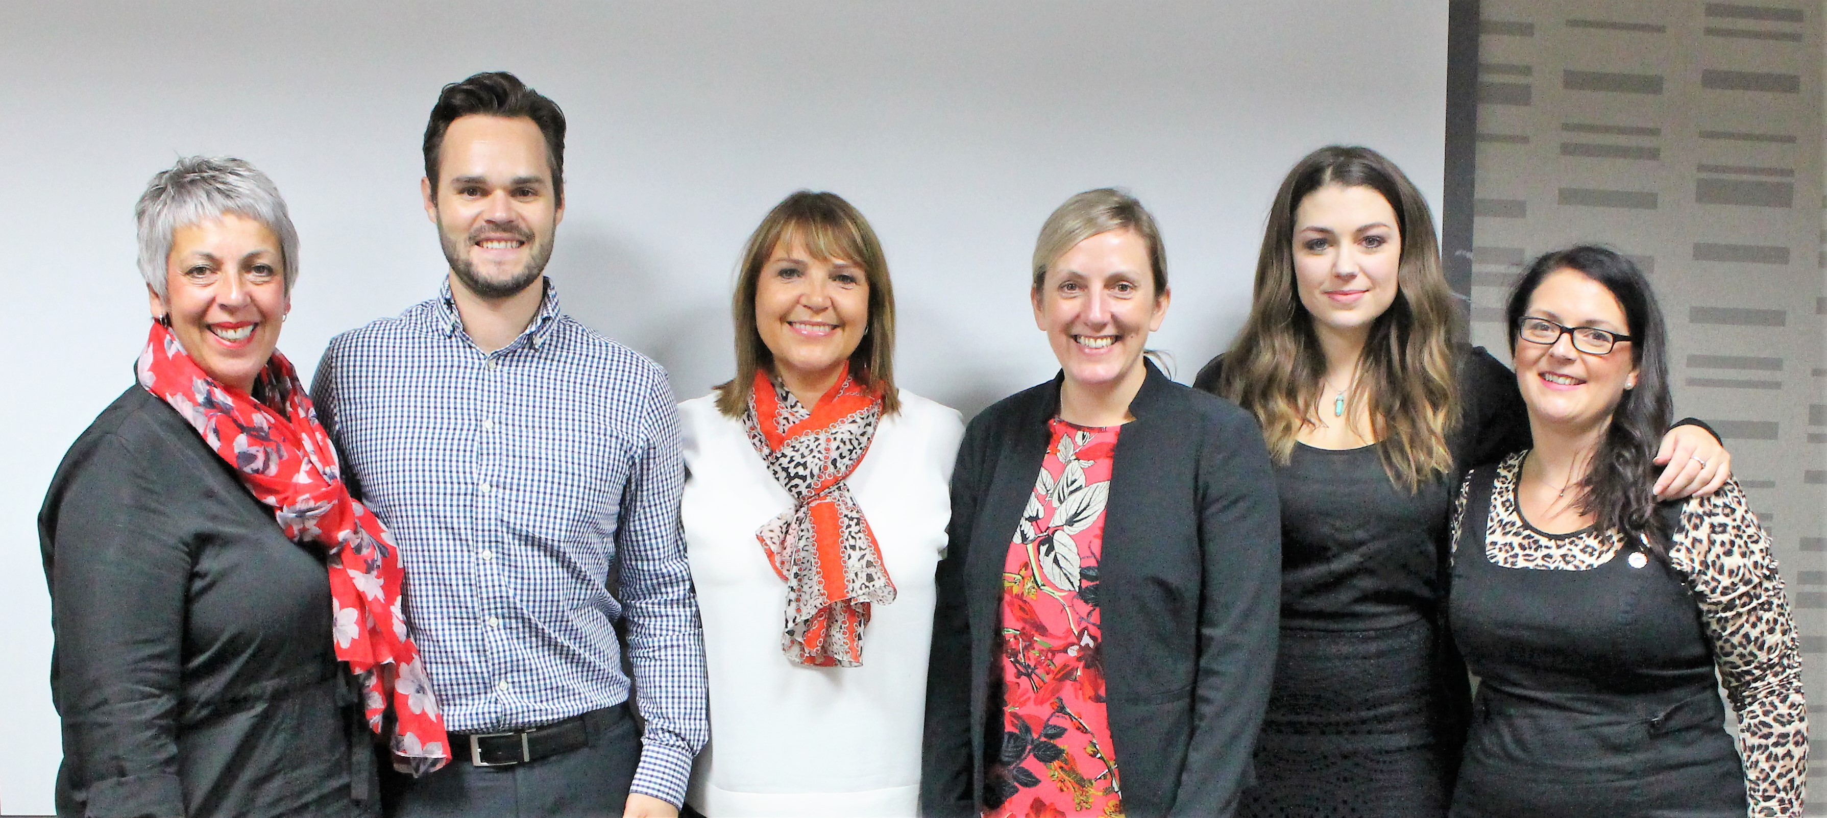
The NHS Improvement National AHP team
Caroline Poole
Stuart Palma
Roz Campbell
Jo Fillingham
Steph Gates
Helen Conway

Slide 4
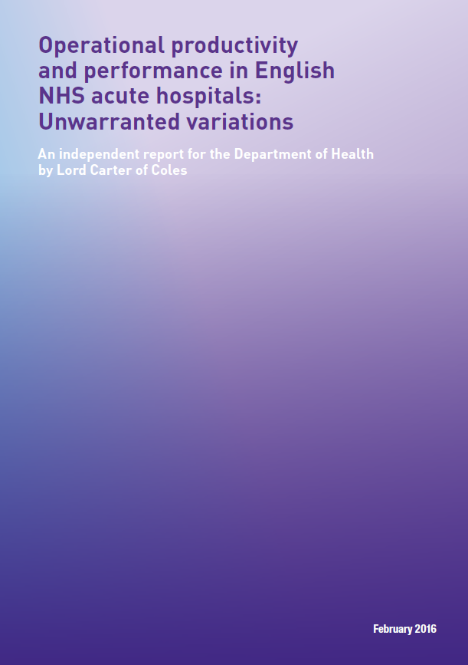
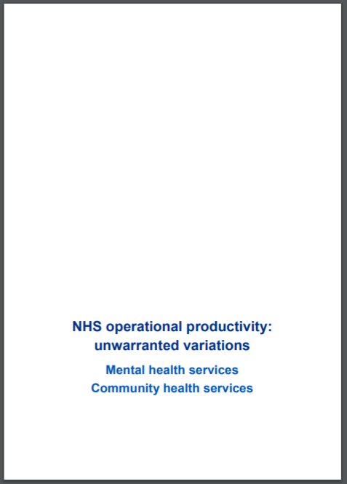

Lord Carter’s Feb 2016 report emphasised unwarranted variation and the need for providers to use data systematically in decision making
May 2018
September 2018

Slide 5
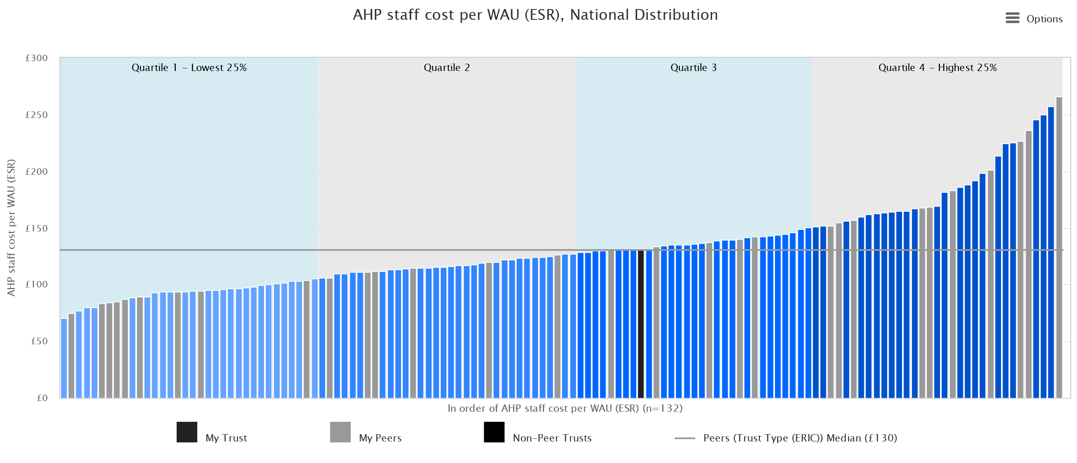
Why we are undertaking this project
A distribution of AHP cost per WAU
The Carter Review identified that ”the most expensive trusts spend around 2.0 times more on AHPs per WAU than the least expensive trusts”, which is believed to be due to variation in deployment of this workforce group. In fact, the Carter Report states figures from the 2012 Quality Watch report, which show that the number of AHPs per 1,000 population varied from 0.95 in the East of England, to 1.43 in the North East. Comparisons across acute hospitals is difficult, as AHPs are often deployed across organisational boundaries, but we know there is a significant opportunity to drive out unwarranted variation in AHP deployment.
Notes:
So to do that it might be useful to go back to the beginning –quick over view
In general the size and shape of the AHP workforce in trusts is based on custom and practice rather than science. By applying ‘science’ (cost per WAU) we revealed the variation that exists across AHP workforces in the 136 non specialist acute trusts.
To accurately plan for the right workforce for the future, we need to understand how many AHPs we need? What does good look like?

Slide 6
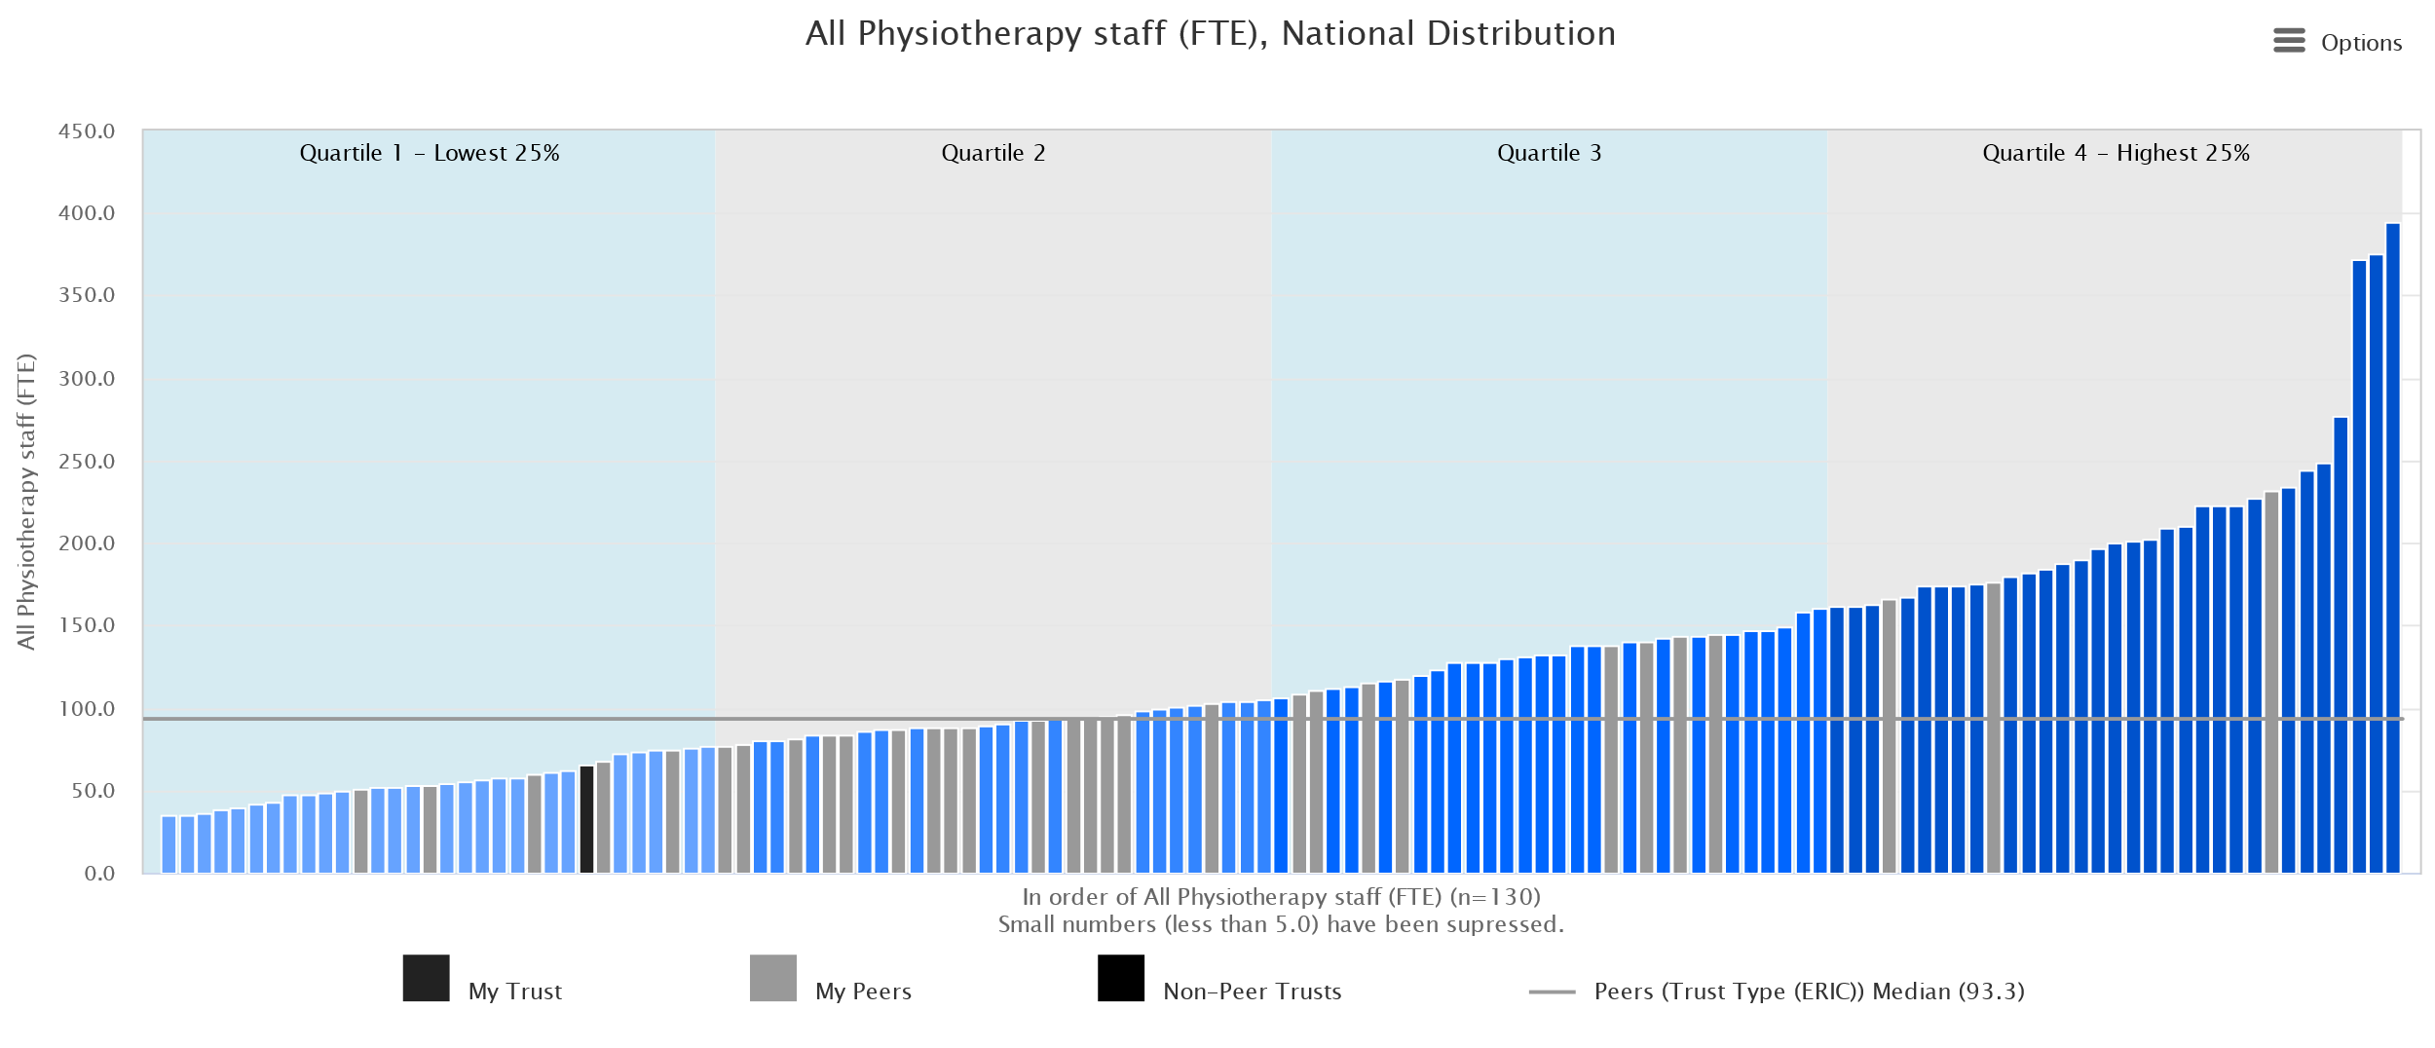
Physiotherapists in acute trusts

Slide 7

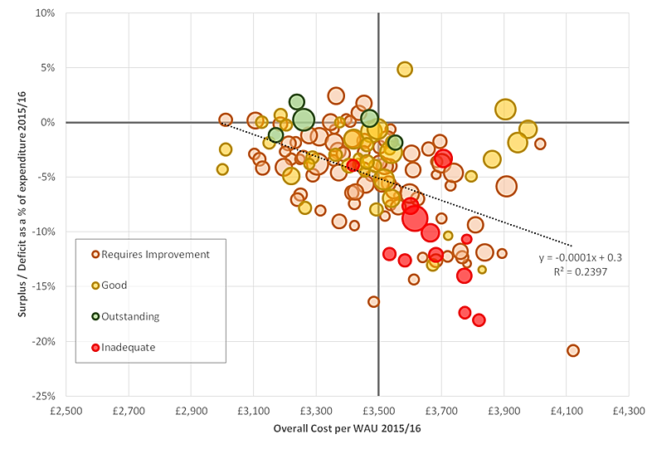
The delivery challenge – targeting our efforts on our under-performing trusts
We need to identify the specific actions in each trust that will improve productivity – and NHSI needs to target its support towards those most in need
BETTER PRODUCTIVITY, SUSTAINABLE FINANCES
WEAKER PRODUCTIVITY, SUSTAINABLE FINANCES
Trusts with a lower cost per WAU (more productive) tend to have a smaller deficit and more sustainable finances
Inadequate trusts tend to have weaker productivity and unsustainable finances
Outstanding trusts have higher productivity and more sustainable finances
Direction of Improvement
IMPROVEMENT TRAJECTORY
Dots: 136 non specialist trusts
Size of dot: Standardised clinical output (WAU)
Colour of dot: CQC rating
Cost per WAU: is from Reference Cost 15/16
Surplus deficit: from trusts accounts, figure excludes impact of impairments and transfers by absorption and charities
BETTER PRODUCTIVITY, UNSUSTAINABLE FINANCES
WEAKER PRODUCTIVITY, UNSUSTAINABLE FINANCES

Slide 8
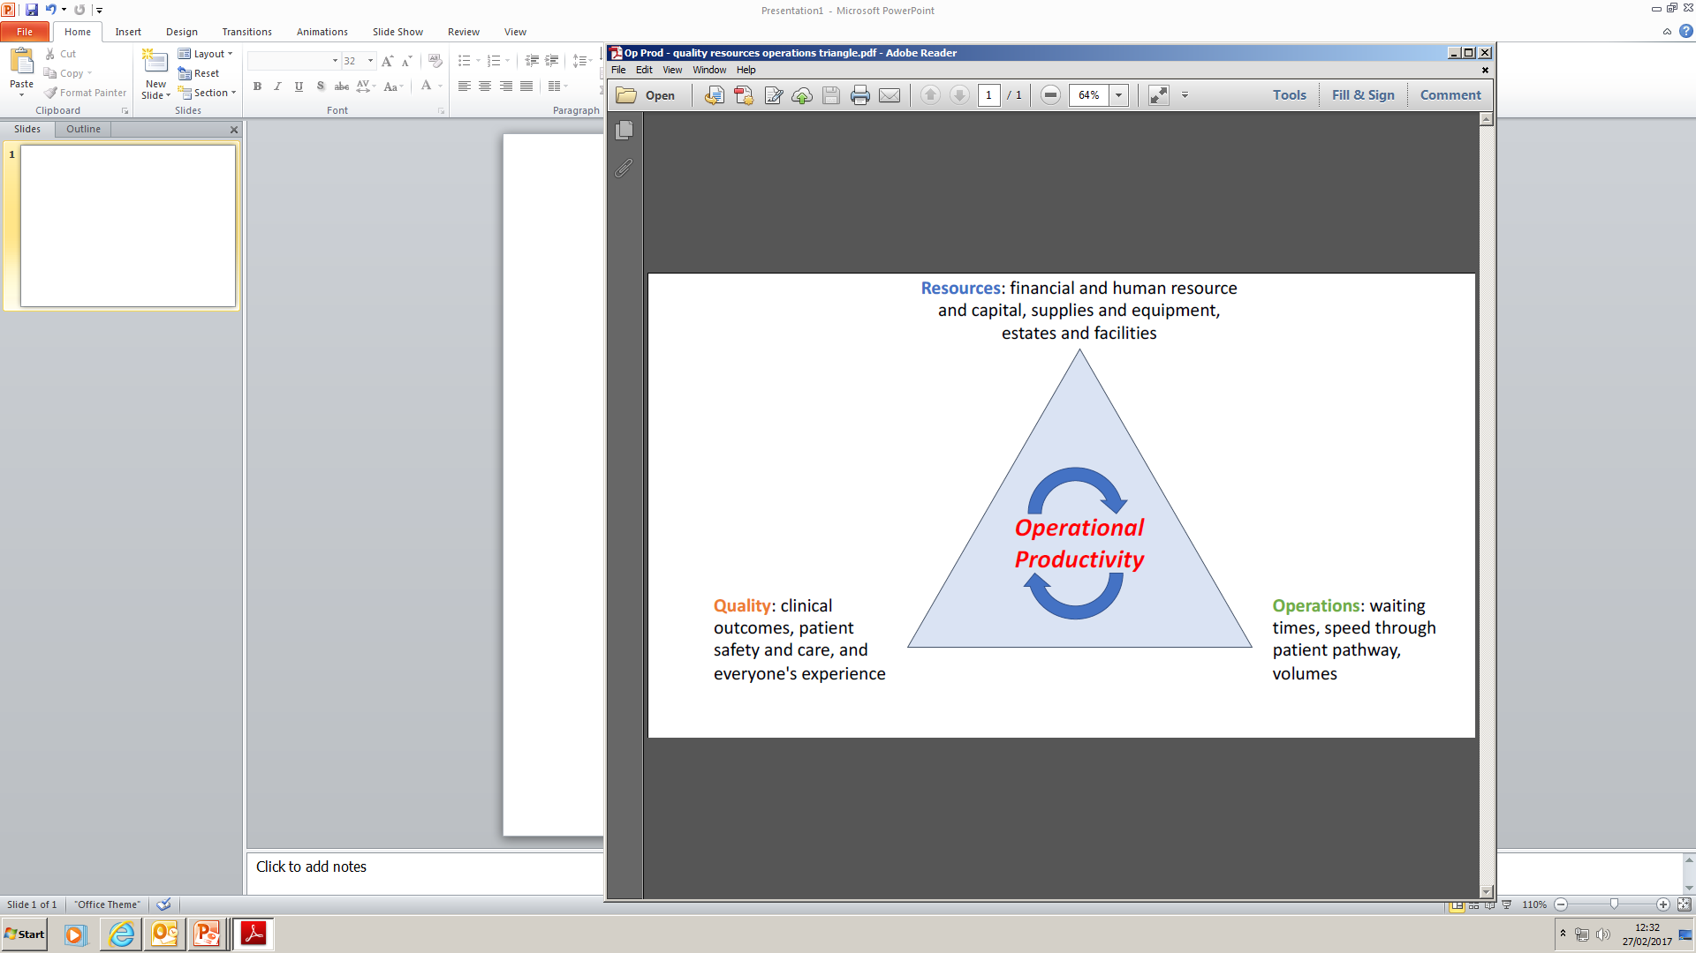

Achieving an efficient and sustainable system by optimising operational productivity
Notes:
Title slide with embedded images

Slide 9
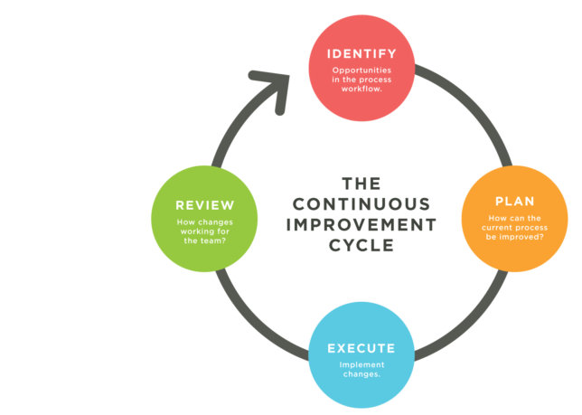

Government policies have focussed on targets and competition to motivate improvement, we need something new
Pre 1990s NHS founding ethos was ‘Leave it to the professionals and they will provide the best care’
Universal targets to achieve minimum standards emphasised from late 1990s
Trusts need help to identify opportunities for improvement then to plan, execute and review
From the 1990s Government promotes competition as a way to improve public services – GP Fundholding and then the NHS Internal Market
For NHS Managers and Clinicians peer pressure and reputation can be a stronger motivator for change and improvement
The Model Hospital promotes peer comparison and improvement cycles

Slide 10
The Model Hospital aims to help trusts identify opportunities
VISION
If all non-specialist acute trusts could perform at least as well as the current average performers in all areas, the NHS will save at least £5bn each year within the next 3 to 4 years
The model hospital provides a nationally available information system relating to metrics of productivity, efficiency and quality of care
It provides information in support of trusts developing a greater understanding of their performance, and how it compares nationally, as well as with smaller peer groups
Notes:
Catherine

Slide 11
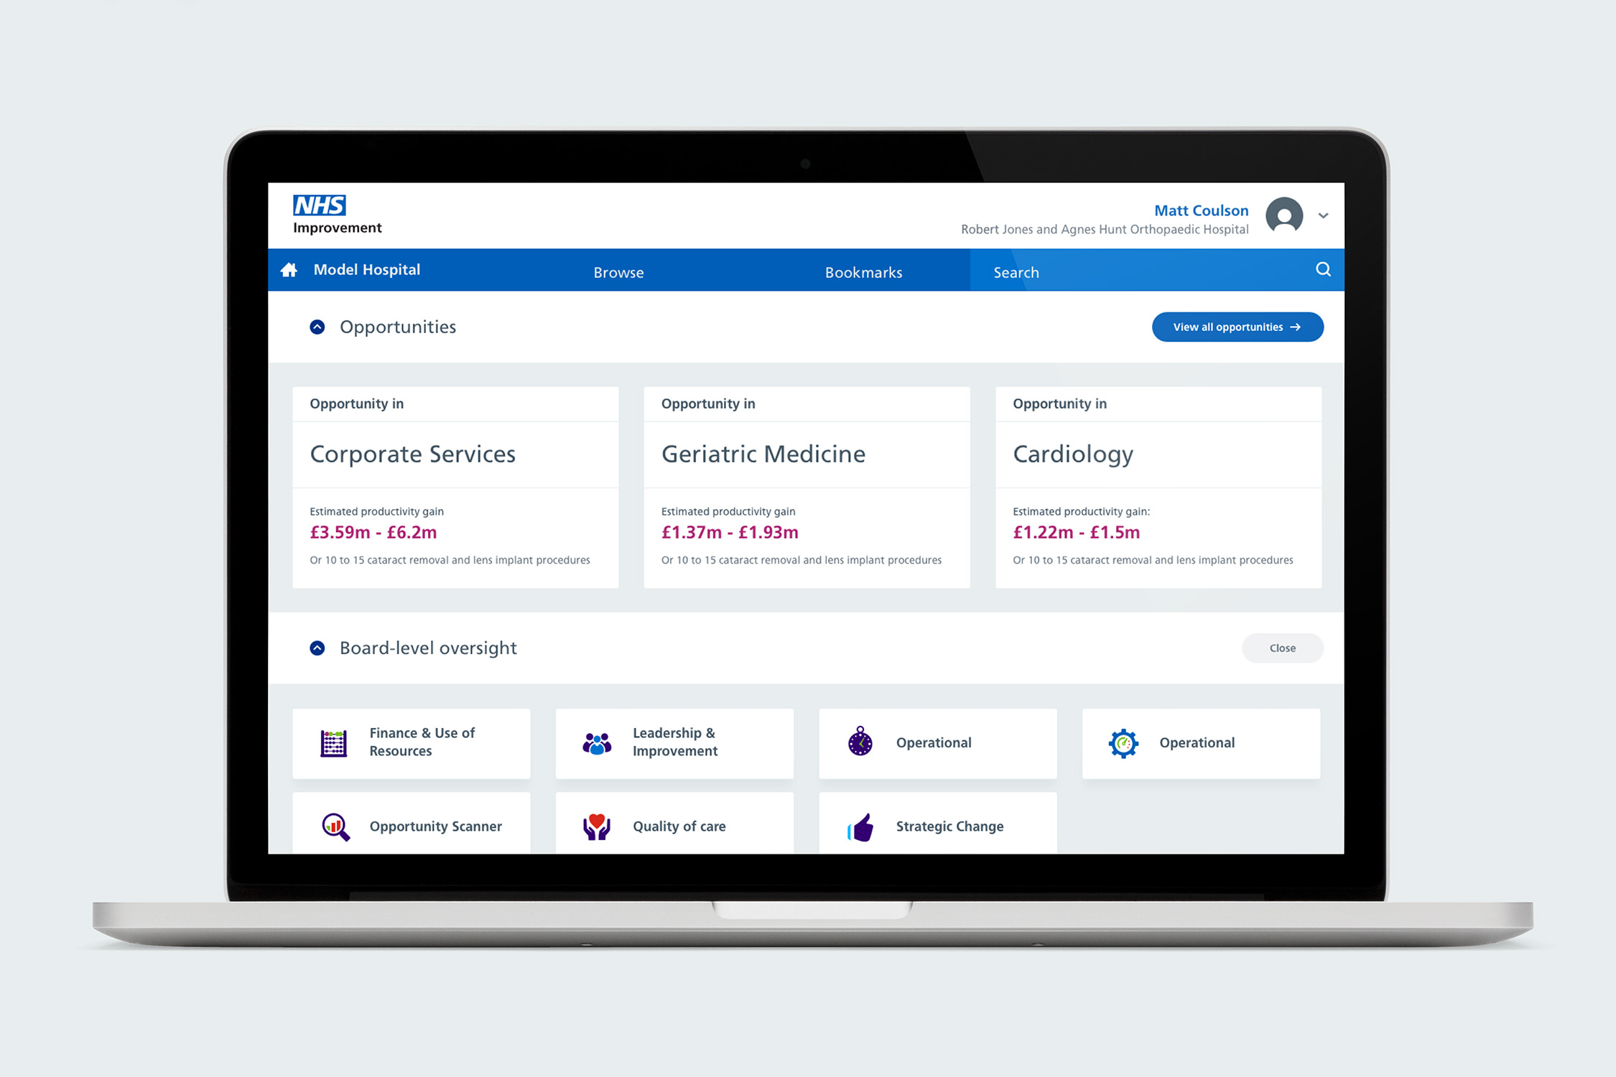
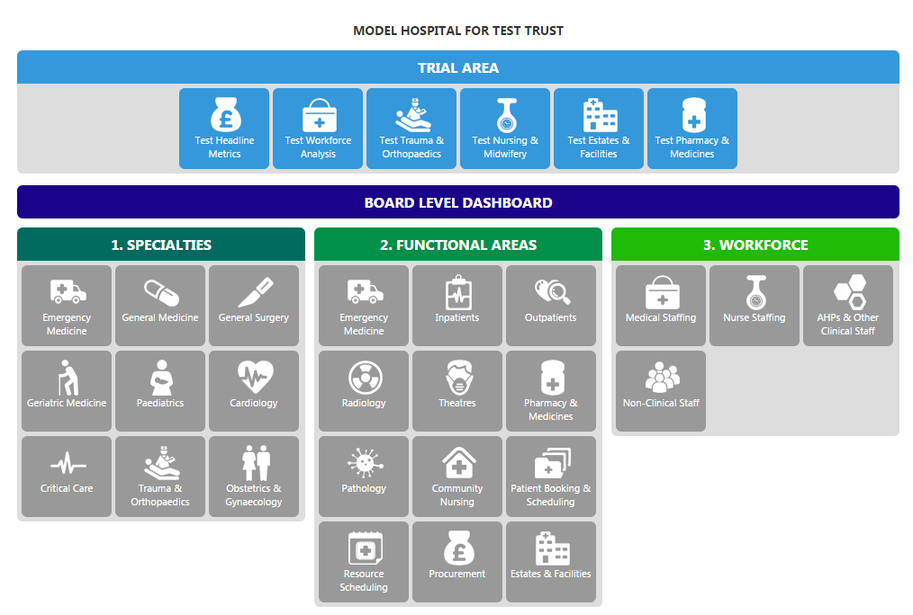
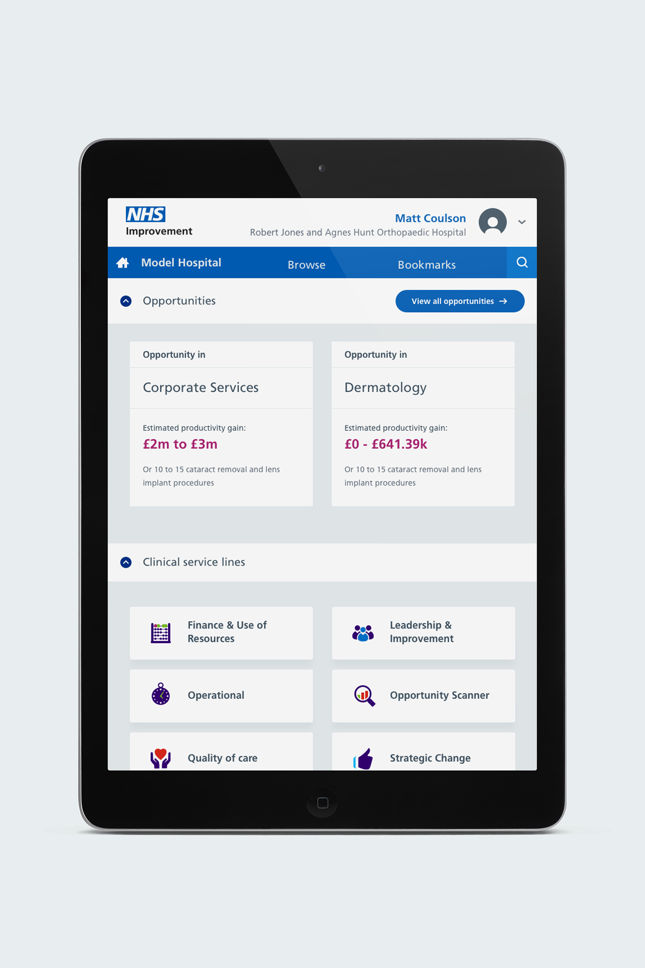
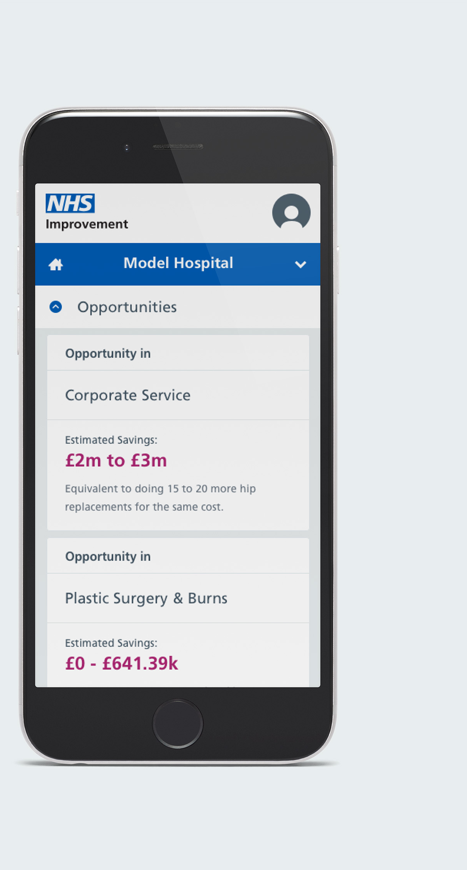
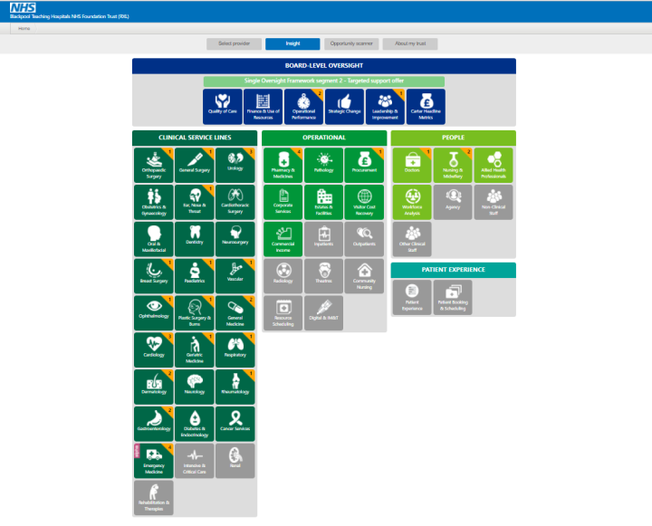
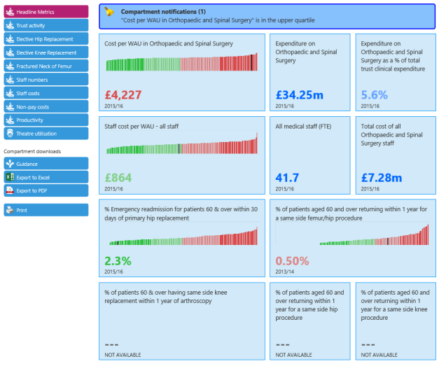
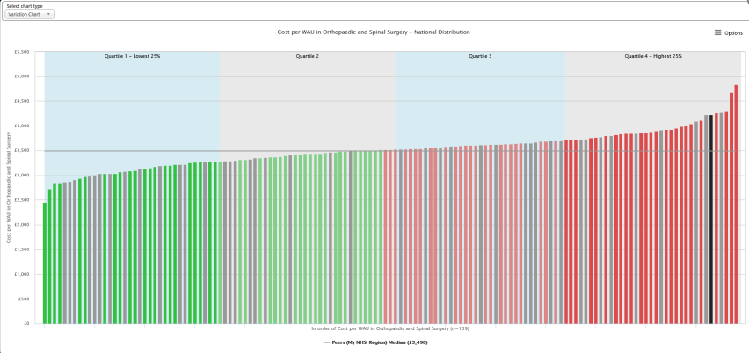

The product development journey has been iterative with the most recent release in September 2018, now reaching over 13,000 users across the NHS provider sector
Prototype in early 2016
September 2018 new version release
Incorporating:
Responsive design (for mobile devices)
Focus on accessibility W3C standards
New look-and-feel based on user-feedback
New approach to identifying local opportunities for improvement
Improved support / onboarding
Extension to ‘Model Ambulance’
Sharing of good practice and guidance in addition to benchmarking data
Search, bookmarks and a notification centre to support personalisation
Alpha release to all acute hospitals from April 2017
View our Animations:
http://bit.ly/ModelHospitalVideos

Slide 12
Some quotes from users of the Model Hospital
We’re finding the Model Hospital increasingly invaluable as it develops and it has become our defacto ‘go-to’ benchmarking tool for much of our improvement work. A really useful resource with great potential for even more.
I look at Model Hospital almost daily. I can systematically review the specialist areas with my team, for improvement opportunities.
Professor Mike Reed, Clinical Director for Trauma & Orthopaedics, Northumbria Healthcare NHS Foundation Trust
PMO
It's amazing that the NHS is so insular so anything like the Model Hospital that brings people together is a good idea
I find it very helpful. By finding out which Trusts are doing well I can connect up with them to ask what they are doing.
Performance & Information Director
Everyone needs to be using the Model Hospital information to prompt challenge in the way that services are delivered within the resources available while maximising the patient experience and clinical outcome.
Nursing Director
Director, PMO

Slide 13
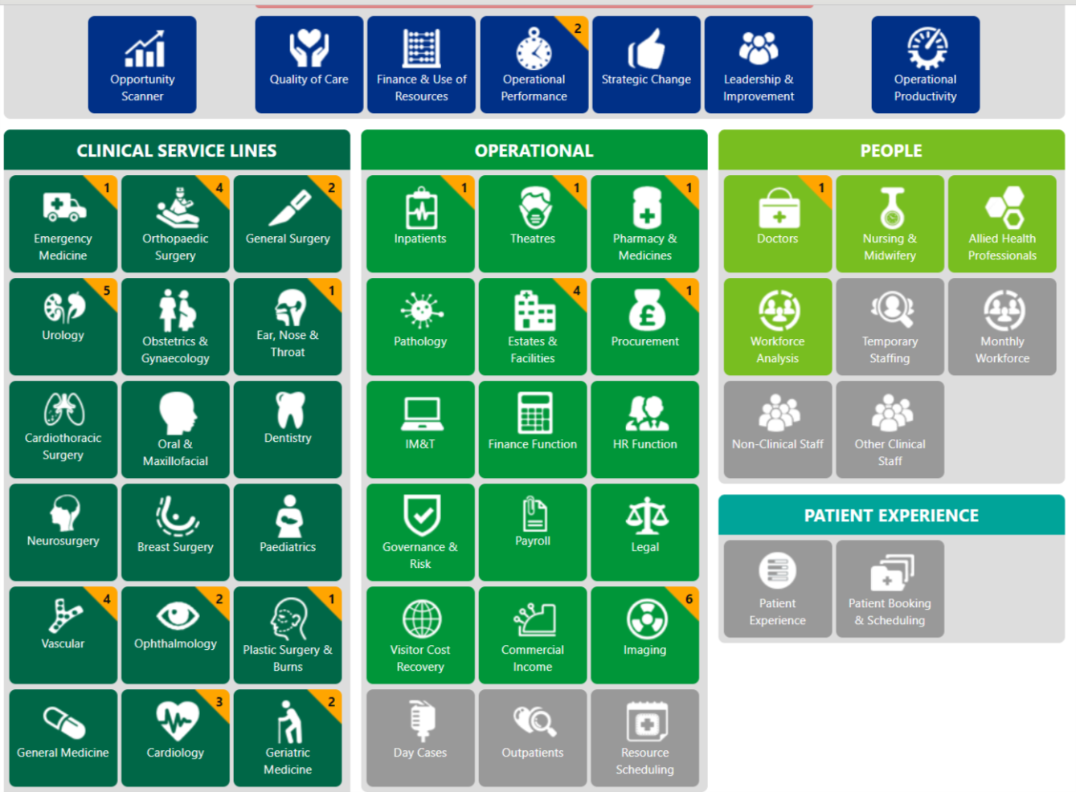
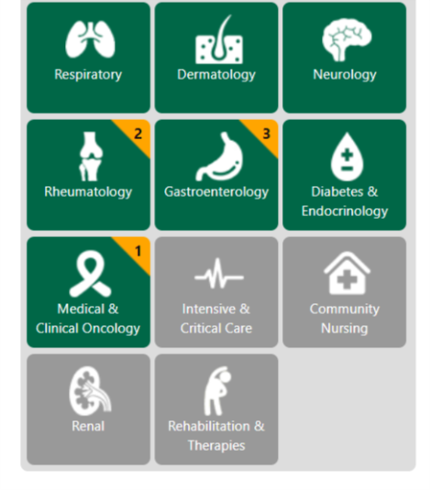
The Model Hospital is constantly being updated

Slide 14
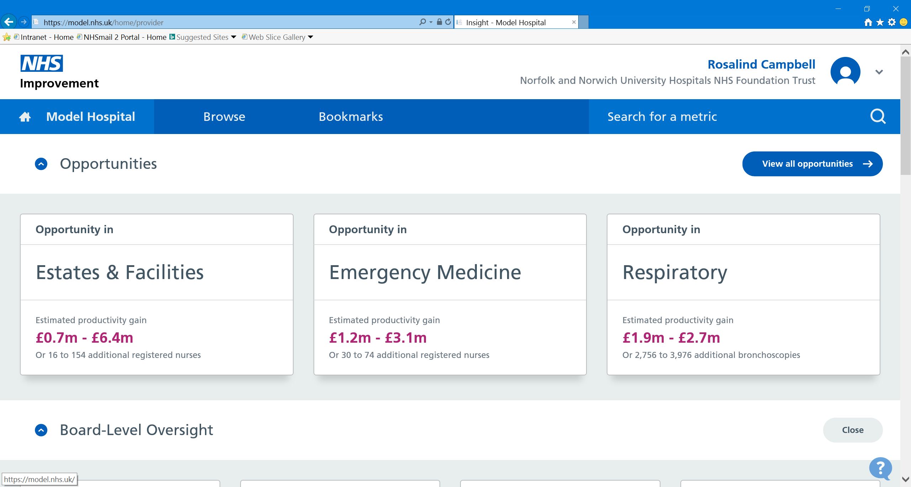
Introducing the Model Hospital

Slide 15
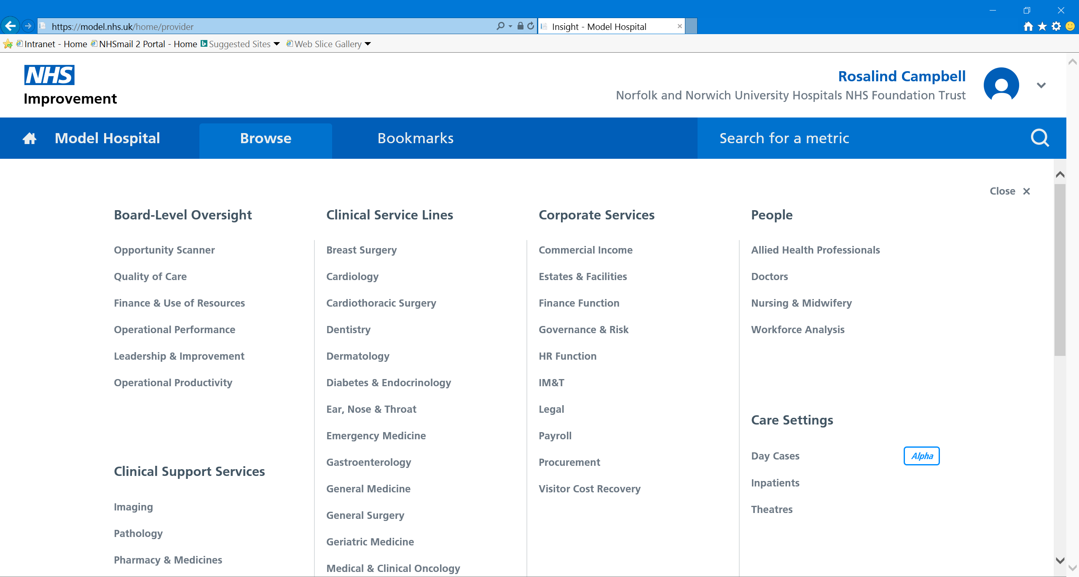
The new look navigation page

Slide 16
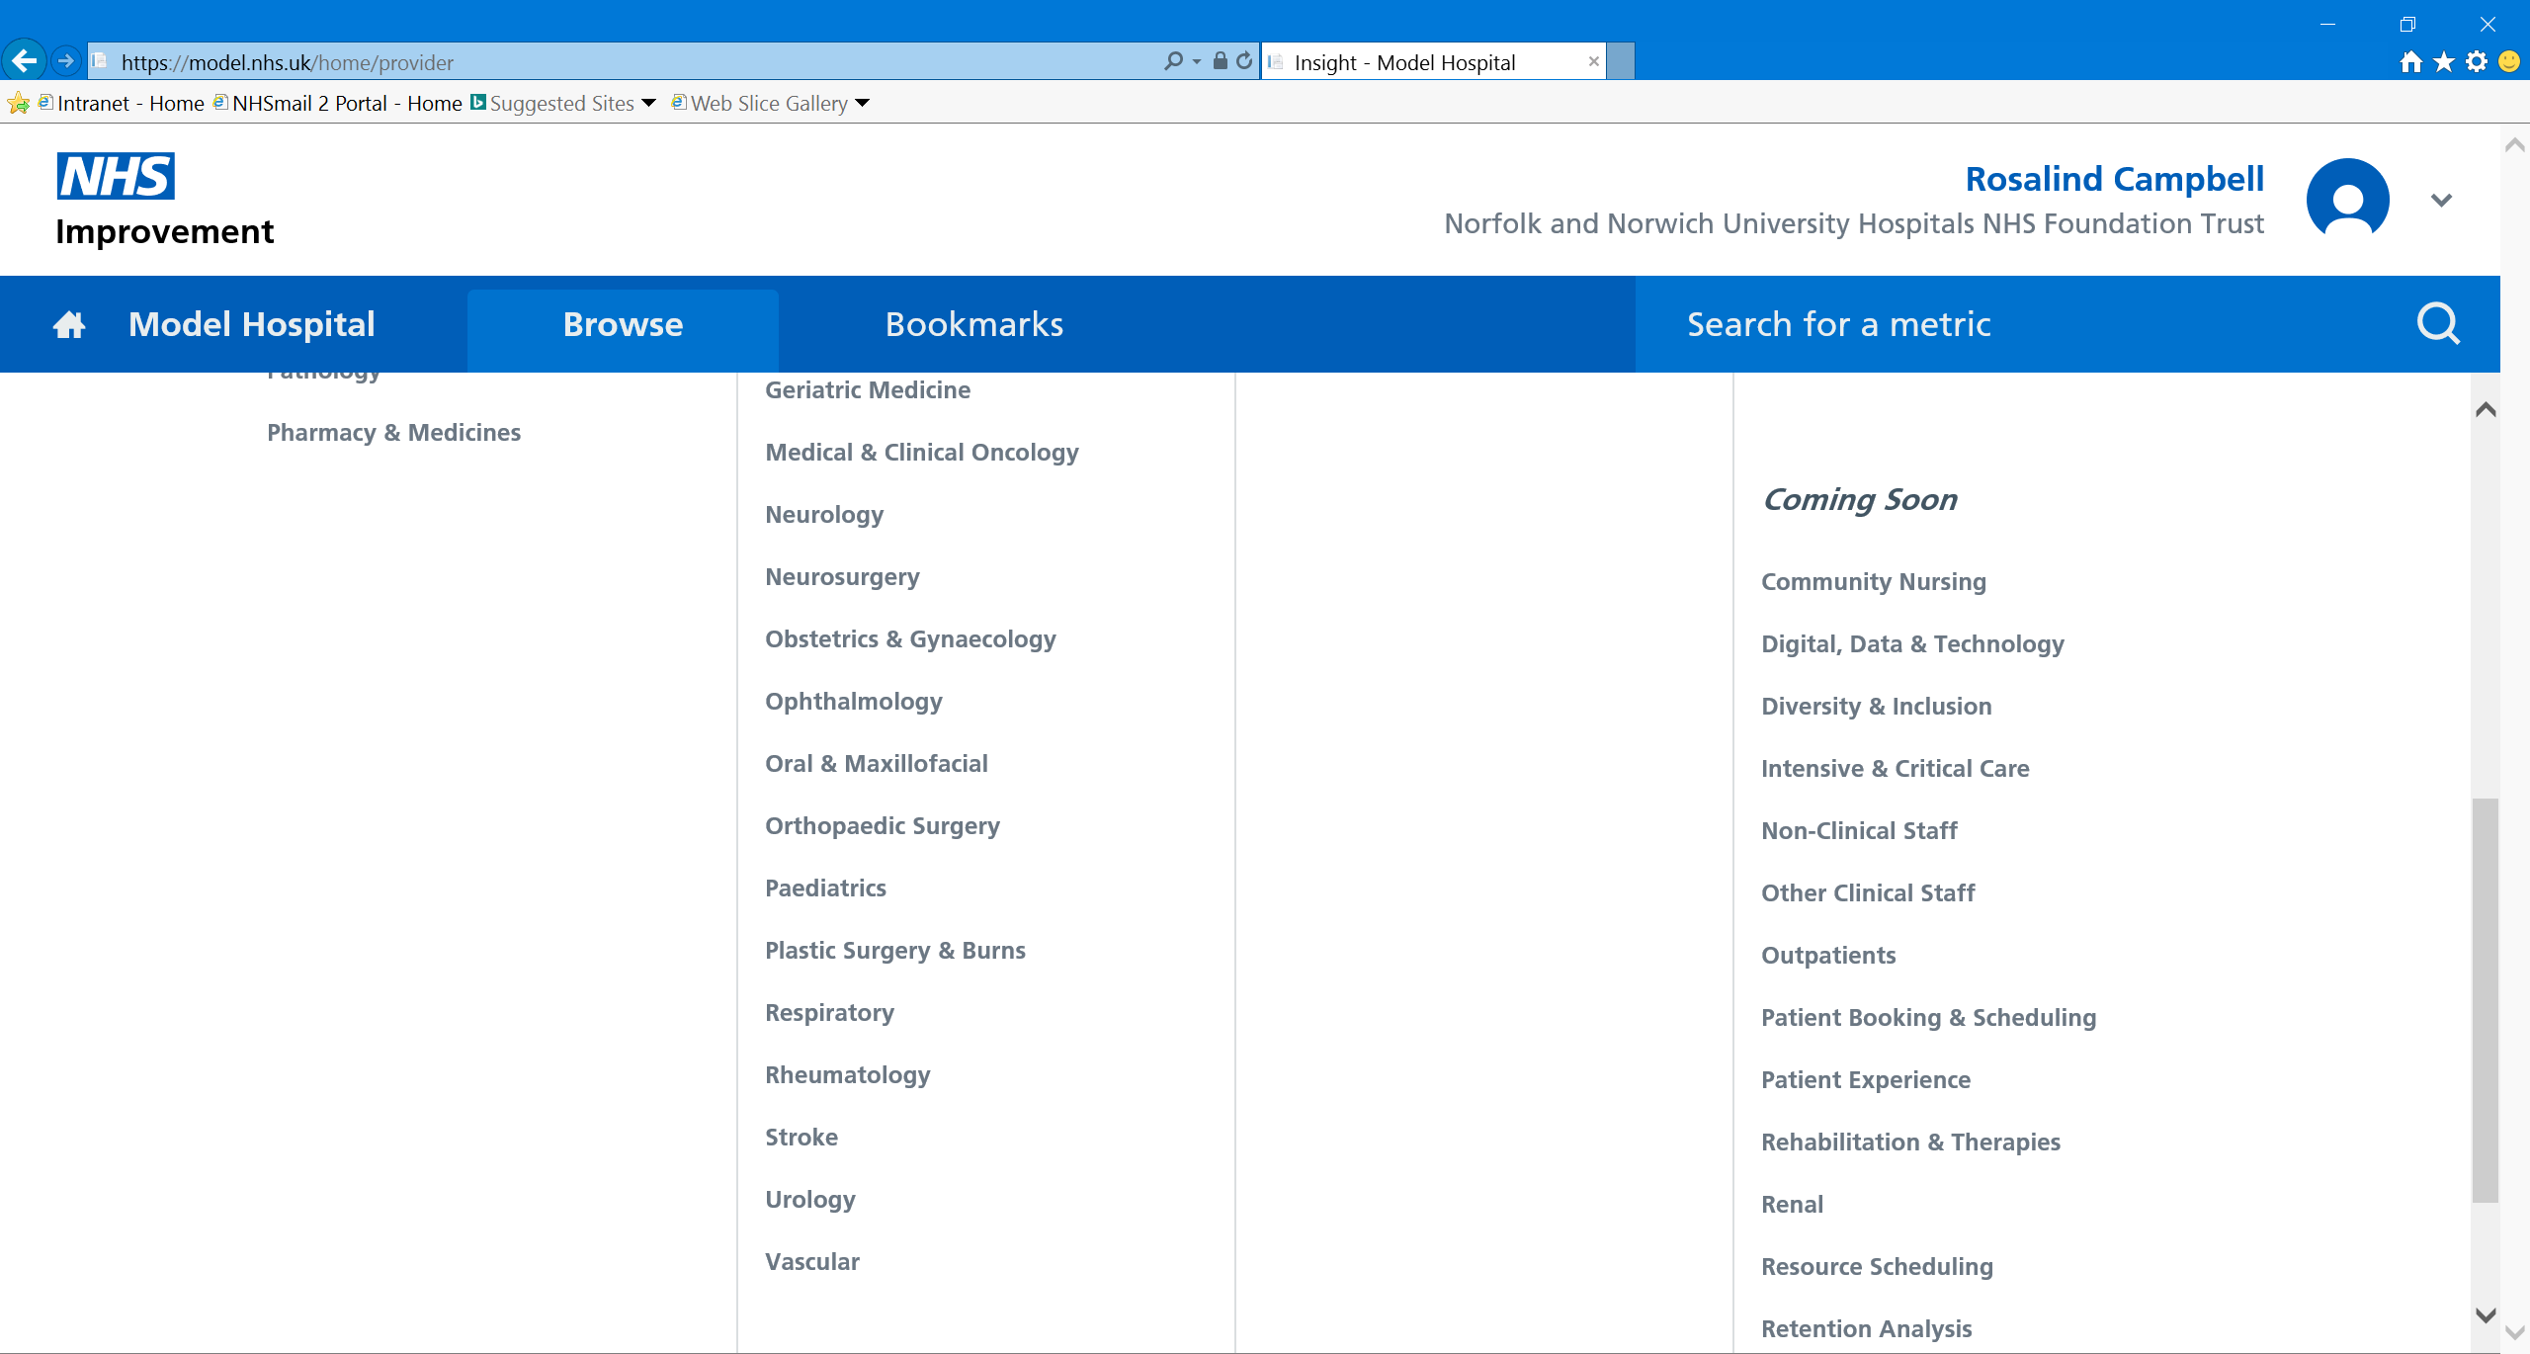
The new look navigation page continued…

Slide 17
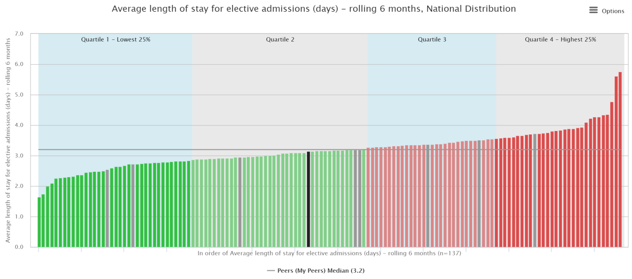
Orthopaedic surgery – elective length of stay
The 6 month rolling average varies from 1.7 to 5.8 days

Slide 18
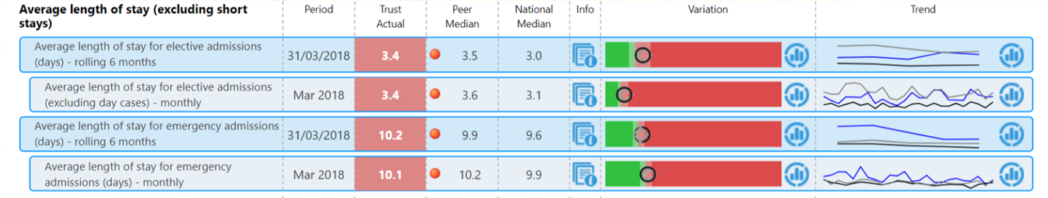
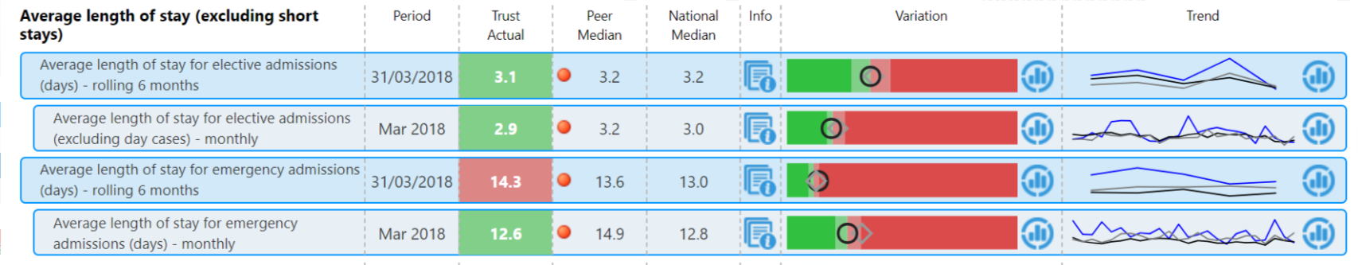
AHP impact on Length of stay
Trust wide
Orthopaedic surgery

Slide 19
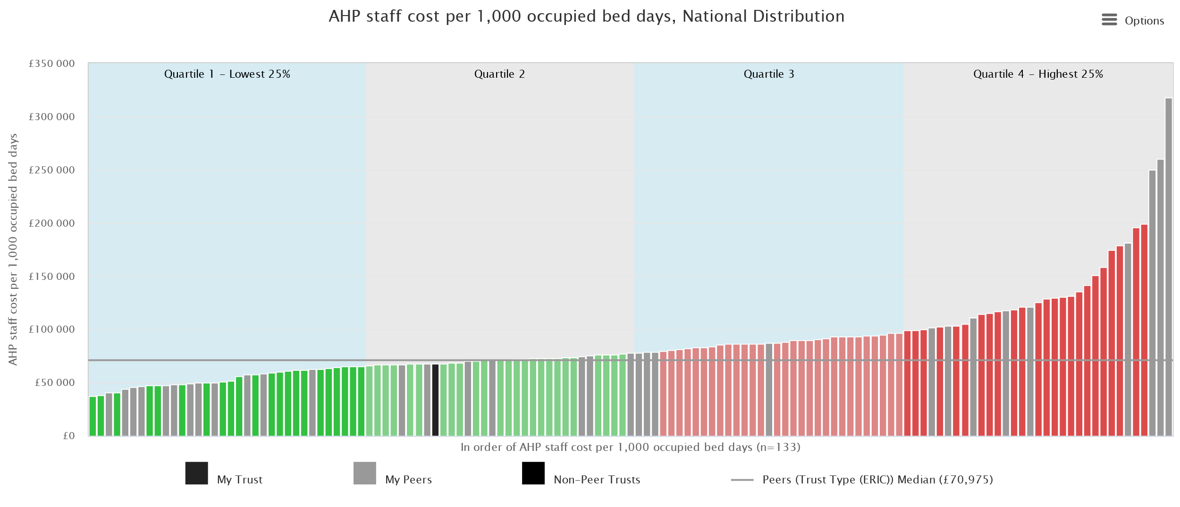
AHP staff cost per 1000 occupied bed days varies from £37,546 - £317,398

Slide 20
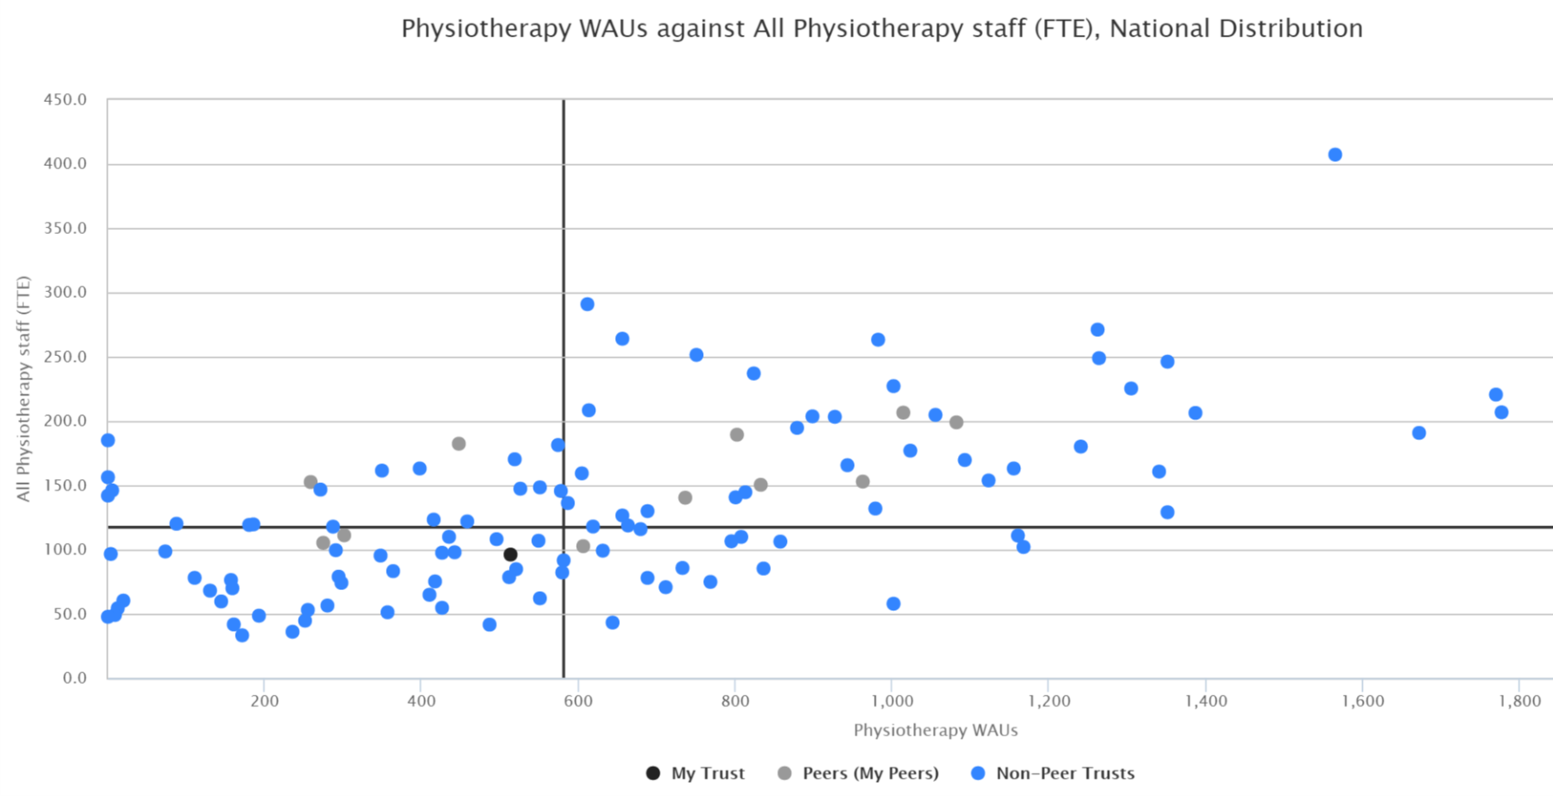
Some trusts have more physiotherapy staff but lower levels of activity
Trusts in this quadrant have high staff numbers but low activity
Trust C
Trust A
Trust B
Trusts in this quadrant have low staff numbers and high activity
Trust D

Slide 21
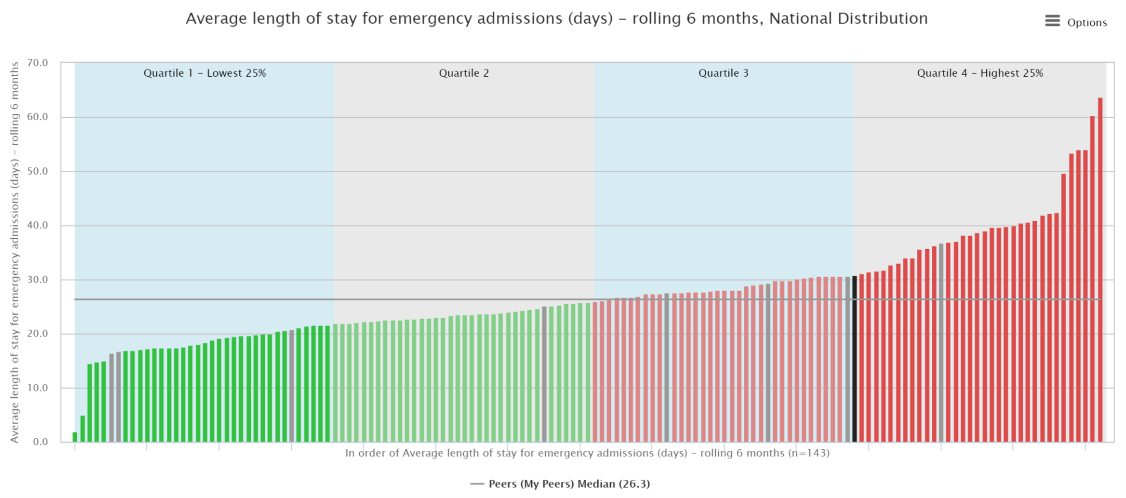
Patients discharged to a care home
The 6 month rolling average length of stay varies from 2 days to 63 days for emergency patients who are subsequently discharged to a care home

Slide 22
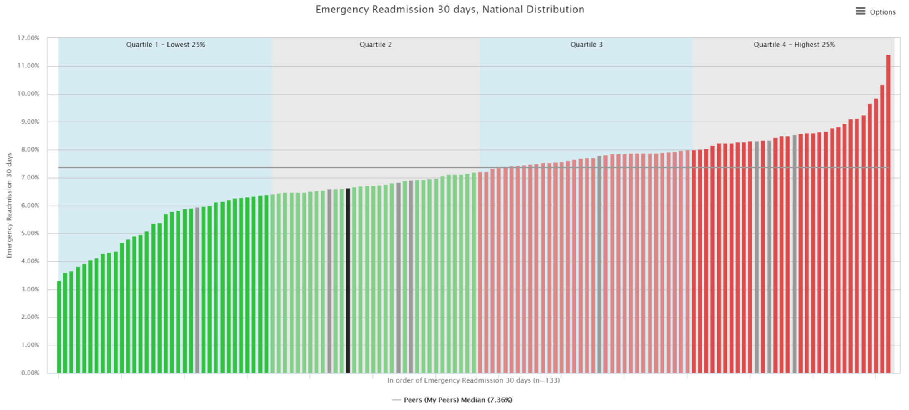
Emergency re-admissions
The rate of emergency re-admissions within 30 days varies from 3.3% to 11.4%

Slide 23
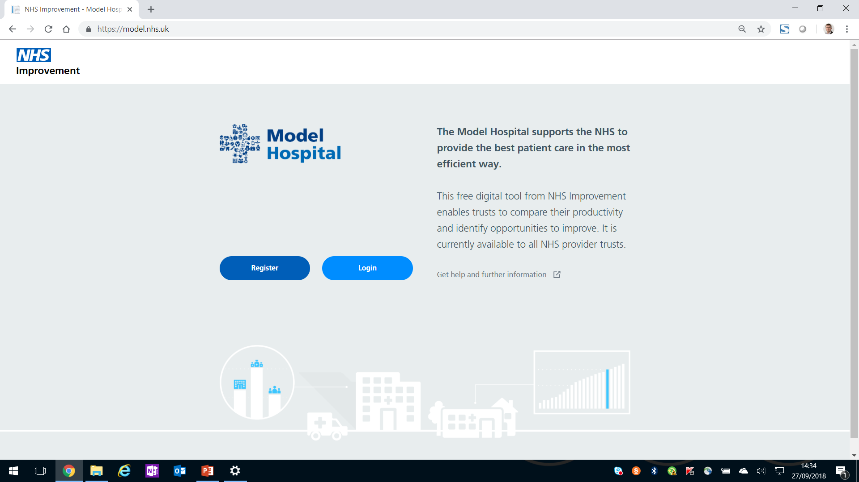
The Model Hospital is an existing digital information platform, providing benchmarking insight to all NHS provider trusts. https://model.nhs.uk
Secure login
Homepage
Compartment headlines
Metrics scorecard
Metric detail

