Slide 1
The importance of utilising data in service design and development
CSP North East
Nov 2018
Fiona Ottewell

Slide 2
Overview
To have an understanding of the RightCare approach
Reflection on Value
Regional plans for MSK, Respiratory and CVD
Reflection on shared decision making
NHS RightCare Plans for 12 CCGs in NENC in 18/19
Understand how you can contribute to a sustainable future in health care

Slide 3
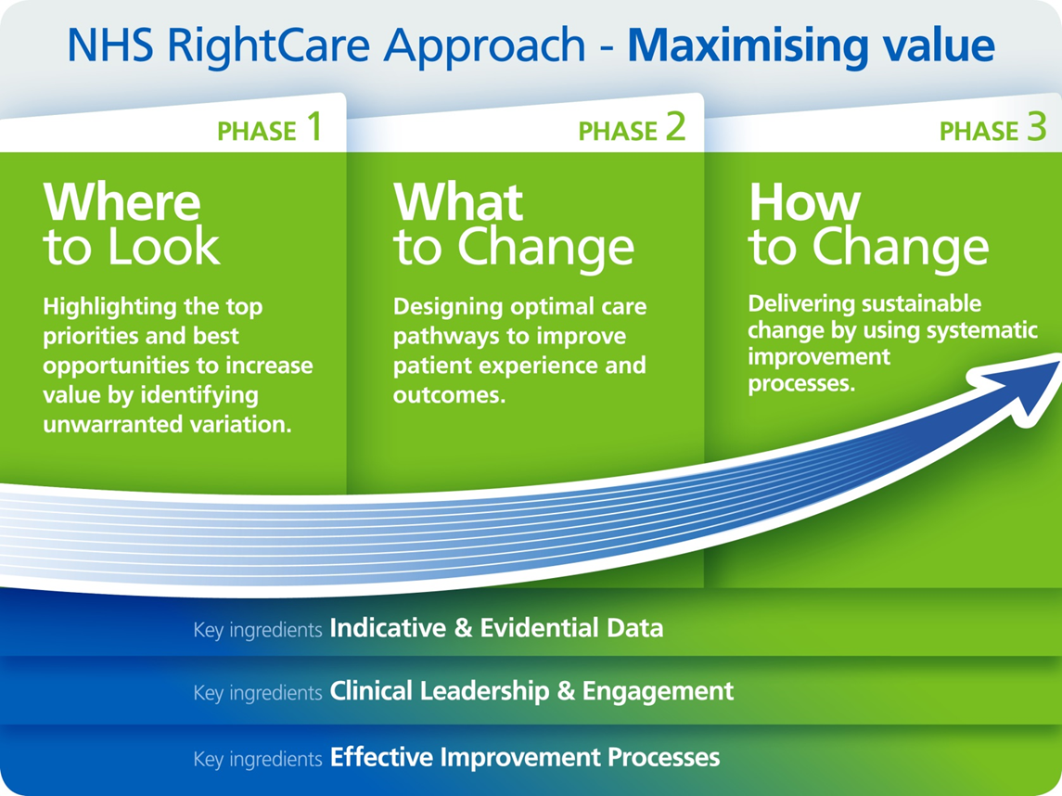
Notes:
This is for the RightCare Approach (just looking at reform process in more detail)

Slide 4

Triangulation of indicators
Quality
Spend
Outcome
Identify
improvement
opportunities
by addressing
unwarranted variation
to create
optimal value

Slide 5
Generics of improving population healthcare
Principles
Get everyone talking about same stuff
Talk about fix and future
Demonstrate viability
Isolate reasons for non-delivery
Principles
Objective
Maximise Value

Slide 6

Value

Slide 7
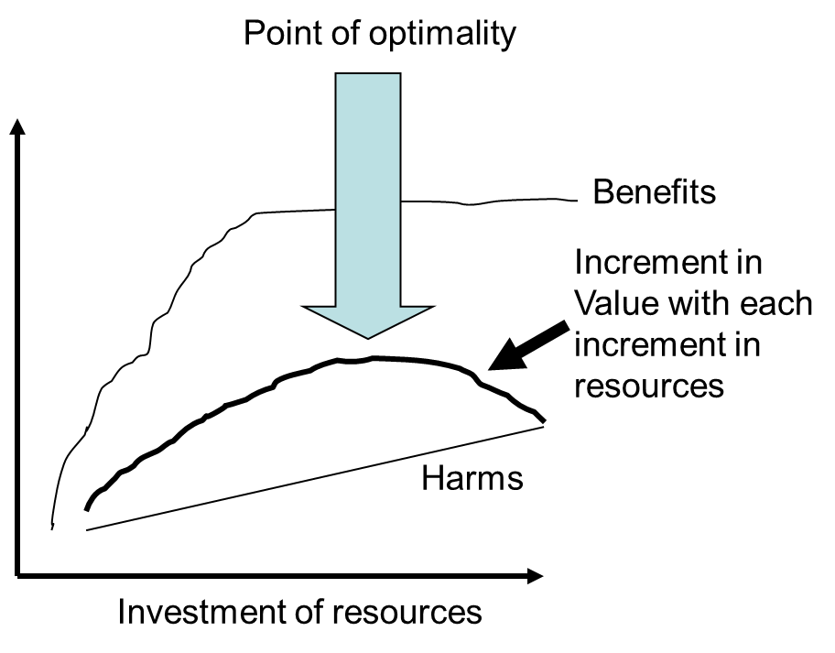
The beginning of the value journey:
Donabedian’s Point of Optimality
Notes:
Benefits taper off, harm-done-to-treat is a straight line. If value is a balance between the two then there is a point of optimality, beyond which value decreases. At some point the lines cross….

Slide 8
So, where is the Point of Optimal Value?
BENEFIT
HARM
Resources
CLINICAL
ECONOMIC
VALUE
Necessary Appropriate Inappropriate Futile
High Low Zero Negative
Notes:
Do we know? We know it isn’t at zero or negative economic value – so eradicating that activity is a starting point – chemo in the last weeks of life, proportion of hip and knee replacements. Need to find out where this activity is happening = variation data. Add to intervention variation, prevention, detection, management, spend and processing of healthcare variation that we also have and you begin to draw a picture of where an organisation, health economy or system is regularly at the wrong end of the variation scale. This is Where to Look for optimal improvement…

Slide 9
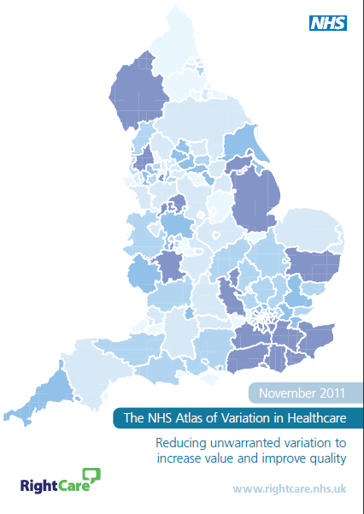
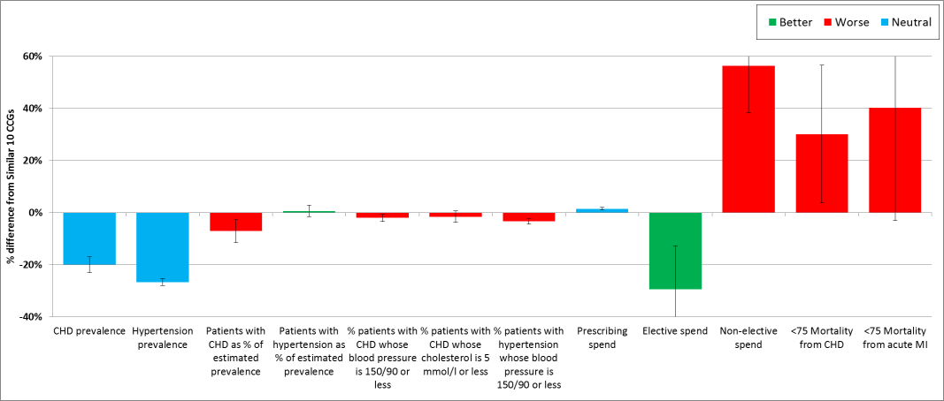
The 1st principle of
Population Healthcare Improvement
Awareness is the first step towards improvement –
If the existence of clinical and financial variation is unknown, the debate about whether it is unwarranted cannot take place
Notes:
Low CHD prevalence
Low elective spend
High Non elective spend
High mortality

Slide 10
We have the opportunity to detect an additional 4,000 patients with AF across NENC
Performance across most CCGs in the STP has decreased for this indicator with the opportunity increasing from year on year.
Notes:
keep

Slide 11
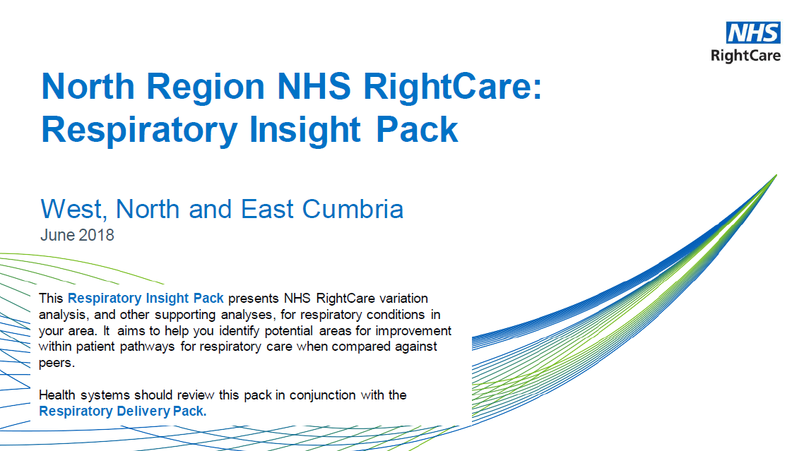
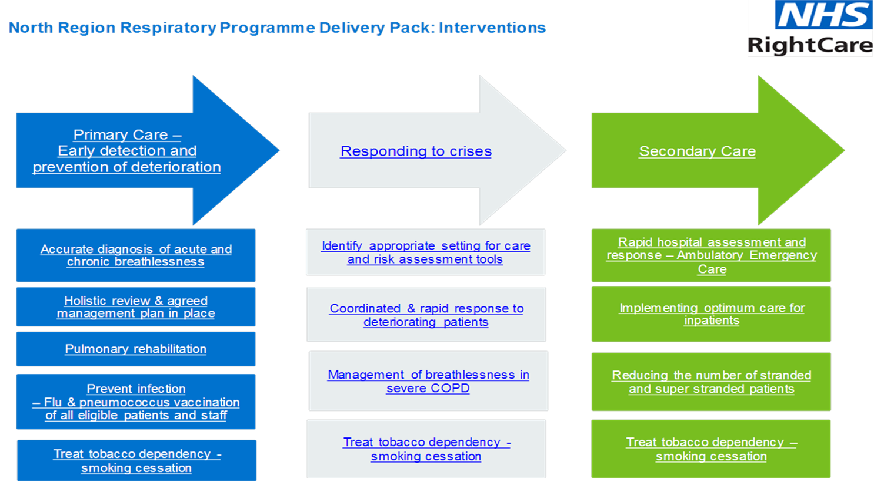
Respiratory

Slide 12
Cumbria and the Northeast CCGs are currently using over 85,000 more bed days for Respiratory than their lowest 5 peers
Notes:
STP automation tool v3.12 Resp (2018-03-02)
H:\Transformation\Pillar 4- Enablers\RightCare\Analysts\5. Local ad hocs\06-2018 - Fiona Ottewell - CNE Respiratory Insight Pack\Data and Charts

Slide 13
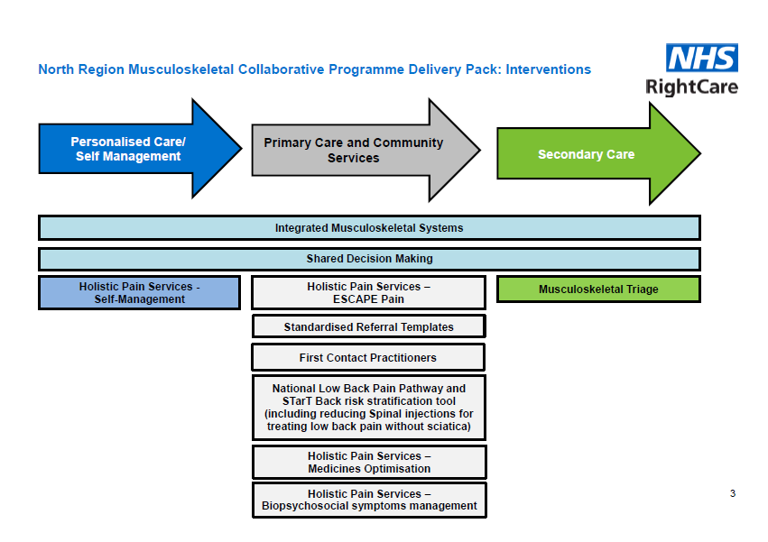
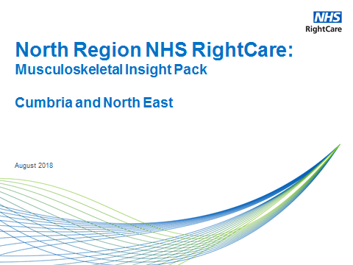
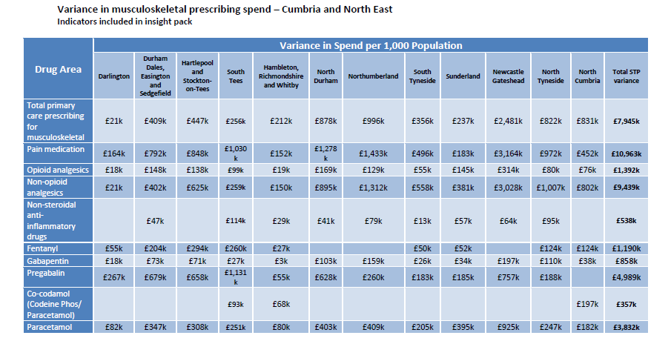
MSK
13

Slide 14
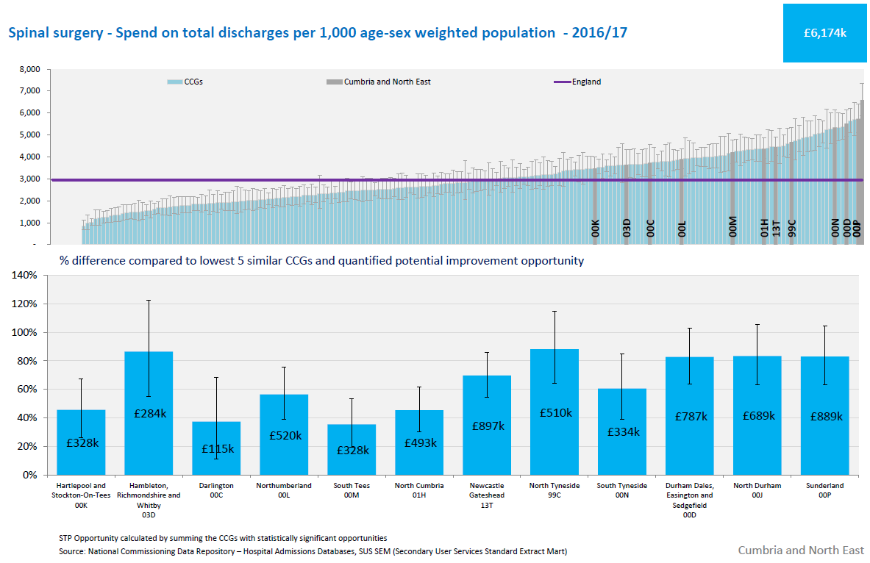
All CCGs have high rates of spend for spinal surgery by comparison to similar CCGs
These procedures are frequently associated with limited clinical value for patients

Slide 15
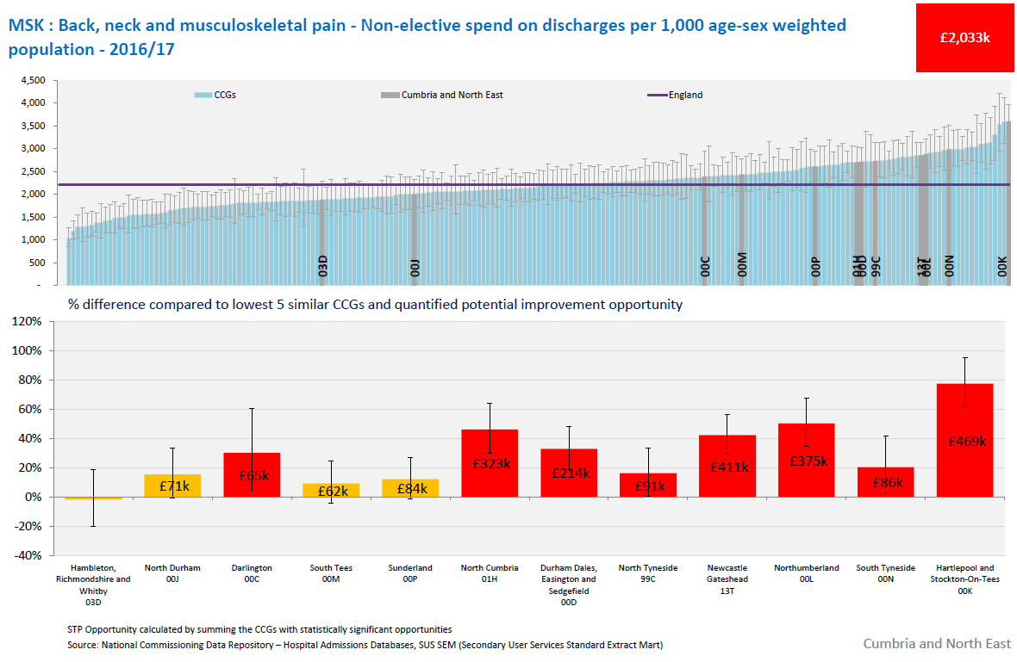
Is there an opportunity to improve self management and primary care treatment of musculoskeletal spinal pain for patients by using the National Back Pain Pathway and First Contact Practitioners?

Slide 16
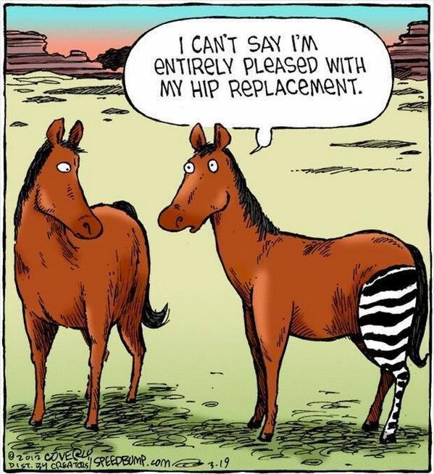
Shared Decision Making is…
…a process in which patients are encouraged to participate in selecting appropriate treatments or management options when they are faced with a preference sensitive decision.

Slide 17
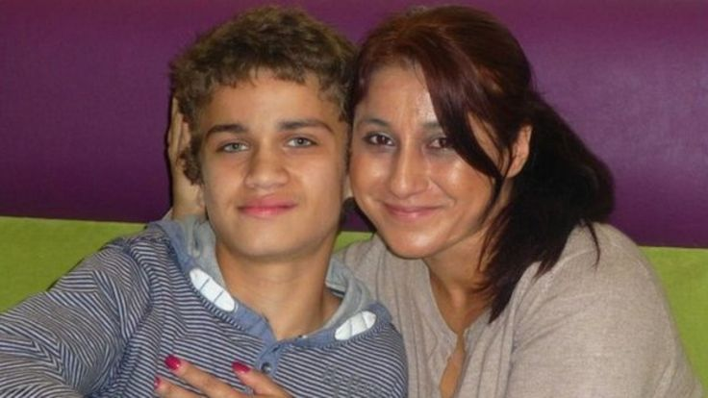
Shared Decision Making is…
The Law.
Montgomery Ruling March 2015 .
Notes:
Nadine Montgomery claimed medics neglected to give her proper advice which may have led to her son Sam having a safer caesarean birth.
Mrs Montgomery gave birth to her son in 1999.
As a result of complications during delivery, Sam was born with severe disabilities.
The case hinged on whether the health board went far enough in advising Mrs Montgomery, who is small and a Type 1 diabetic, of all the potential risks of giving birth to her son.
It is recognised that diabetic mothers can give birth to larger than average babies, putting them at risk of complications from traditional births, including shoulder dystocia, where the baby gets stuck.
In Mrs Montgomery's case, Sam's shoulder became stuck after the delivery of his head.
The staff performed appropriate manoeuvres to release the shoulder, but during the 12-minute delay, he suffered oxygen deprivation.
The need for resuscitation resulted in brain damage, leading to cerebral palsy and damage to the nerves which control shoulder, arm and hand movements.
Mrs Montgomery expressed concerns during pregnancy about her ability to deliver the baby safely.

Slide 18
SDM embedded across the whole pathway
Notes:
Shared Decision Making is embedded within the overall pathways of care, with all patients having a collaborative conversation to explore options and risk, and align these with individual value.

Slide 19
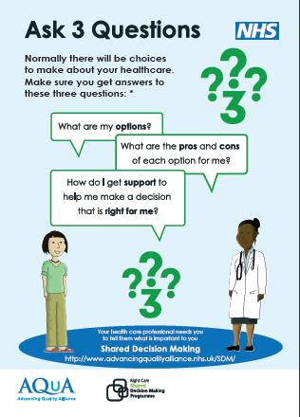
Patient Awareness
Posters, leaflets, banners, postcards, animations images for inclusion on existing correspondence
Activating patients prior to their consultation
Raising awareness

Slide 20
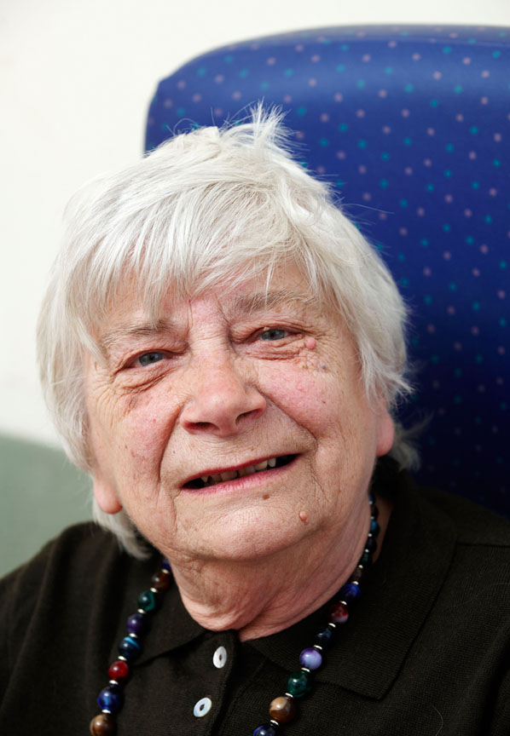
Population healthcare:
The variation between standard and optimal pathways
Janet’s story: Frailty
August 2016

Slide 21
Janet’s story: Journey 1
Janet is 84 - a retired teacher living with her 85 year-old husband Arthur
On a Friday evening, Janet falls. Arthur calls 999. Janet is taken to A&E
She is given a hip x-ray. There is no fracture but blood and urine tests show UTI and dehydration, so she is admitted to an acute medical ward
The next day (Saturday) she is moved to a general medical ward
After the weekend, Janet is assessed as having postural hypotension
In 2014/15 there were 2,154 serious falls (per 100k population) in the average CCG
Due to a lack of available beds in the community, Janet is moved to a winter escalation ward in the hospital. She falls again in the ward. As a result she is no longer fit for rehabilitation and requires a care package
This is put in place almost three weeks after admittance and she is finally discharged.
10 days in a hospital bed leads to the equivalent of 10 years of ageing in the muscles for people over 80
Seven months later, Janet falls again and, after discharge from hospital, goes into a care home. After rapid deterioration and another fall, she returns to acute care and after 10 days on the intensive care ward, she passes away aged 85.
This version of Janet’s journey costs £35k at 2015/16 prices

Slide 22
Janet’s story: Journey 1
Janet is 84 - a retired teacher living with her 85 year-old husband Arthur
On a Friday evening, Janet falls. Arthur calls 999. Janet is taken to A&E
She is given a hip x-ray. There is no fracture but blood and urine tests show UTI and dehydration, so she is admitted to an acute medical ward
The next day (Saturday) she is moved to a general medical ward
After the weekend, Janet is assessed as having postural hypotension
In 2014/15 there were 2,154 serious falls (per 100k population) in the average CCG
Due to a lack of available beds in the community, Janet is moved to a winter escalation ward in the hospital. She falls again in the ward. As a result she is no longer fit for rehabilitation and requires a care package
This is put in place almost three weeks after admittance and she is finally discharged.
10 days in a hospital bed leads to the equivalent of 10 years of ageing in the muscles for people over 80
Seven months later, Janet falls again and, after discharge from hospital, goes into a care home. After rapid deterioration and another fall, she returns to acute care and after 10 days on the intensive care ward, she passes away aged 85.
This version of Janet’s journey costs £35k at 2015/16 prices

Slide 23
Janet’s story: Journey 2
Janet’s journey begins four years earlier when, aged 80, she and Arthur are visited by the Fire Service. As well as helping with fire prevention, they conduct a gait speed test on Janet and Arthur and deem Janet to show early signs of frailty. They provide her with the Practical Guide to Healthy Ageing and put her in contact with a local charity that runs exercise classes for the over 80s which Janet enjoys.
Five years on she remains well and engaged in the local community but is beginning to feel frail. She visits her GP who diagnoses moderate frailty and refers the system-wide multi-disciplinary team to her. The team assess her needs, make her home ‘frailty-friendly’, optimise her medication and engage her in the local Memory Service. This culminates in a jointly agreed personalised frailty and dementia care plan.
Two years later, aged 87, Janet falls. The out of hours GP visits, armed with her care plan and aware of her personal preferences. Via discussion with Janet, Arthur and – by phone – the on-call case management team leader, they agree how to manage the situation, without recourse to A&E or a hospital bed. Instead the new Community Geriatric Rapid Access Clinic is used.
A year later, Janet falls again and this time does have a hospital stay but returns home quickly, with a support package. 11 months on, aged 89, Janet passes away.
Journey 1 cost £35k
Journey 2 cares for Janet much better and costs only £19k

Slide 24
CCG work summary
 | Cancer | CHC | Complex | CVD | Diabetes | Fragility | Gastro | GU | MedOps | MSK | Resp | Paeds
DDES
NDurham
Darlington
HAST
Stees
HRW
NewGates
Sunderland
S Tyneside
N Tyneside
North’land
N Cumbria

Slide 25
Opportunities for the Physiotherapy workforce
Back Pain
Direct Access Physio
MSK pathways
GP Practice Contact practitioners
Long term conditions management
  Pulmonary Rehab
  Cardiac Rehab
  Frailty programmes
Notes:
Discuss FCPP- first contact Physiotherapy practitioner

Slide 26
Conclusion
Do you understand the RightCare approach
What are your reflections on Value ?
How can we improve on shared decision making
How will you use data from your health economy to redesign your service
How you can contribute to a sustainable future in health care

Slide 27
Fiona Ottewell
Delivery Partner
NHS RightCare
fiona.ottewell@nhs.net

